Slide 1
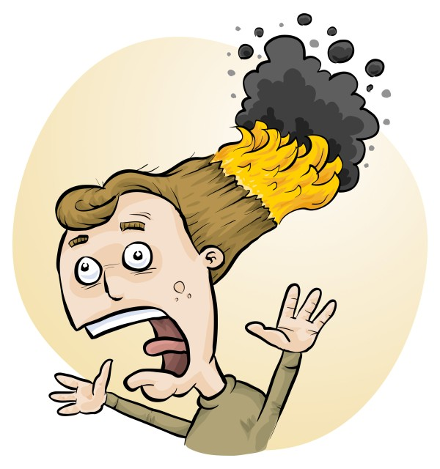
Quick and Easy
Risk Assessments
James, Phillip & Eva Crisp

Slide 2


Slide 3
• reduce injuries
• increase legal protection
Why do risk assessments?

Slide 4
Work Health & Safety Act 2020
. . . a duty . . . to eliminate/minimise risks to health and safety as far as is reasonably practicable.
. . . taking into account and weighing up
all relevant matters including:
(a) the likelihood of the hazard or the risk concerned occurring; and
(b) the degree of harm that might result from the hazard or the risk
. . . .
Part 2, Sections 17 and 18

Slide 5
all relevant matters includes
facilities available
behaviour of the class
students with special needs
students with allergies
• . . . . . . . .
(NOT book “risk assessment”, tick sheet, etc)
likelihood
degree of harm consideration requires
proper risk assessment using a risk matrix
e.g. Aust/ISO Standard on Risk Management

Slide 6
You should:
identify
assess
control
risks
Before: Establish the context
After: Monitor and review
Always: Consult and communicate

Slide 7
Risk identification
• history of “accidents” and “near-accidents”
- at school
- at similar schools
• brainstorming, preferably with colleagues
• checklists of possible risks
• authoritative sources e.g. SDSs, databases
• consider facilities, e.g. fume cupboard
• consider student behaviour, allergies, special needs
• . . . . . . . . . .

Slide 8
Risk assessment
To assess the severity of a risk,
you need to consider:
• the consequences of the event, and
• the chance that it will occur (likelihood)
ISO 31000:2018 “Risk management”
Risk matrices used in schools are 3 x 3 to 5 x 5
See www.riskassess.com.au/info/learning_resources

Slide 9
Risk control
Hierarchy of options:
elimination
substitution
isolation
engineering
administration
personal protective equipment

Slide 10
Assess risks
≥Medium
risk level
Low
risk level
Add control measures
DO
EXPERIMENT
Inherent level of risk
= risk level without any control measures besides “routine procedures”
Residual level of risk
= risk level with control measures in place

Slide 11
What is RiskAssess?
• web-based risk assessment tool
• customised to the school situation
• provides
- electronic templates (AU/ISO)
- databases of information on risks
• easy sharing of risk assessments
• plus ordering, scheduling & labelling

Slide 12
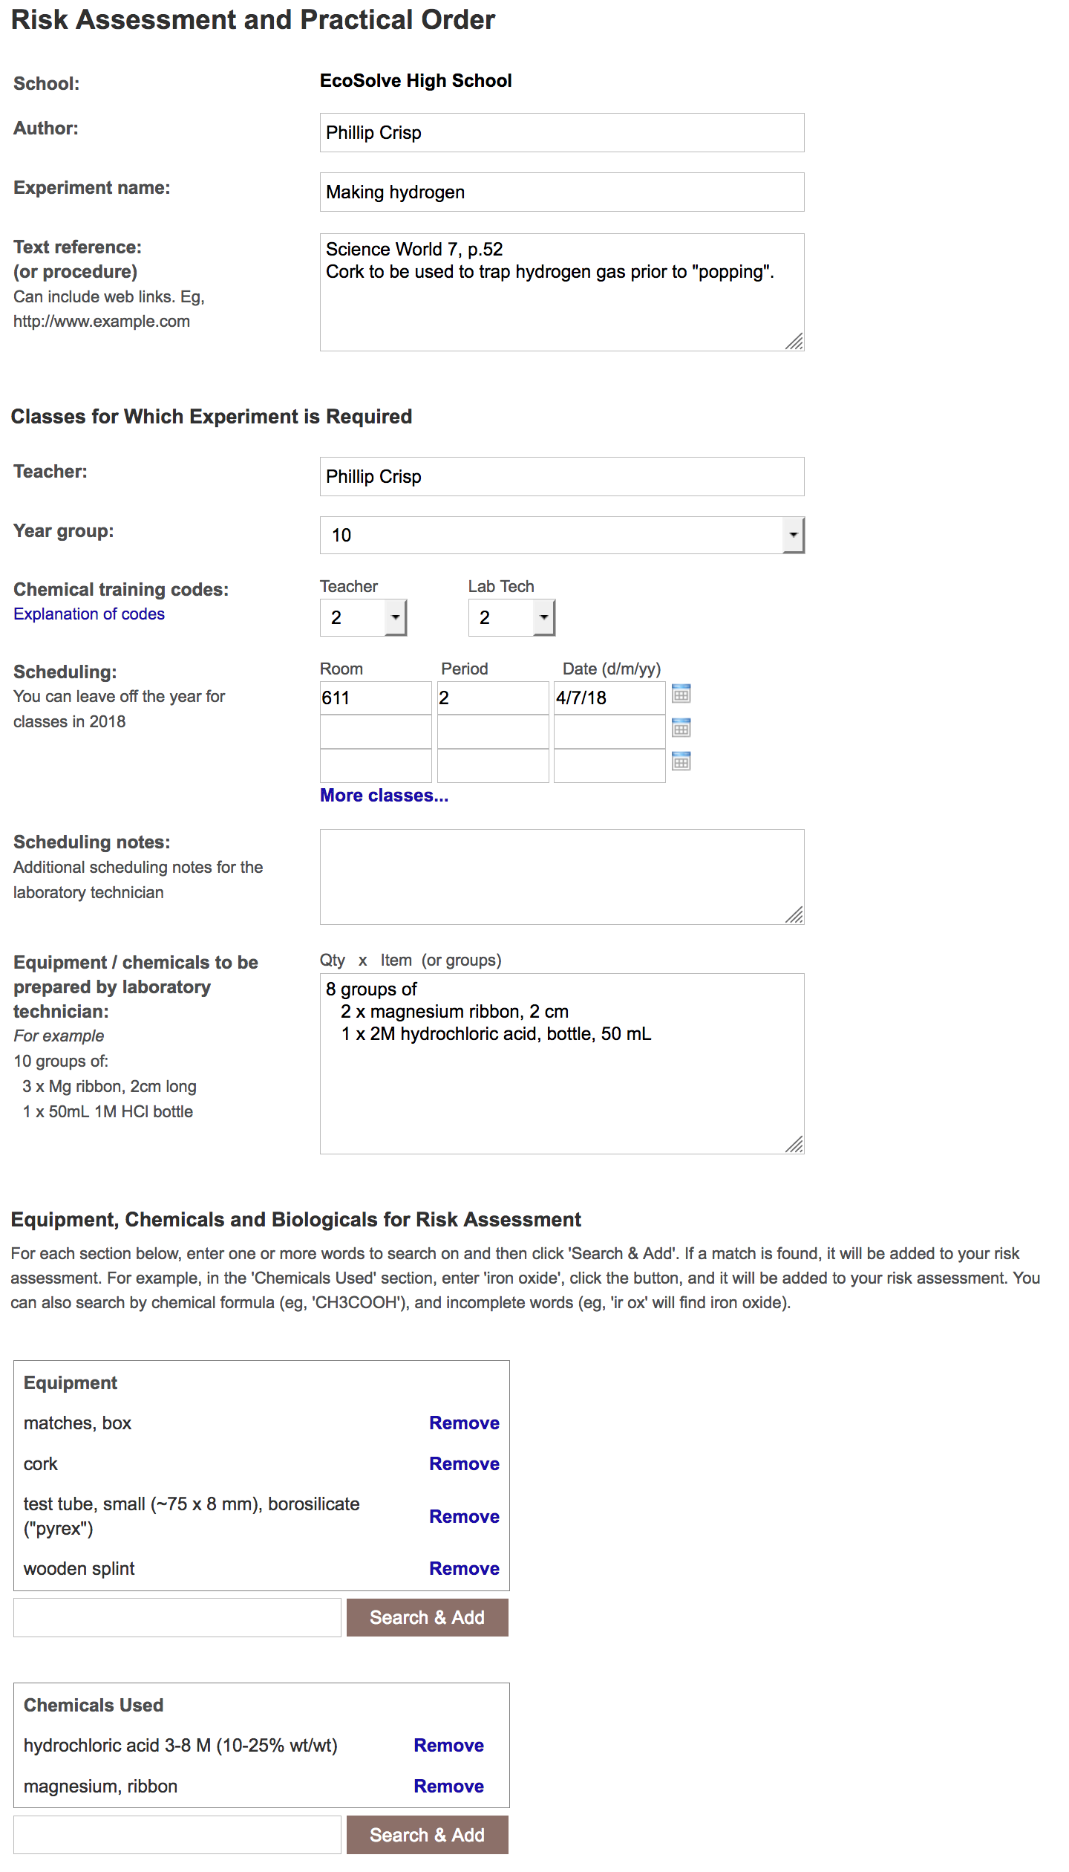
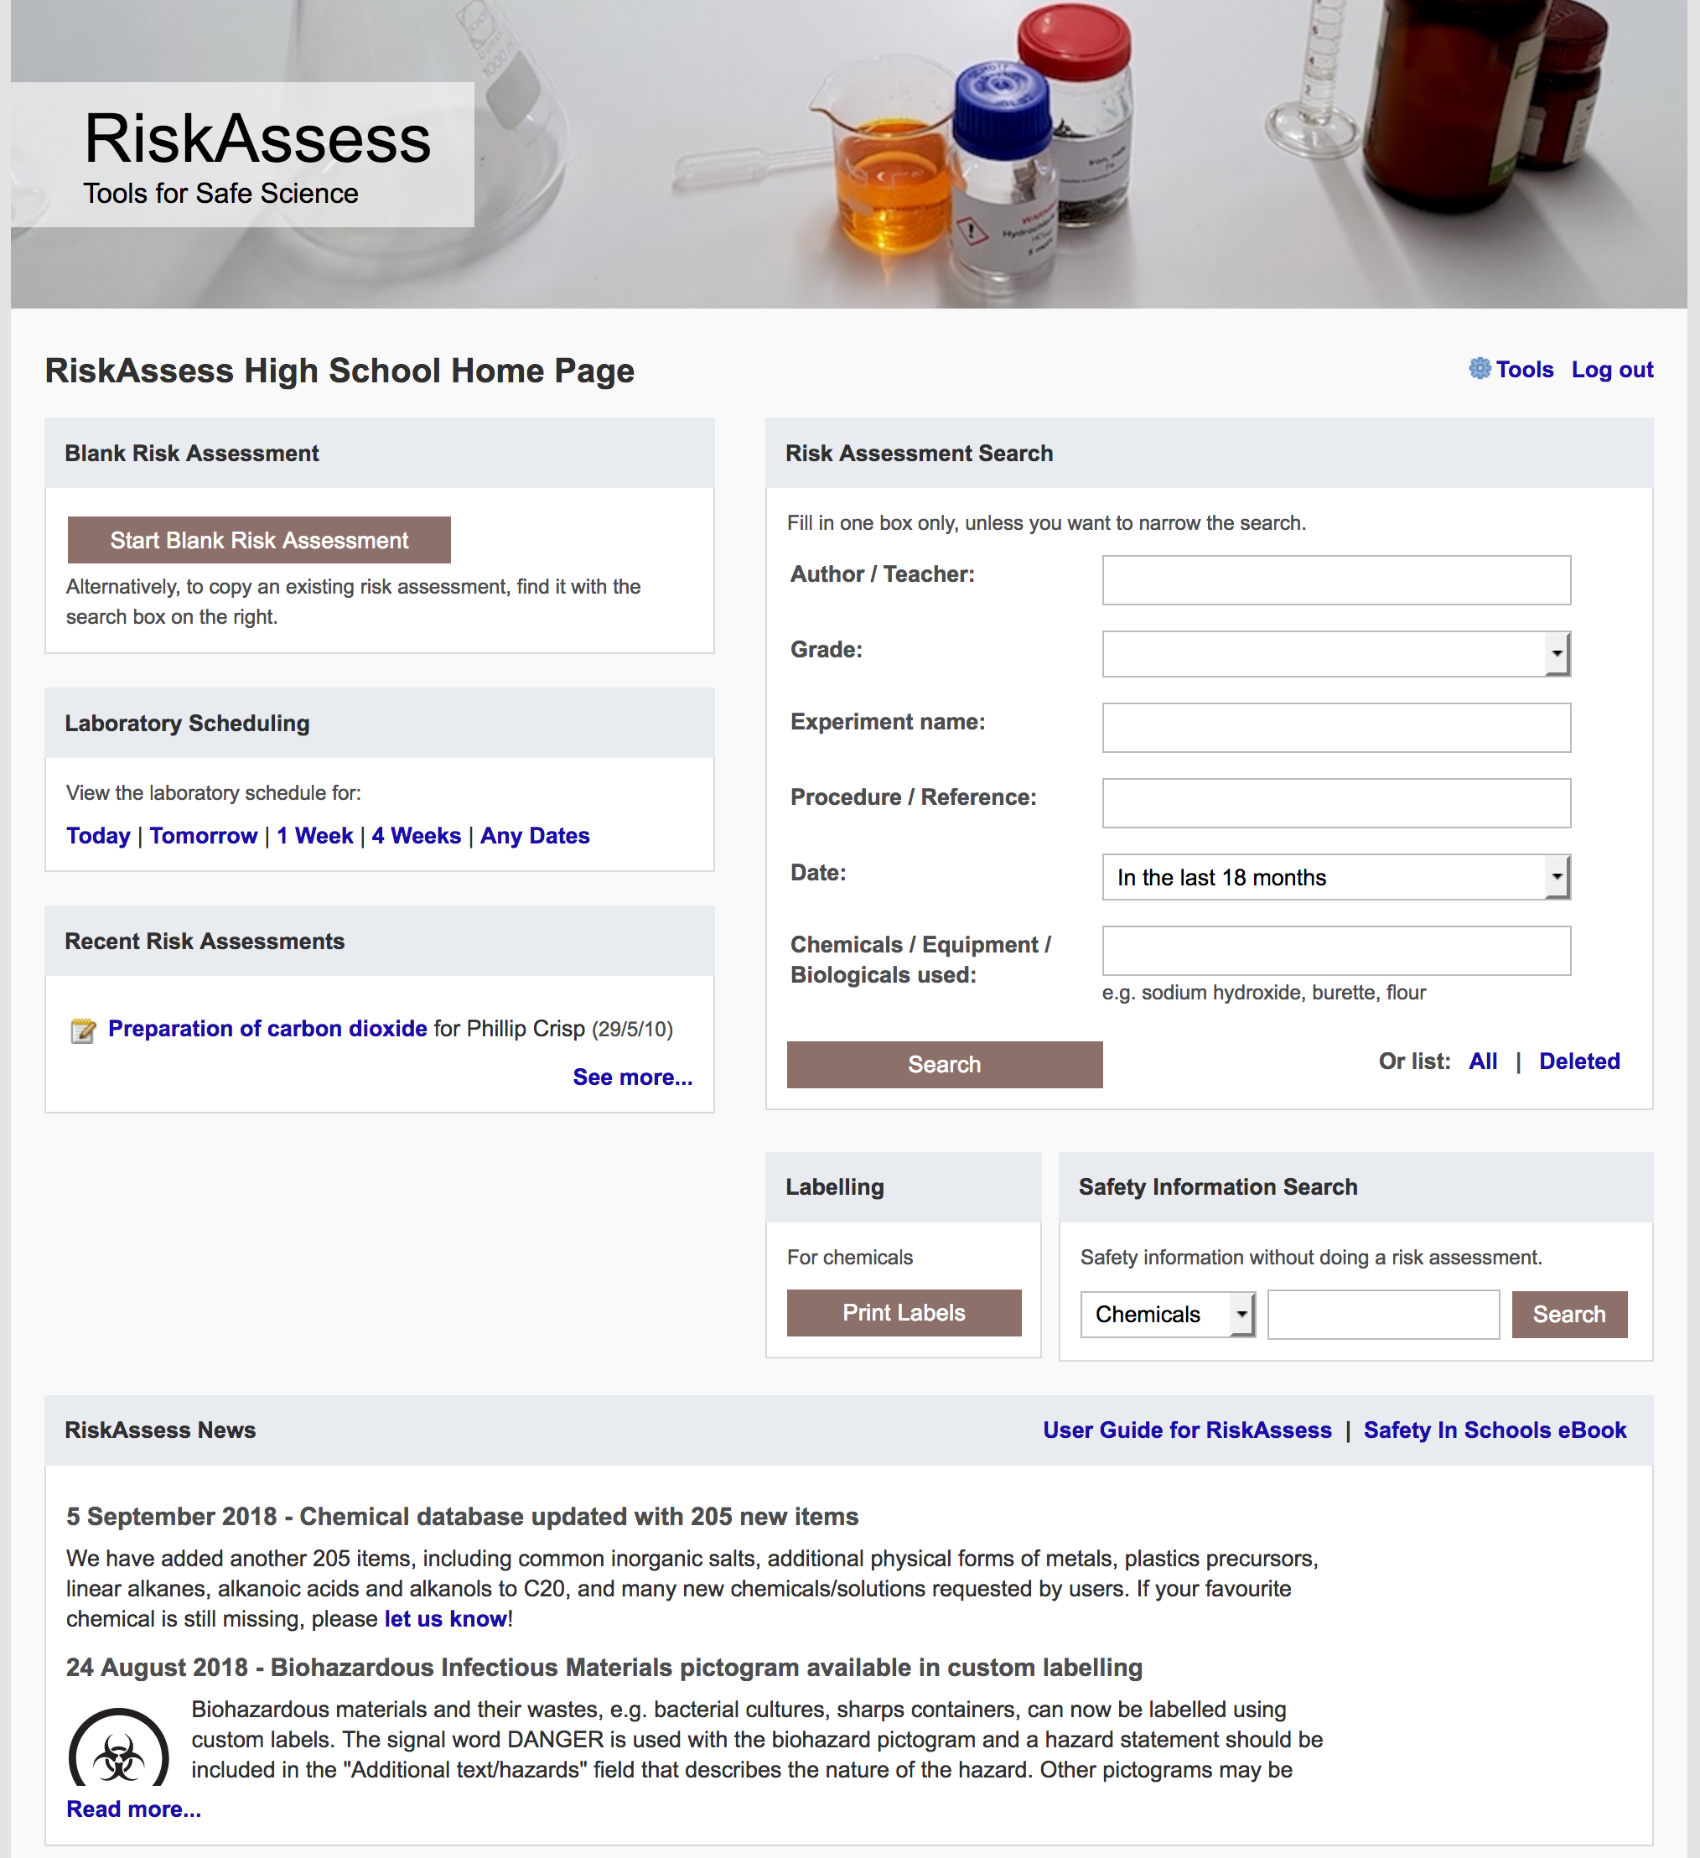

Slide 13
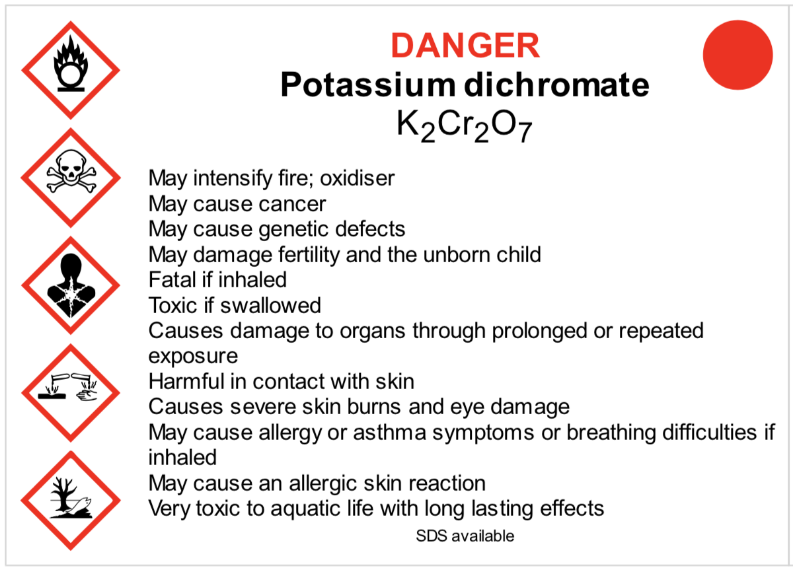
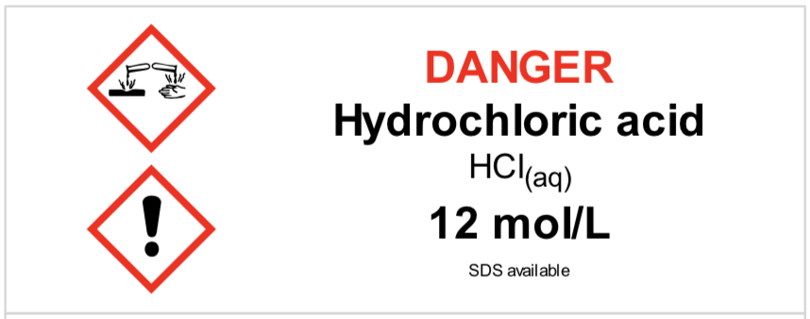
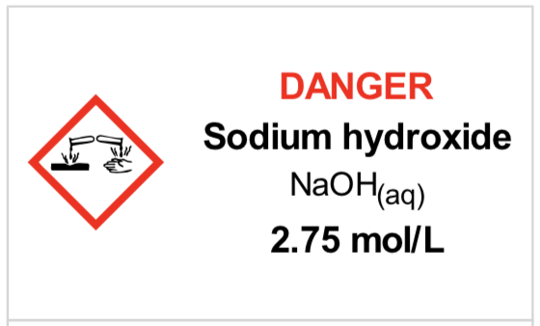
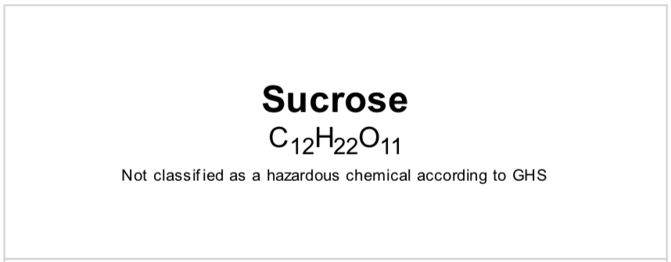
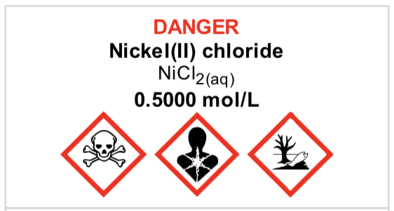
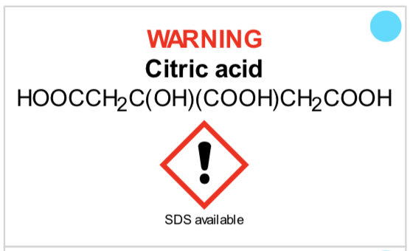
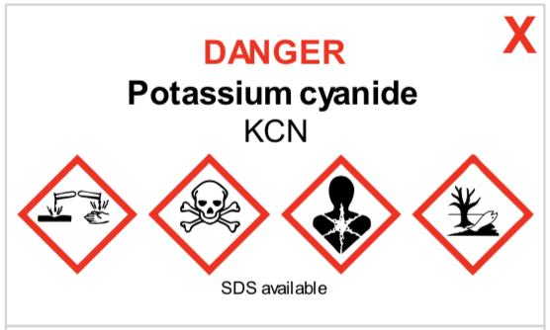
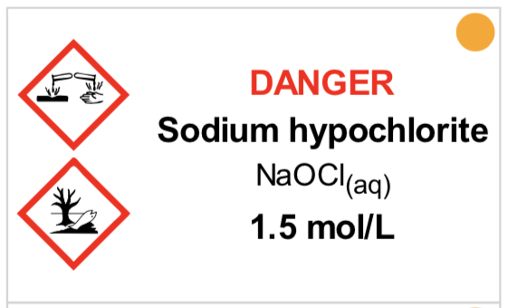
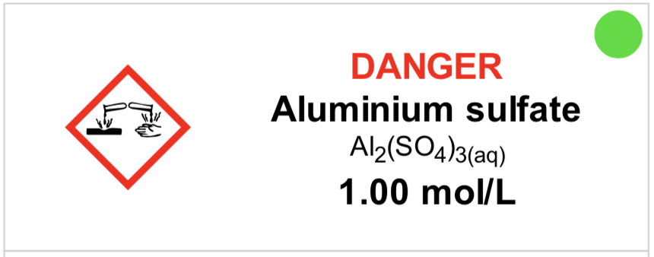
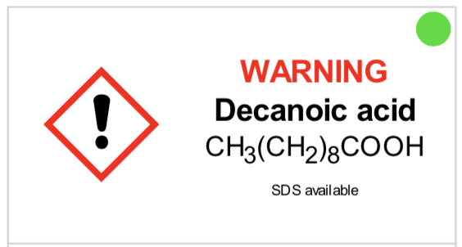
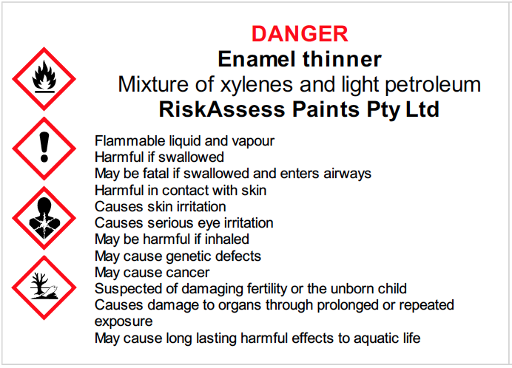
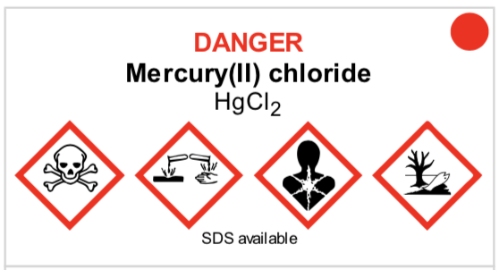
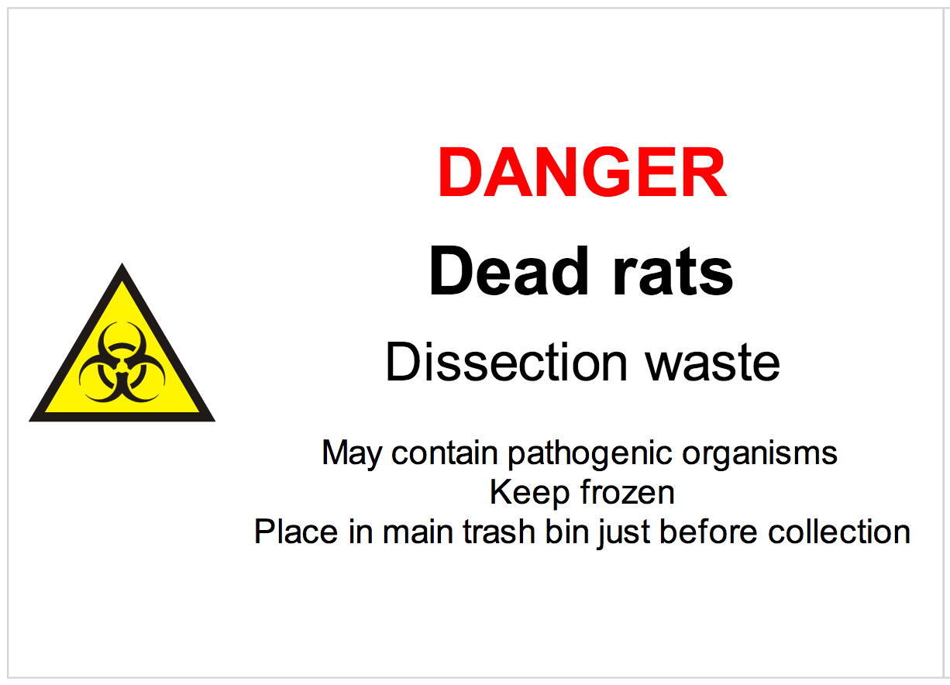
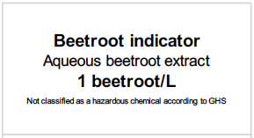
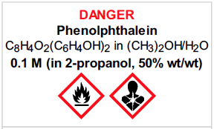

Slide 14
Logic
• separate sections for teacher and science technician
• initial assessment of inherent risk
- if low, go to end
- if medium or more, record control measures
- if high or extreme, third reviewer required
• cross-checking by teacher/scitech/reviewer
• scheduling, ordering, labelling to save time
• inexpensive ($350+GST per campus per year)

Slide 15
Electronic system
• relatively rapid
• prompts sensitive to context
• reduces paper consumption
• easy to review and update
• search and statistics
• long term storage
• demonstrated to work in schools
RiskAssess: 2,700 schools AU+NZ+CA
87% AU, 26% WA
9,000,000 risk assessments

Slide 16
Details
• access from school/home
• nothing to install on computer, tablet or phone
(instant update)
• unlimited number of simultaneous users and risk assessments
• minimal data entry
• complements SDSs
• continuing input from science staff
• multiple backups of data & backup server
• support and advice

Slide 17
DEMO

Slide 18
Advantages of RiskAssess
proper consideration of risks and control measures
standardisation
storage of records for legal purposes
communication between teachers and lab technicians
saves time due to scheduling, labelling, info
saves money with disposal information
discourages spur-of-the-moment experiments
useful for new/inexperienced staff

Slide 19
Even more!
• scheduling system
• prac ordering
• GHS labelling
- standard
- custom
• disposal advice
And an exciting video . . .
“Getting Started with RiskAssess”
starring Phillip and Eva!

Slide 20
Outcomes
• reduced frequency of injuries
- to students
- to school staff
• reduced costs for paperwork, litigation and payouts
• compliance with the law
• easy ordering, scheduling and labelling
• helps maintain variety of chemicals and equipment

Slide 21
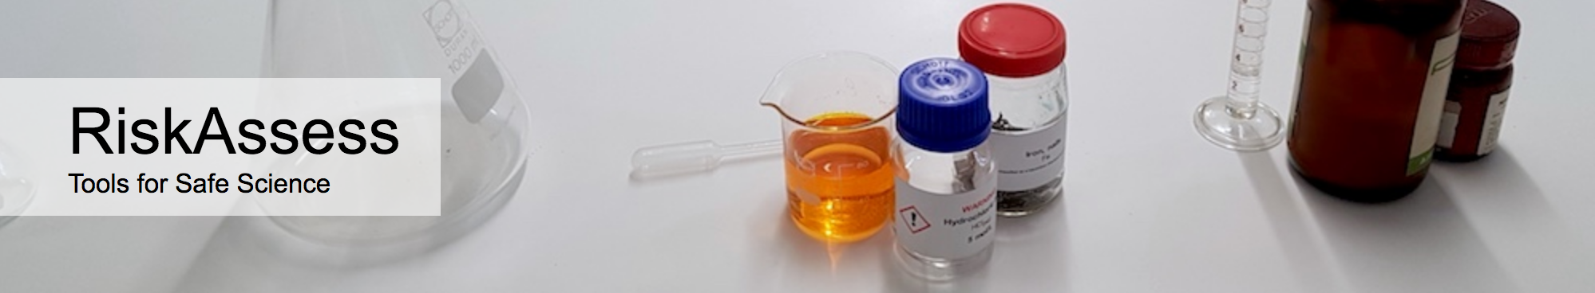

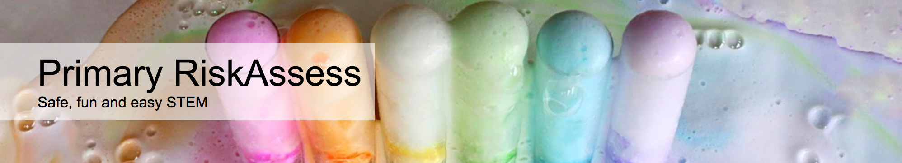

2700 schools
WA: 90 (26%)
600 schools
WA: 2
200 schools
WA: 0
100 schools
WA: 4

Slide 22
Questions?

