Slide 1

RiskAssess
Tips & Best Practices
New Chemical Inventory & Register!
James Crisp
Notes:
People intros; 2 parts of talk; who using RA, anyone not used RA before?

Slide 2
New features and Tips

Slide 3
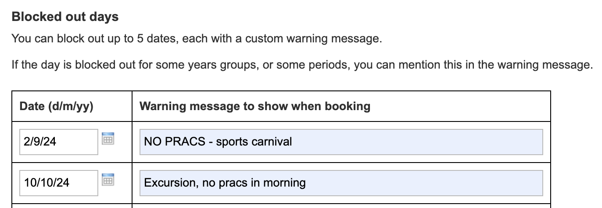
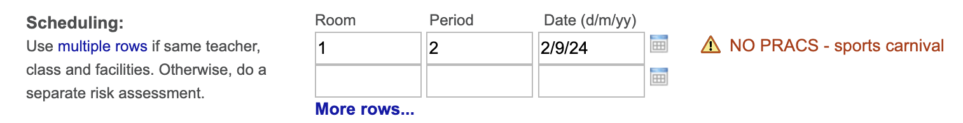
Now up to 10 dates!

Slide 4
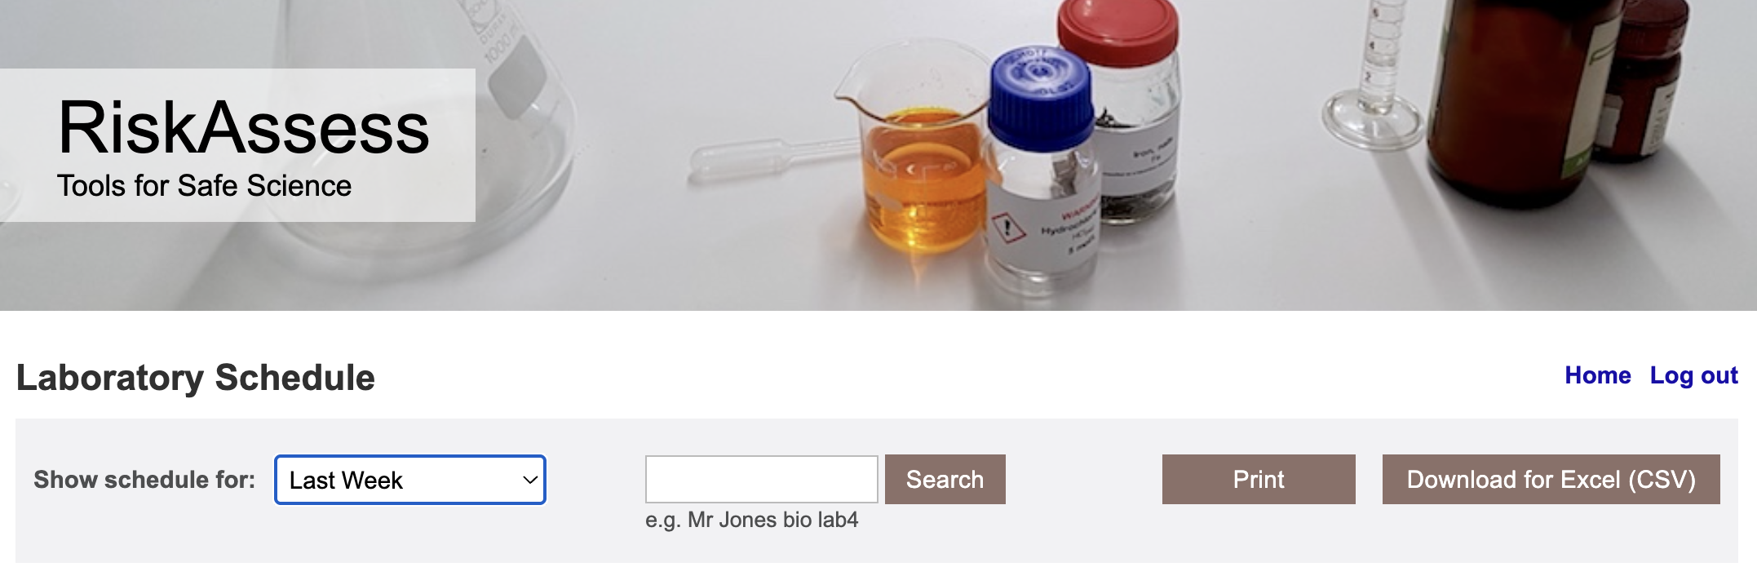
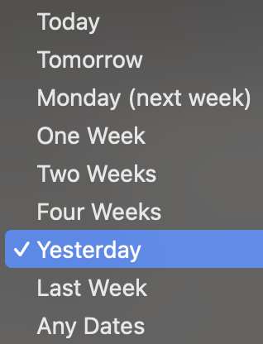

Slide 5
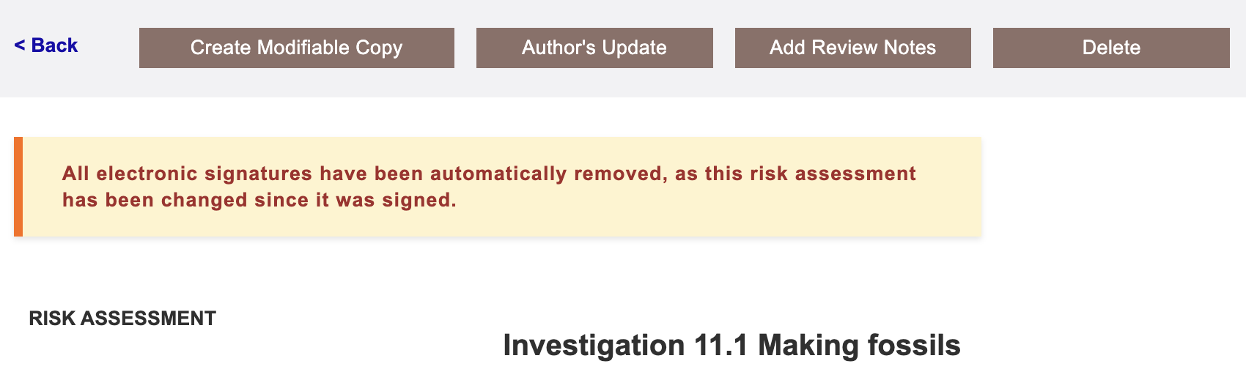
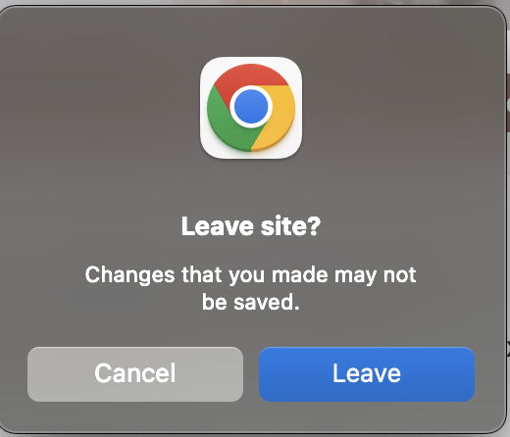
Catching forgotten signatures!

Slide 6
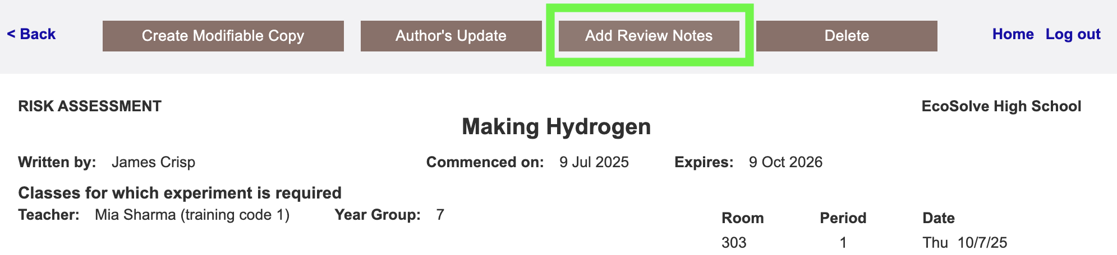
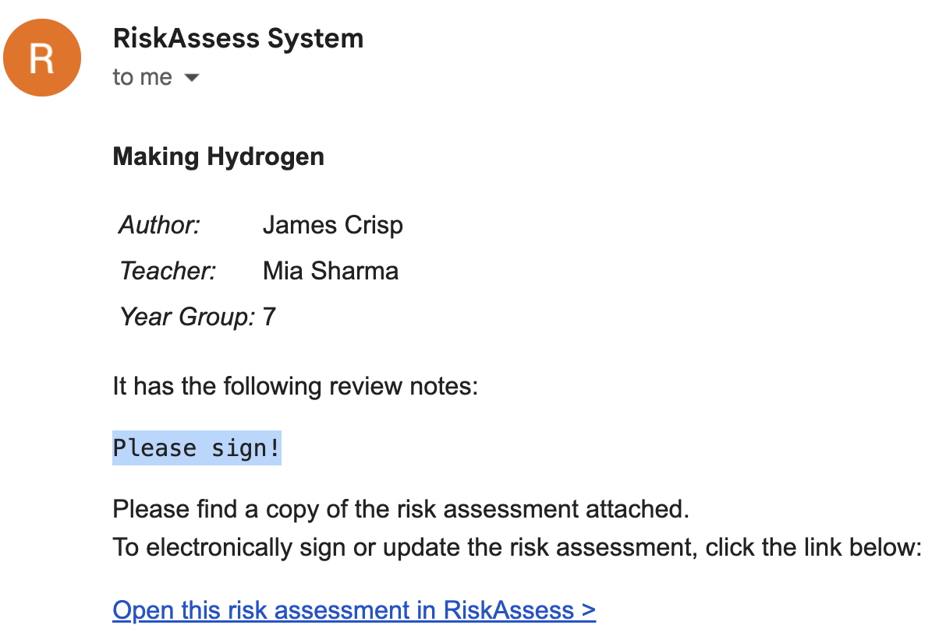

Slide 7
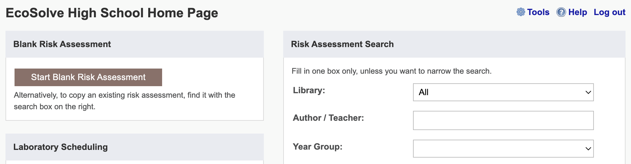
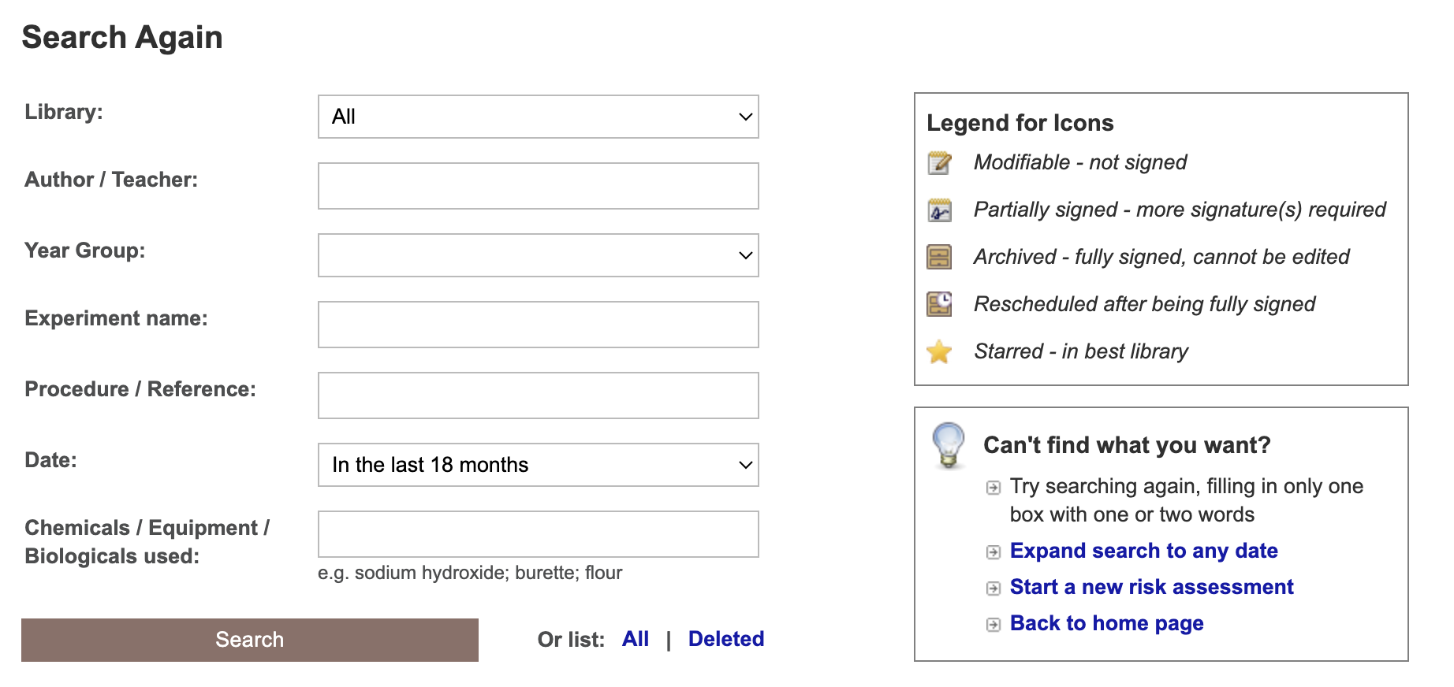
Notes:
Learning resources, videos & faq. And Phillip’s book!

Slide 8
Tools demo including stocktaking & year groups

Slide 9
Share Superuser
Create a library of risk assessments to share between schools

Slide 10
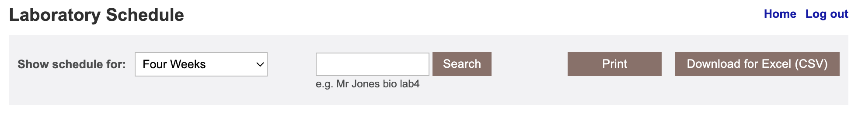
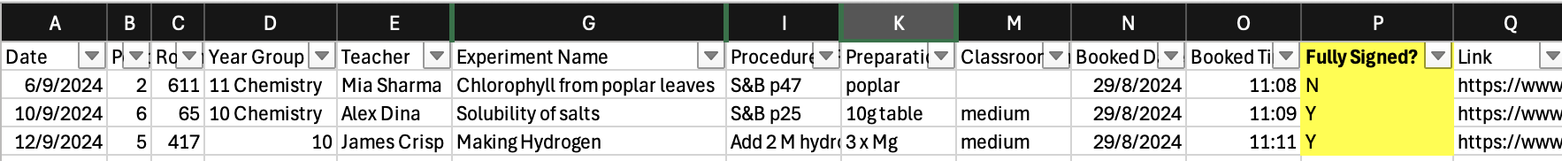
Notes:
Fully signed, but lots of other things like stats, high risk etc

Slide 11
Safety Databases
>830
new and updated items!
New significant changes page:
https://www.riskassess.co.nz/info/changes_in_chemical_hazards

Slide 12
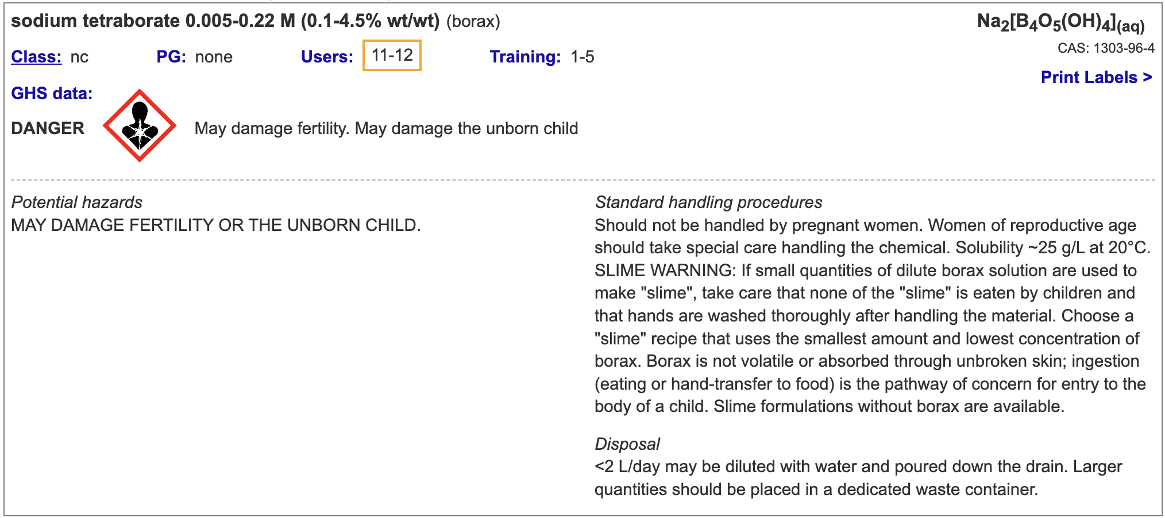
Borax (and "slime") hazards information upgraded
Notes:
Low concentrations of borax are now considered to be more hazardous than previously thought. Solutions down to 0.1% wt/wt now have hazard statements "May damage fertility. May damage the unborn child." Take care that no "slime" is eaten by children and that hands are washed thoroughly after handling the material. Borax is not volatile or absorbed through unbroken skin; ingestion (eating or hand-transfer to food) is the pathway of concern. Slime formulations without borax are available.

Slide 13
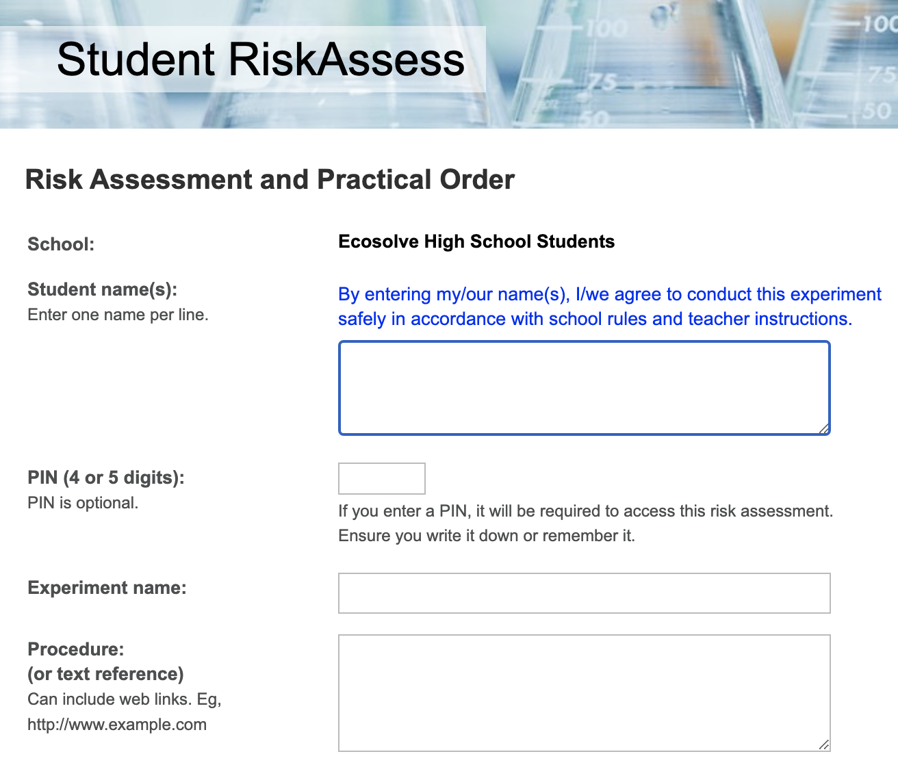
Notes:
For students … SRA for students to use hands-on. Particularly popular for schools that do student designed experiments and depth studies. Helps students learn lifelong skill of risk assessment and also to think more for themselves. Has pin numbers to protect student work and tools for the teachers and techs to review, provide feedback and sign off.

Slide 14
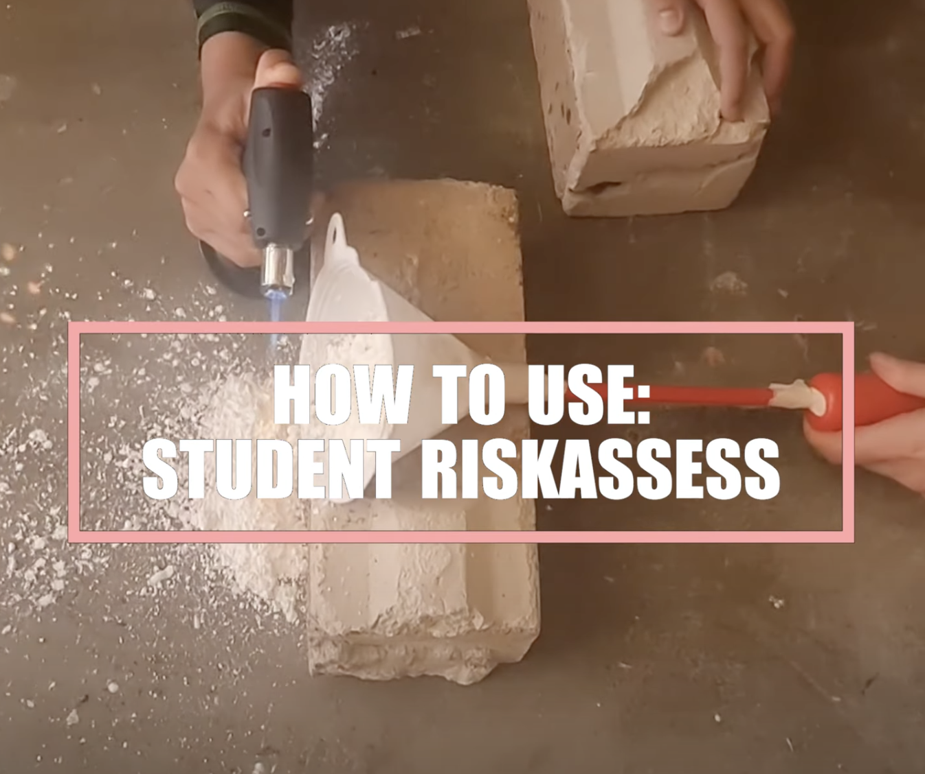

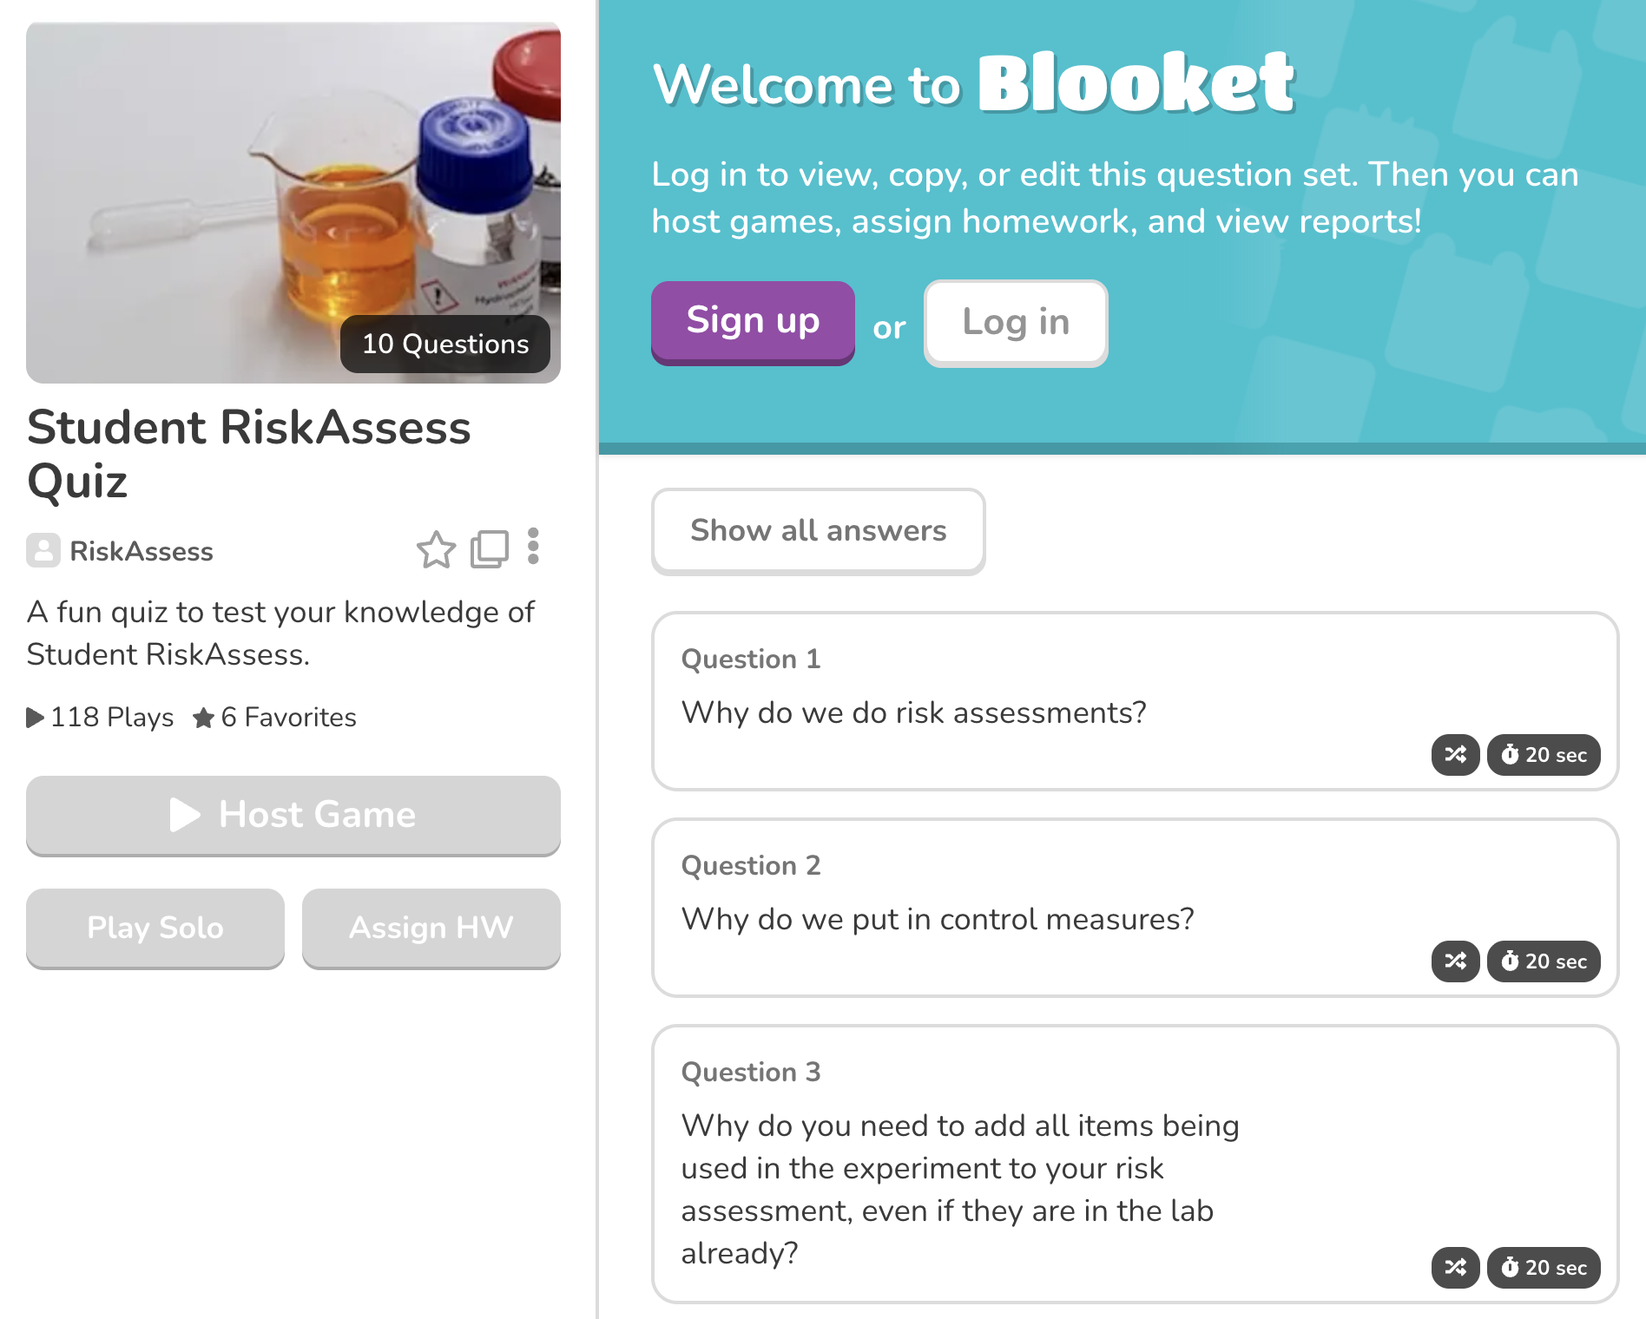
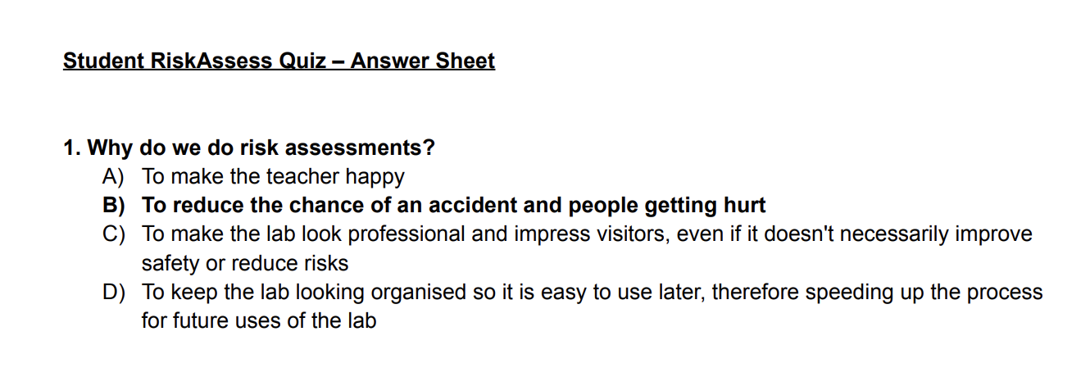
Notes:
New resources, classroom video, blooket & quiz for students

Slide 15
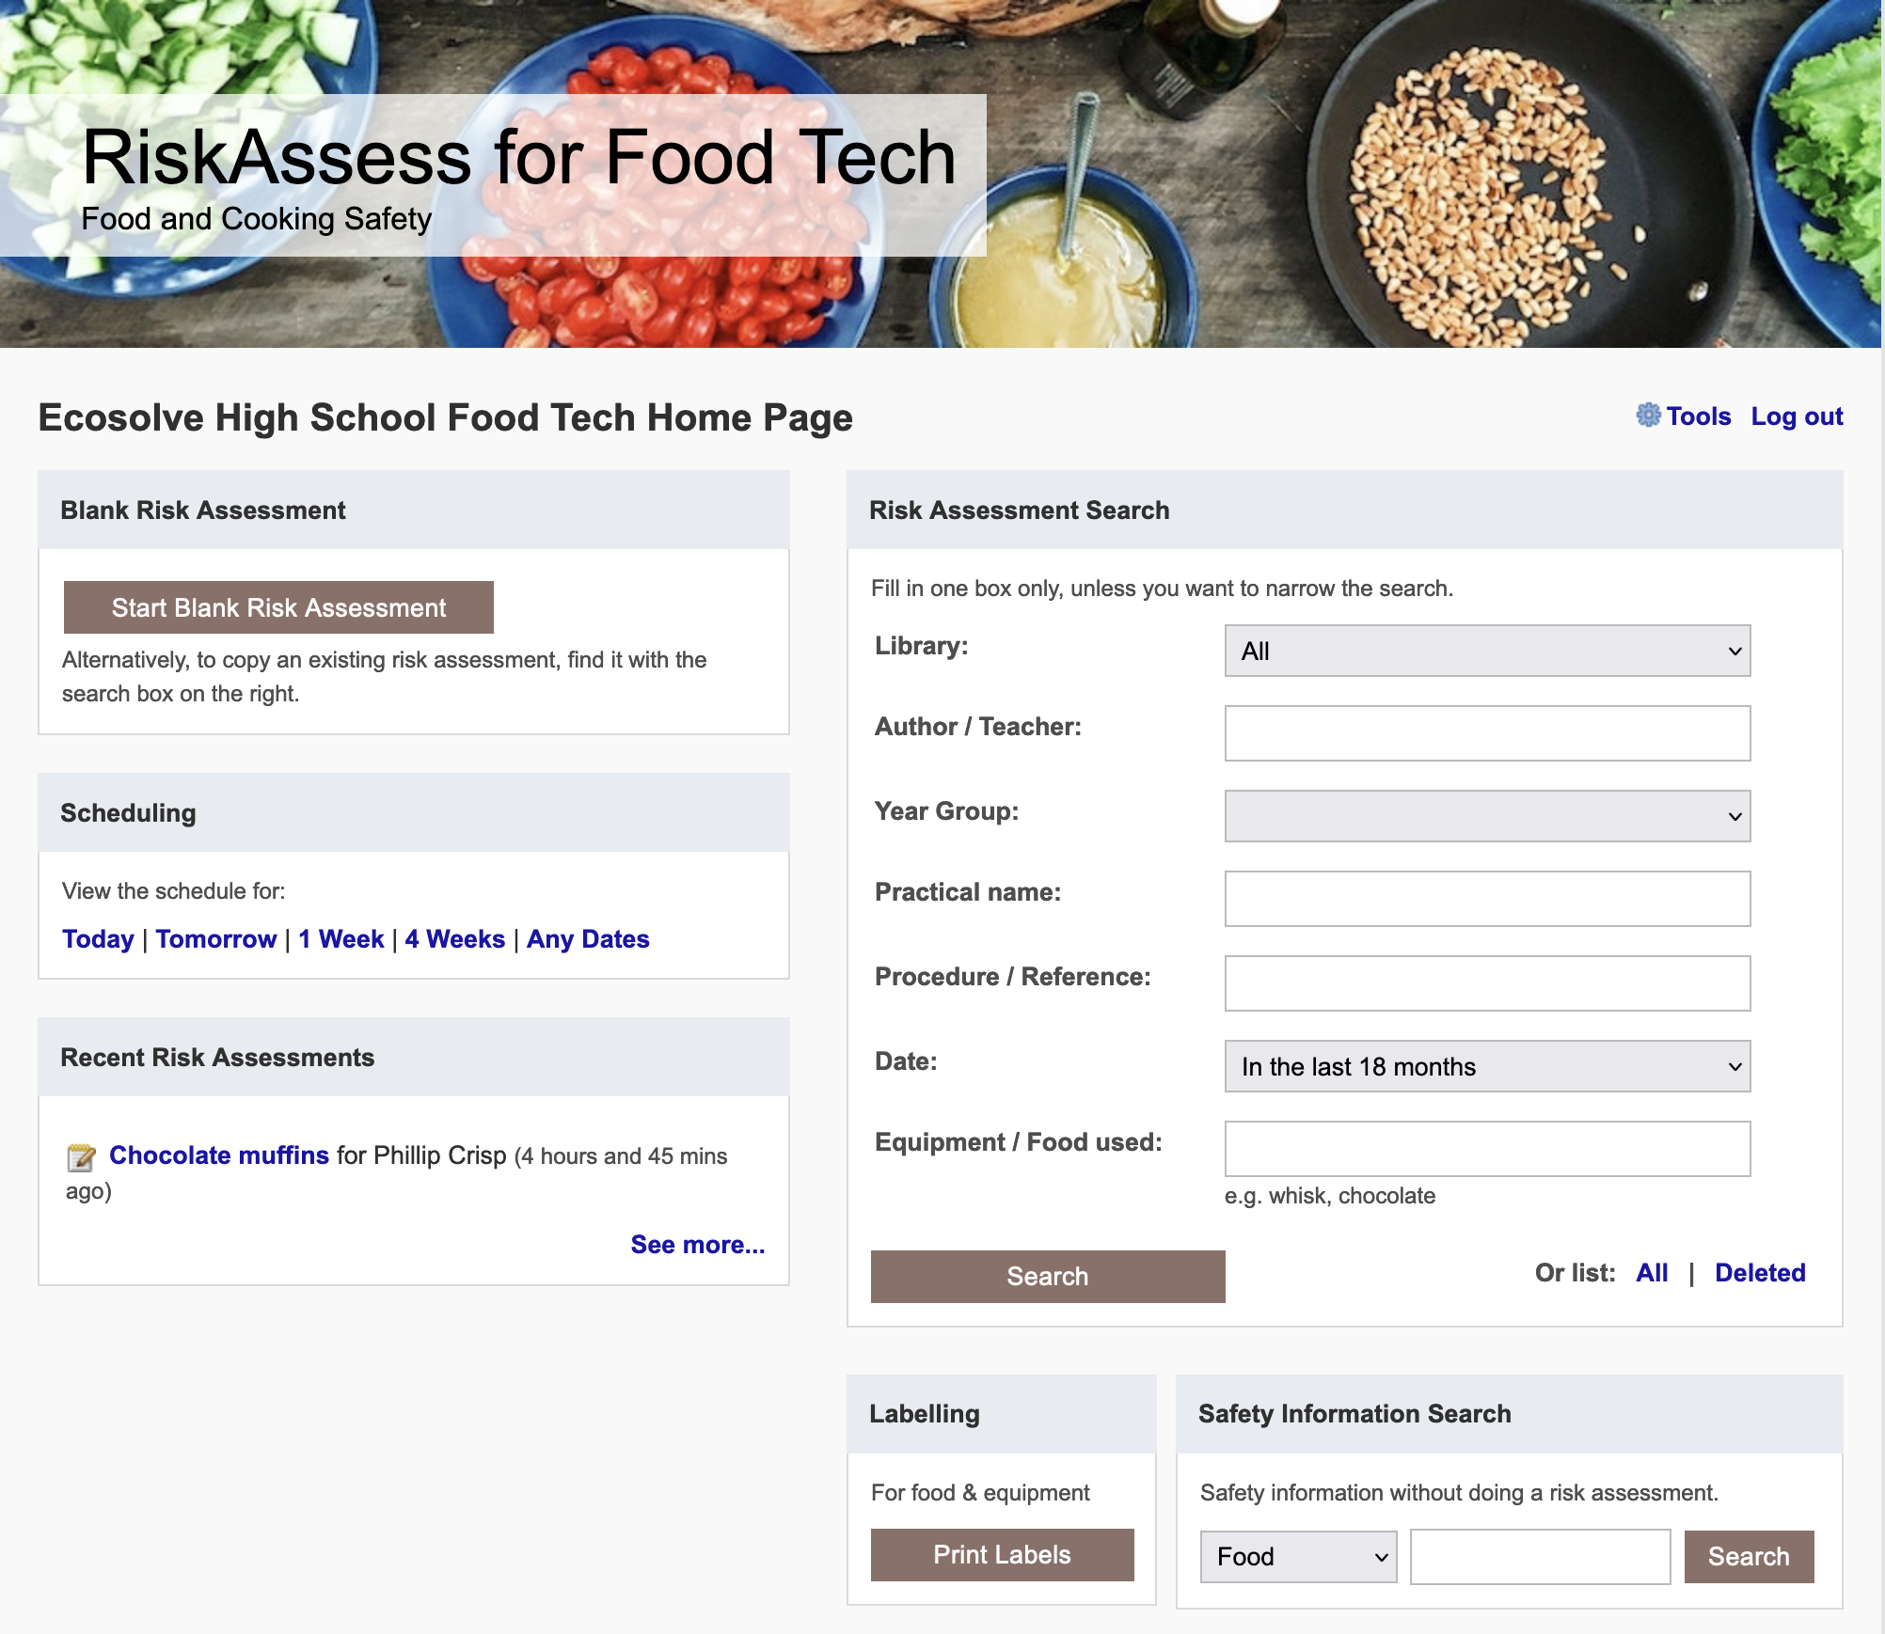
Notes:
For cooking/food pracs

Slide 16
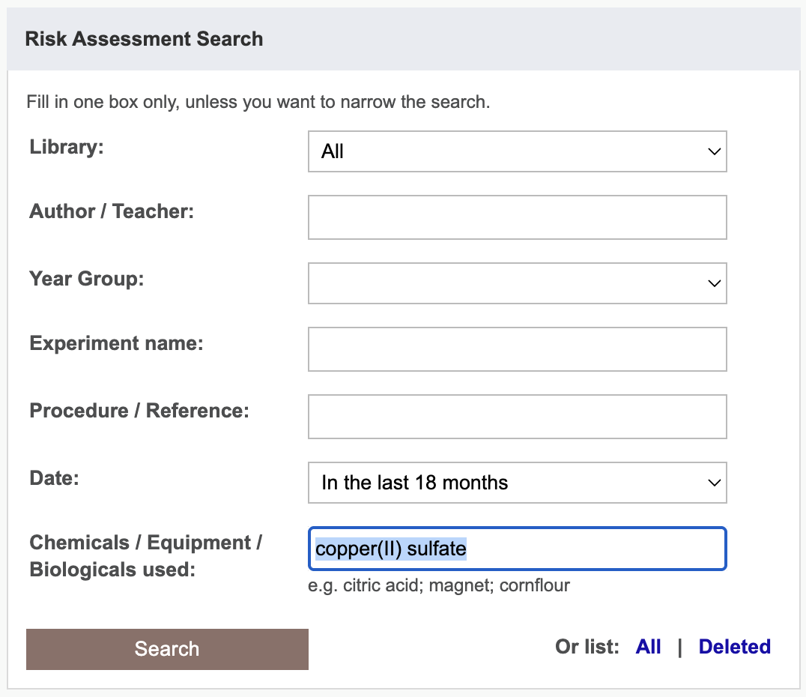
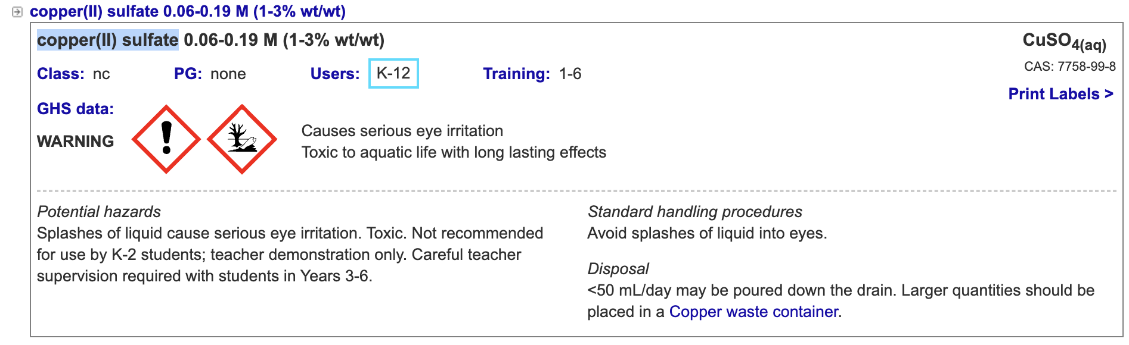
Notes:
If can’t find in chemical used.. will be improved in future updates!

Slide 17
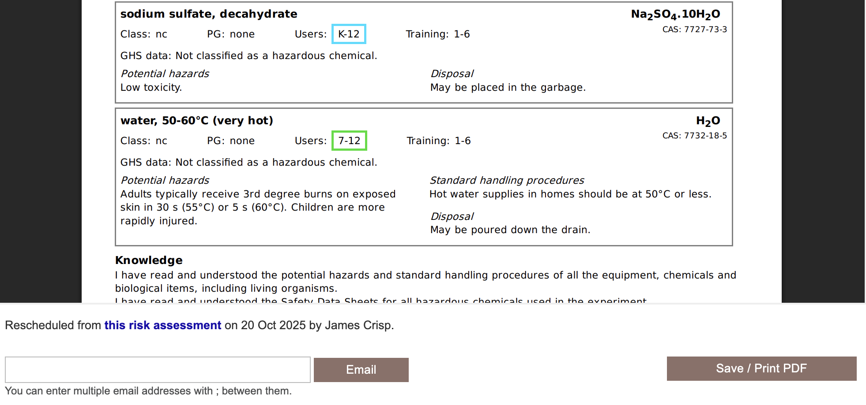

Slide 18
Best practices

Slide 19
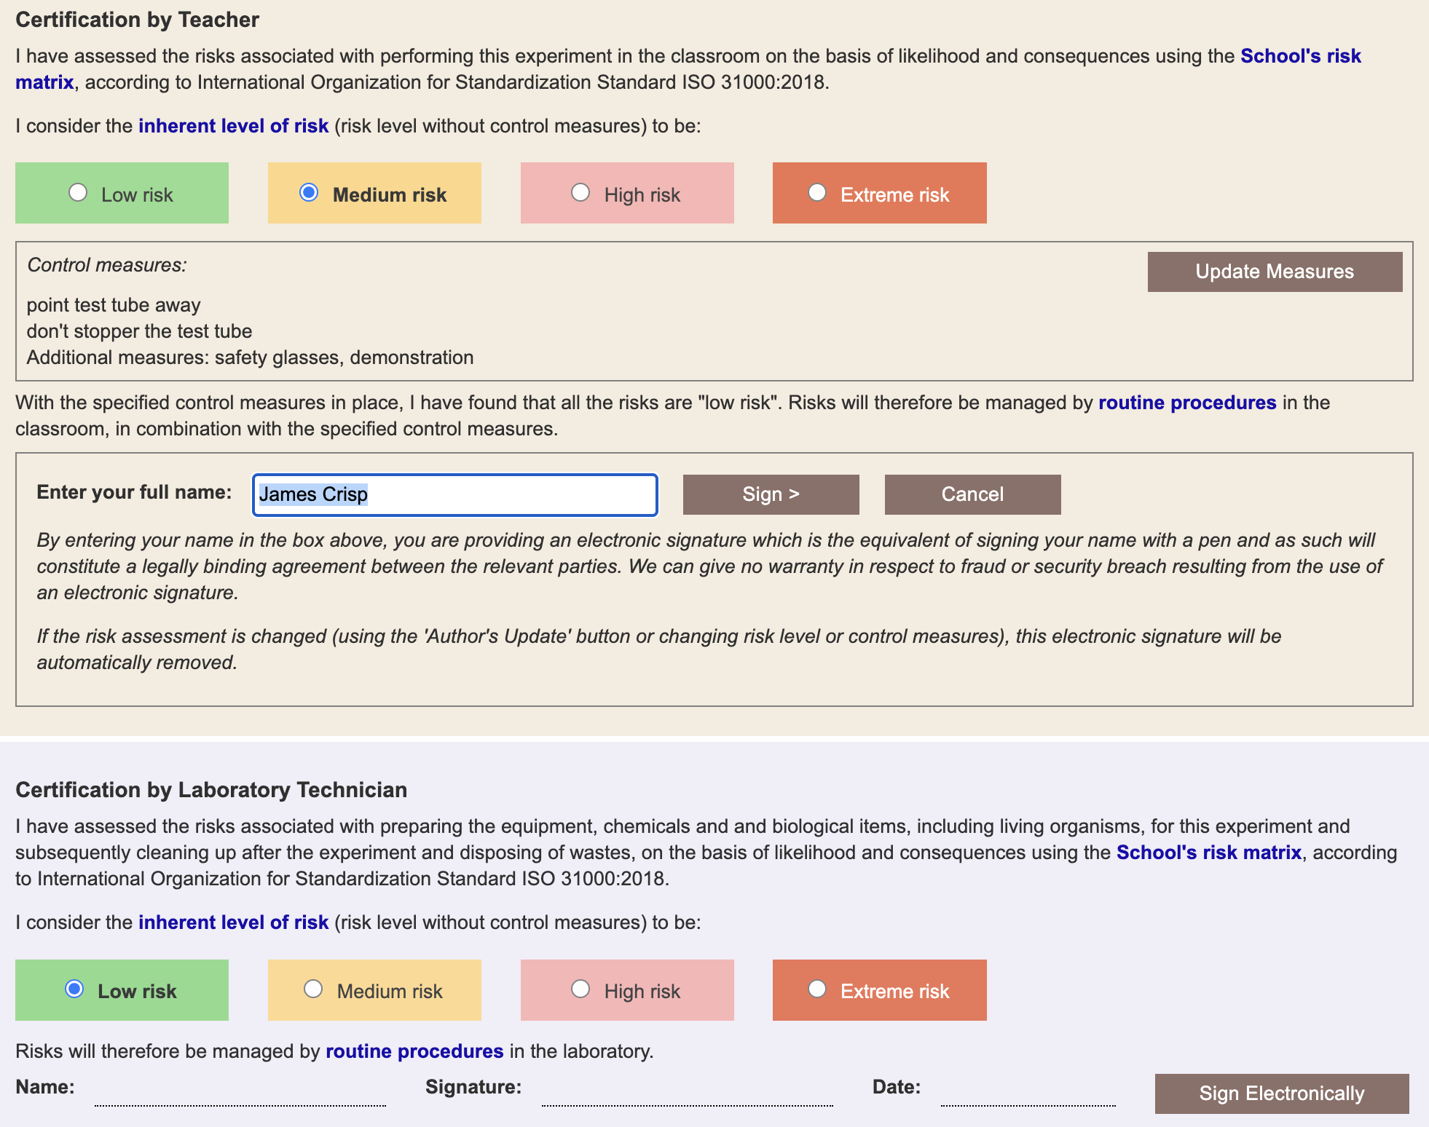
Notes:
more legal protection, not less for teachers

Slide 20
Multiple classes on
ONE SINGLE .
Risk Assessment
Notes:
Multiple scheduling is designed for an experiment that continues over several occasions with the same teacher, in the same location, and with the same class, e.g. observation of seed germination and growth over days or weeks.
Don't use multiple scheduling rows when different classes or different teachers are doing the same experiment. Instead, use 'Create modifiable copy' and carry out a separate risk assessment for each experiment. The reason is that both the law and logic require that all 'relevant matters' be considered when carrying out a risk assessment and these may be different with different classes, locations or teachers. The 'relevant matters' that need to be considered for an experiment include the facilities available (e.g. fume cupboard), the behaviour of the class (a big factor!), students with allergies, students with special needs, teacher experience and skill, etc. These matters will often be different from class to class, teacher to teacher and for different locations. 'Create Modifiable Copy' is fast and efficient to use, as details are carried across from the original risk assessment, ready to be customised for all 'relevant matters'.

Slide 21
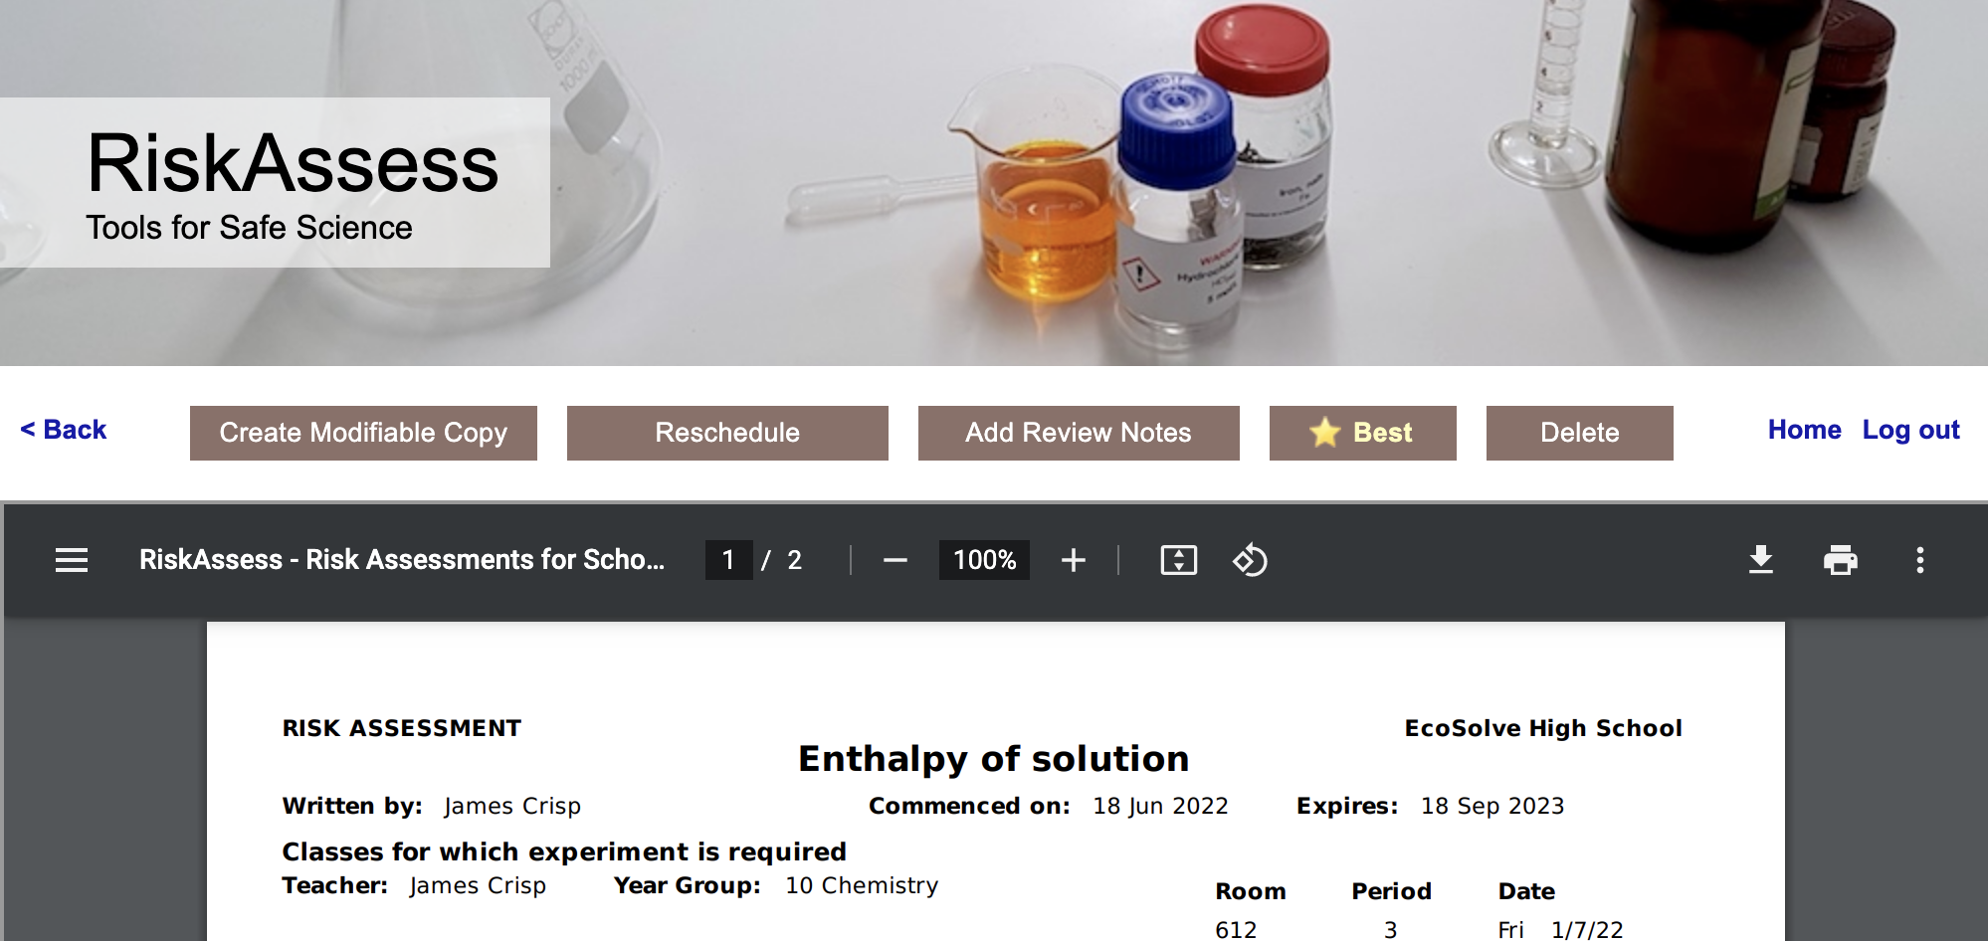
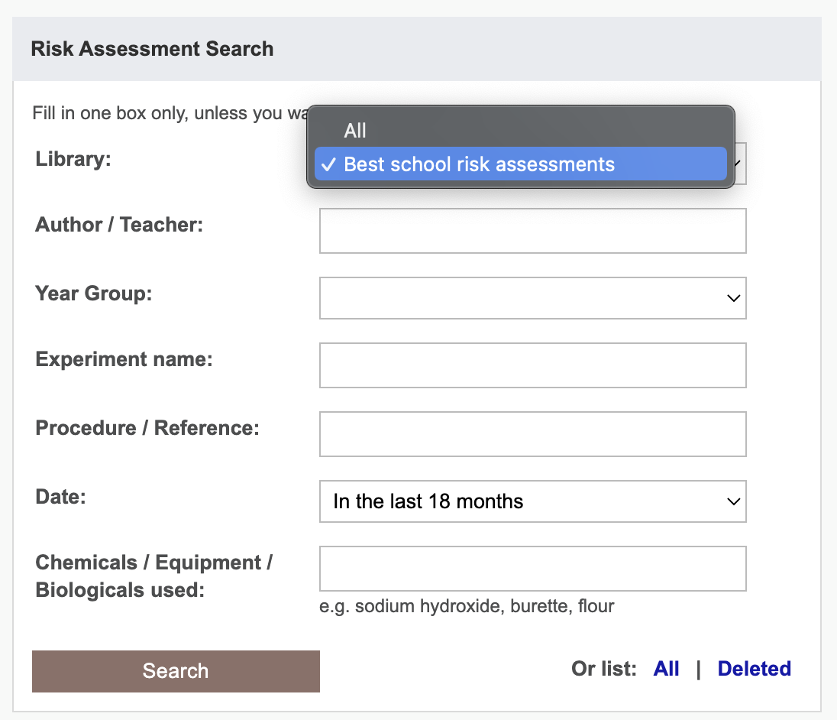
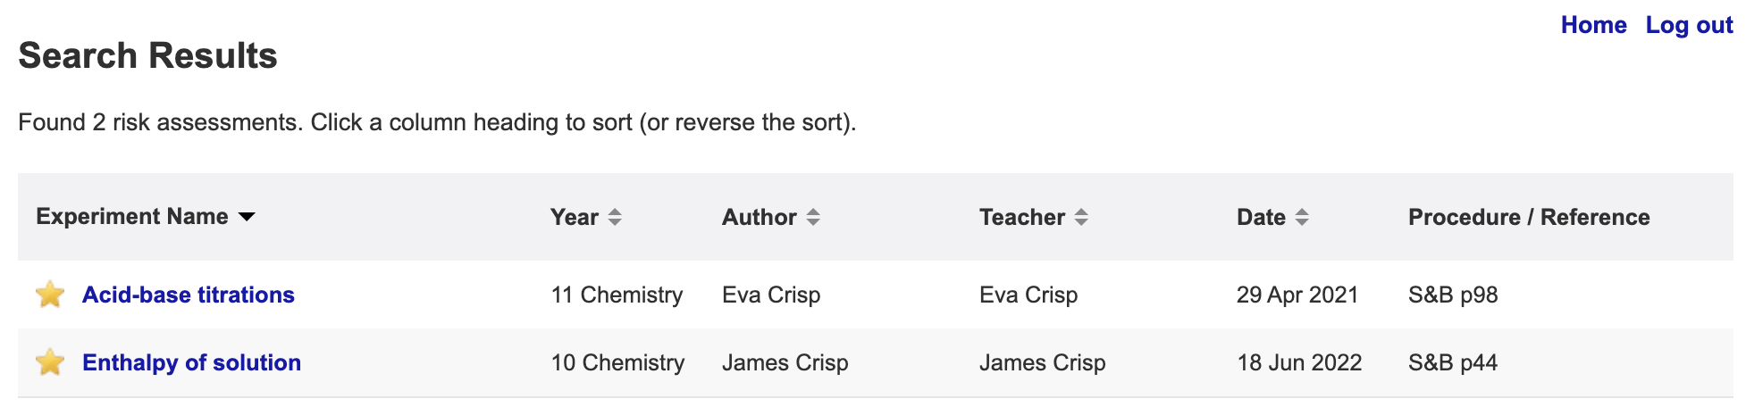
Notes:
BEST/Starred instead of delete

Slide 22
Questions?

Slide 23
Chemical
Inventory & Register

Slide 24
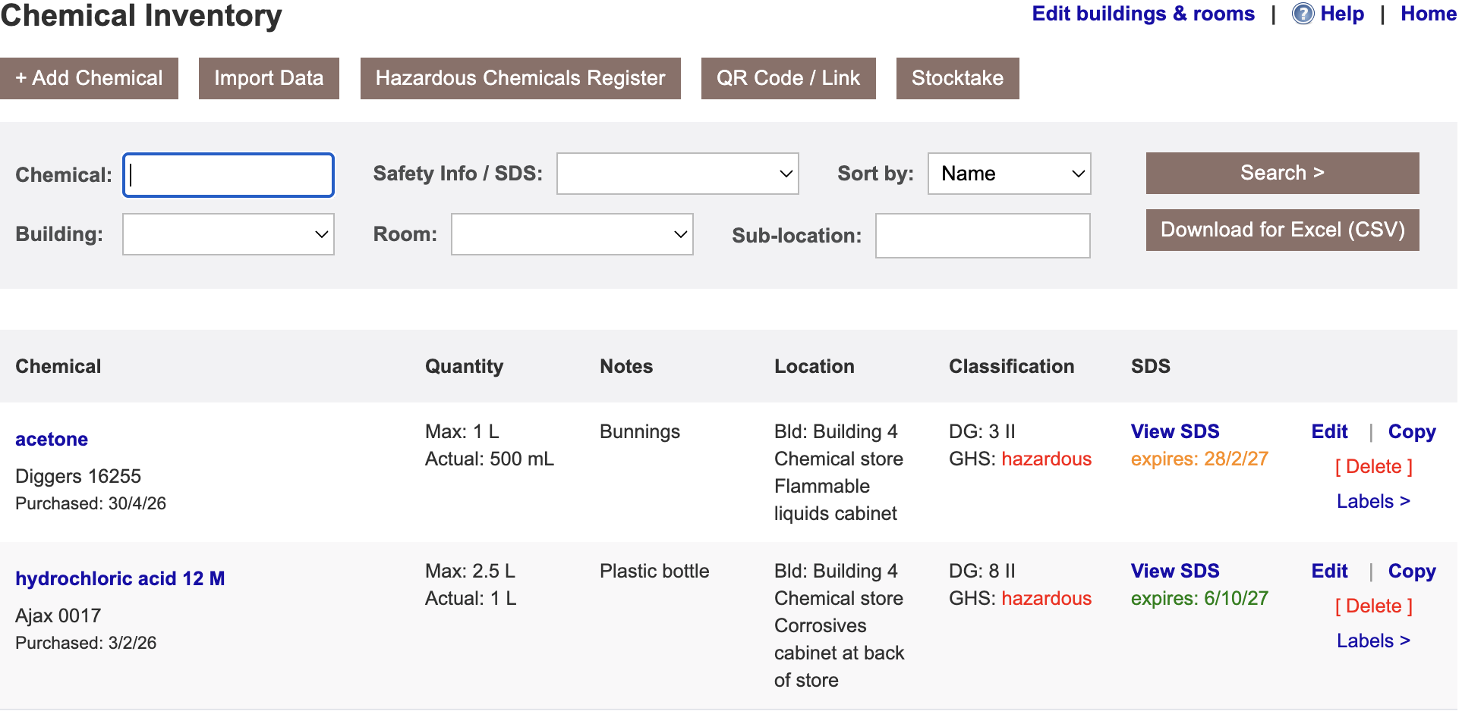

Slide 25
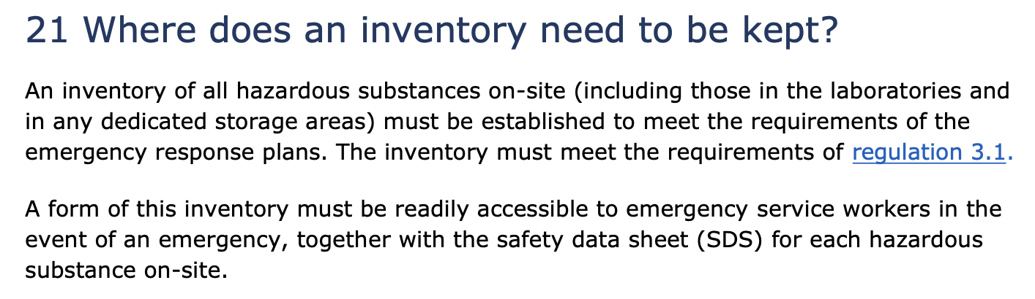
Safety and Science/Pūtaiao (2023)

Slide 26
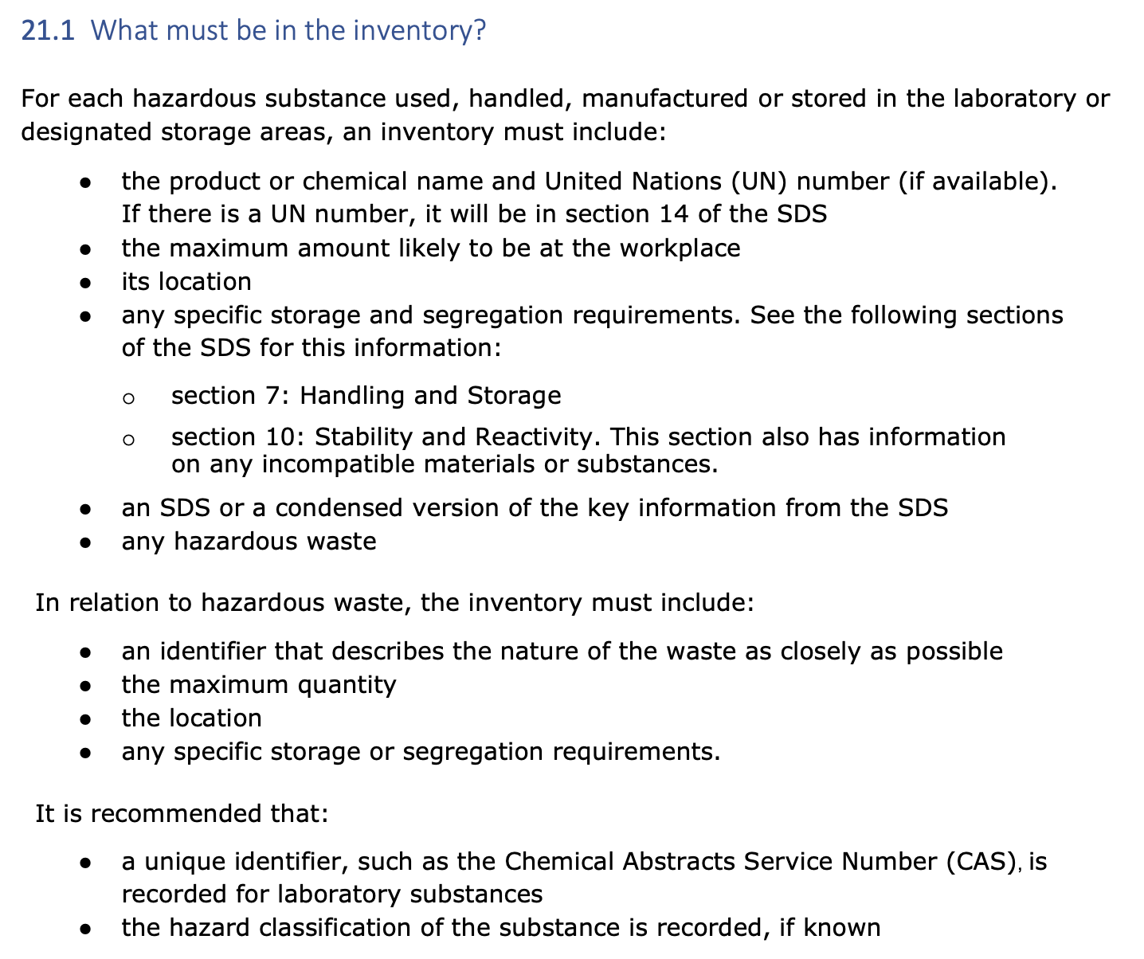

Slide 27
Hazardous ??
GHS adopted in 2021, but workplace regulations still reference HSNO. The two line up closely, with the EPA providing a correlation between them.
Workplace regulations exclude some GHS-hazardous substances from inventory requirements - for a school lab, mainly:
  Ecotoxic-only chemicals — though many are hazardous anyway on other grounds
  Non-hazardous compressed gases — nitrogen, argon, CO₂ (but oxygen, LPG, etc, remain required)
RiskAssess follows GHS: hazardous = has GHS signal word
but you can override this or simply not track these chemicals.
Still, we recommend you track them as emergency services care about compressed gases, and the environment is important!

Slide 28
We decided to differentiate between…
Inventory | Register
School staff | Emergency services
All chemicals | Hazardous chemicals
All data, SDS | Totals by DG Class, Selected data & SDS
Needs login | Accessible via QR Code
Editable | Read-only Automatic from Inventory

Slide 29
DEMO!
Storage guide
Overview of inventory & register
QR Codes
Adding a record
SDS management
Getting started: locations & enter OR import
Importing data
Stocktake
Help & download/backup

Slide 30
Questions?

