Slide 1
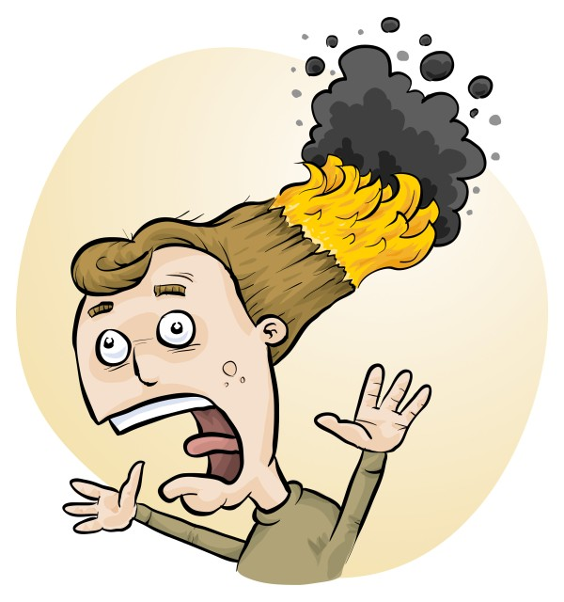
RiskAssess: new features, best practices and tips
Phillip and Eva Crisp

Slide 2
New features

Slide 3
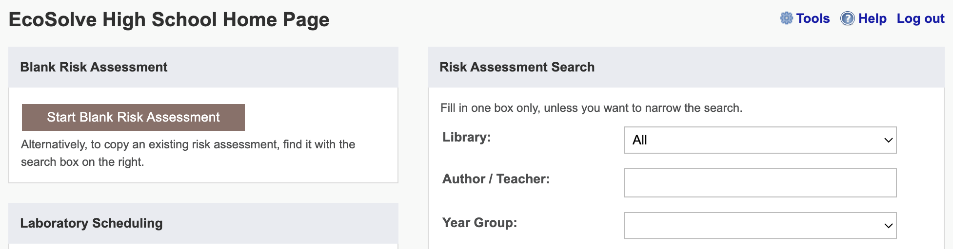
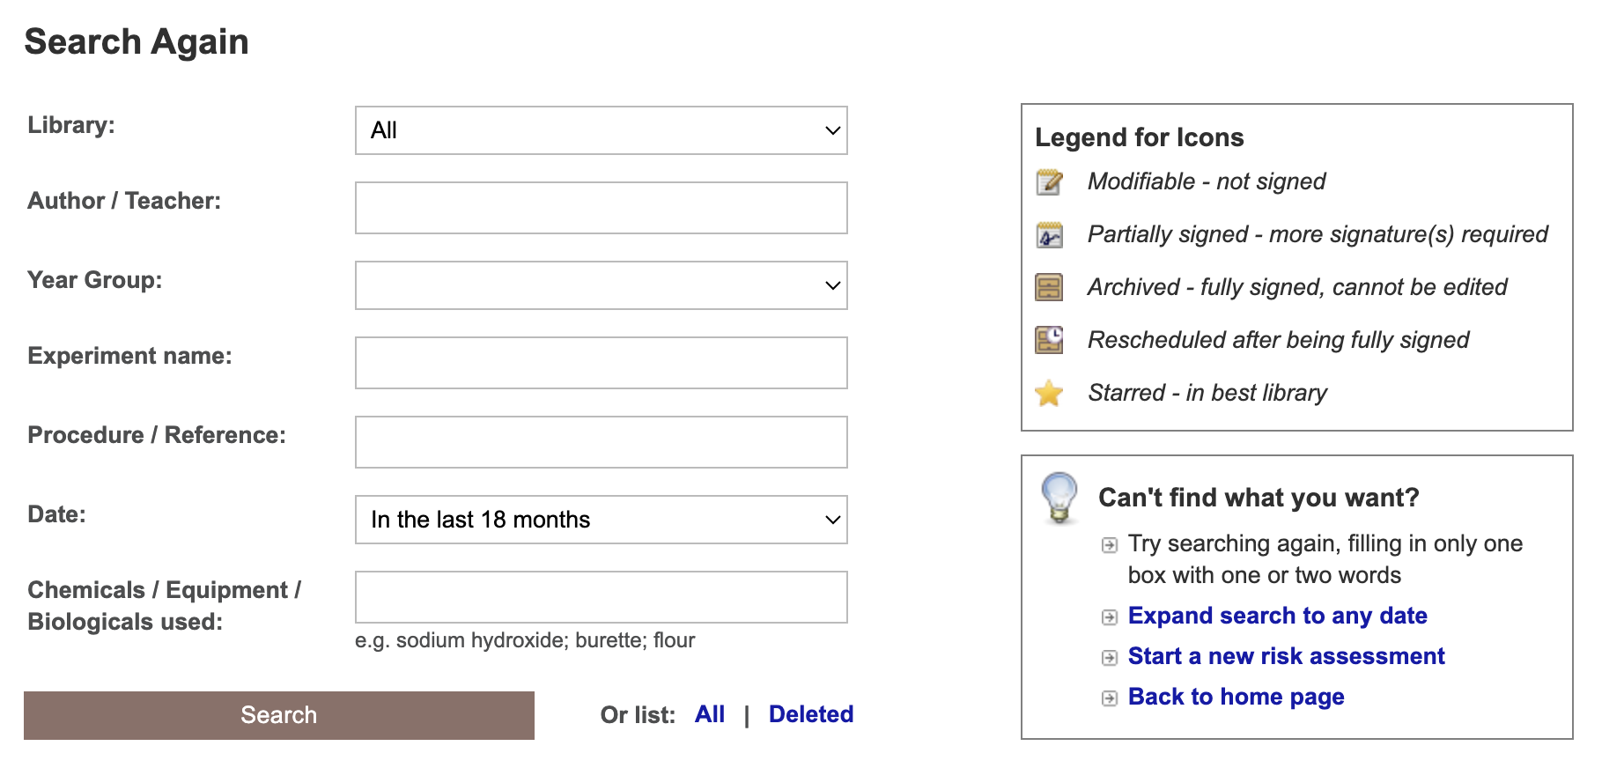

Slide 4
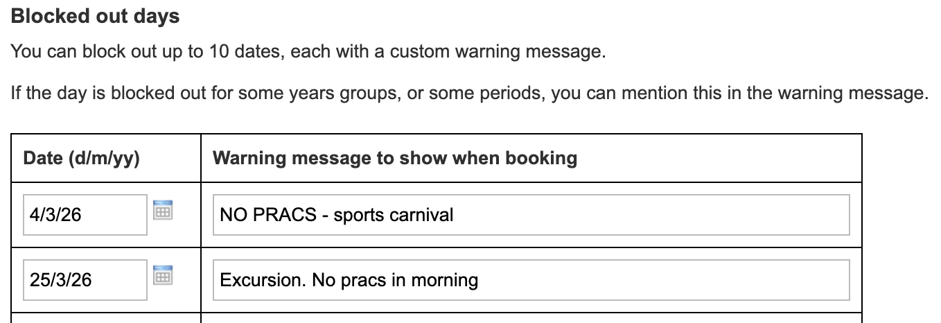
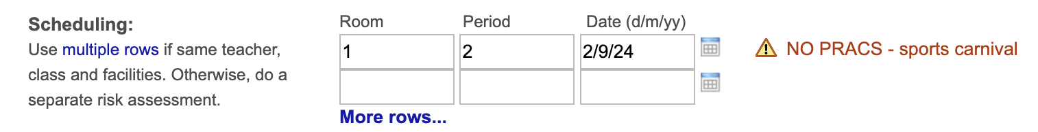
Block out up to 10 dates!

Slide 5
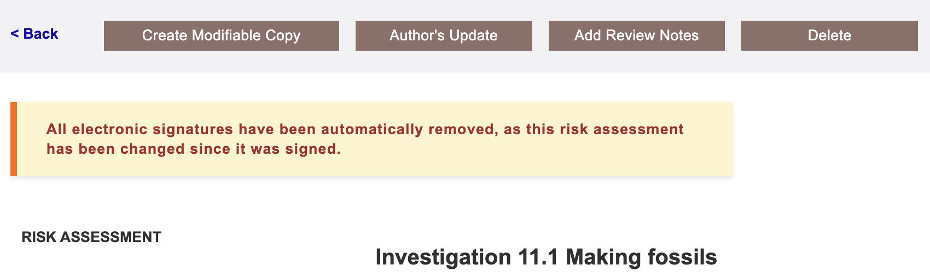
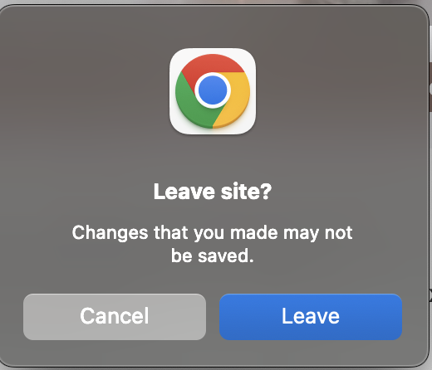
Catching forgotten signatures!

Slide 6
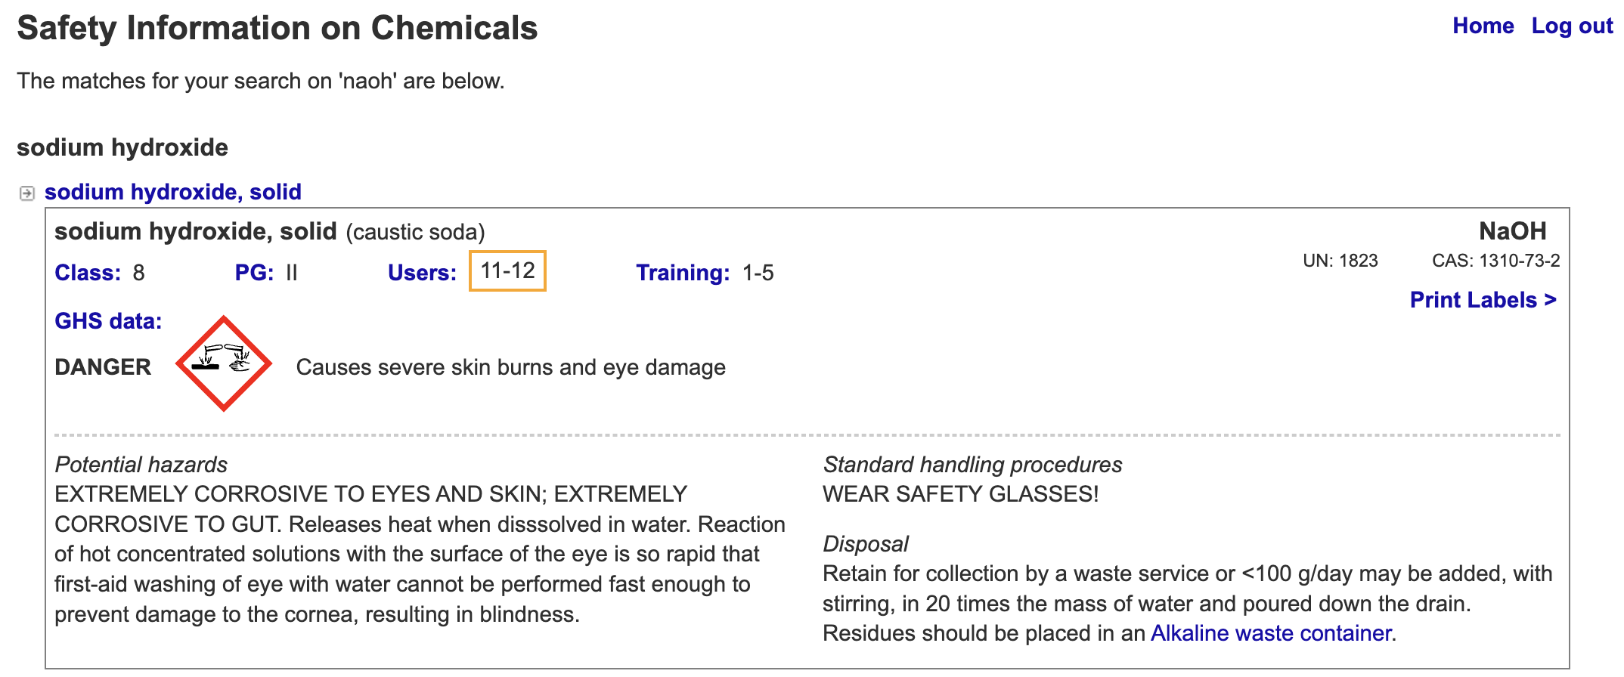
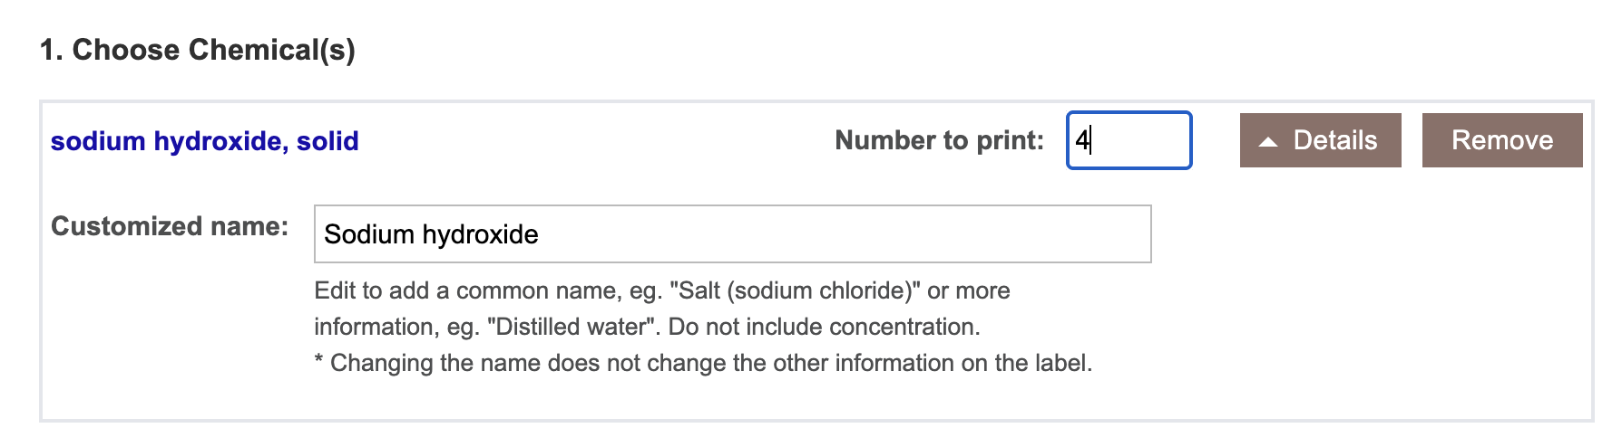

Slide 7
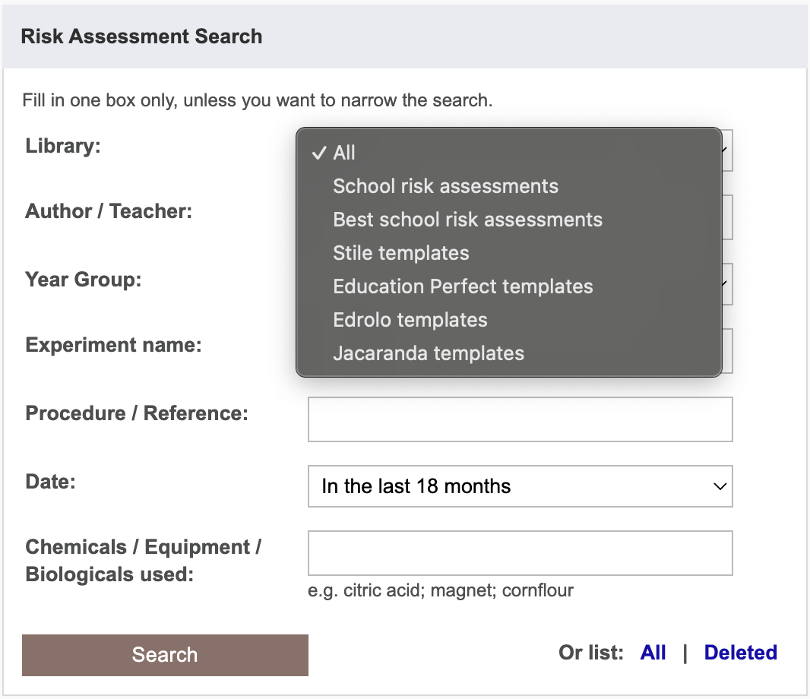

Slide 8
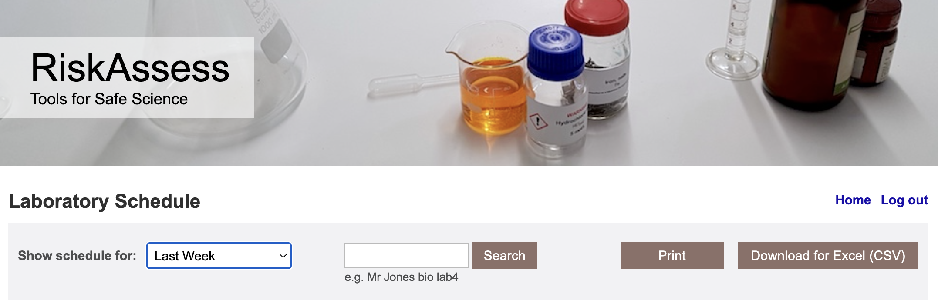
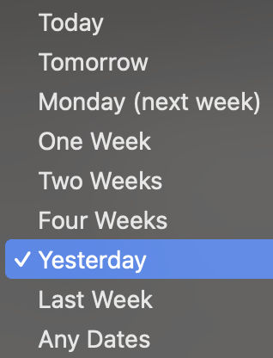

Slide 9
Tools demo including stocktaking & year groups

Slide 10
Share Superuser
Create a library of risk assessments to share between schools

Slide 11
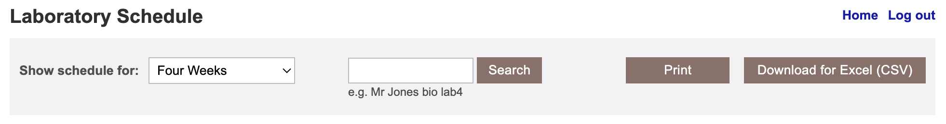
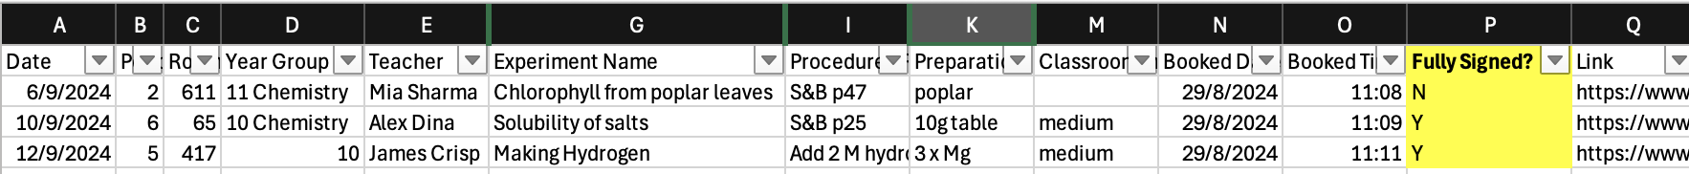

Slide 12
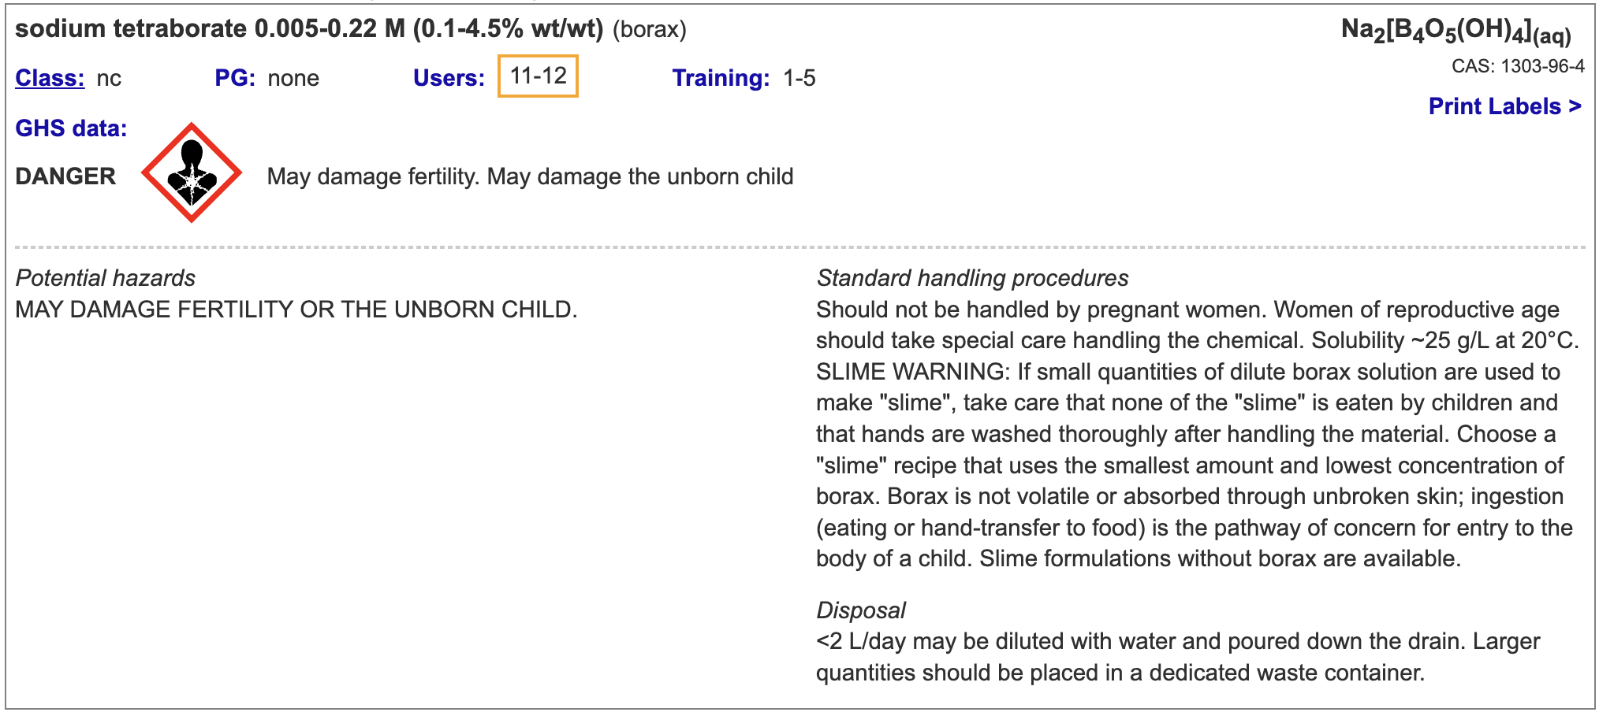
Borax (and "slime") hazards information upgraded
And ~150 other chemical additions and updates

Slide 13
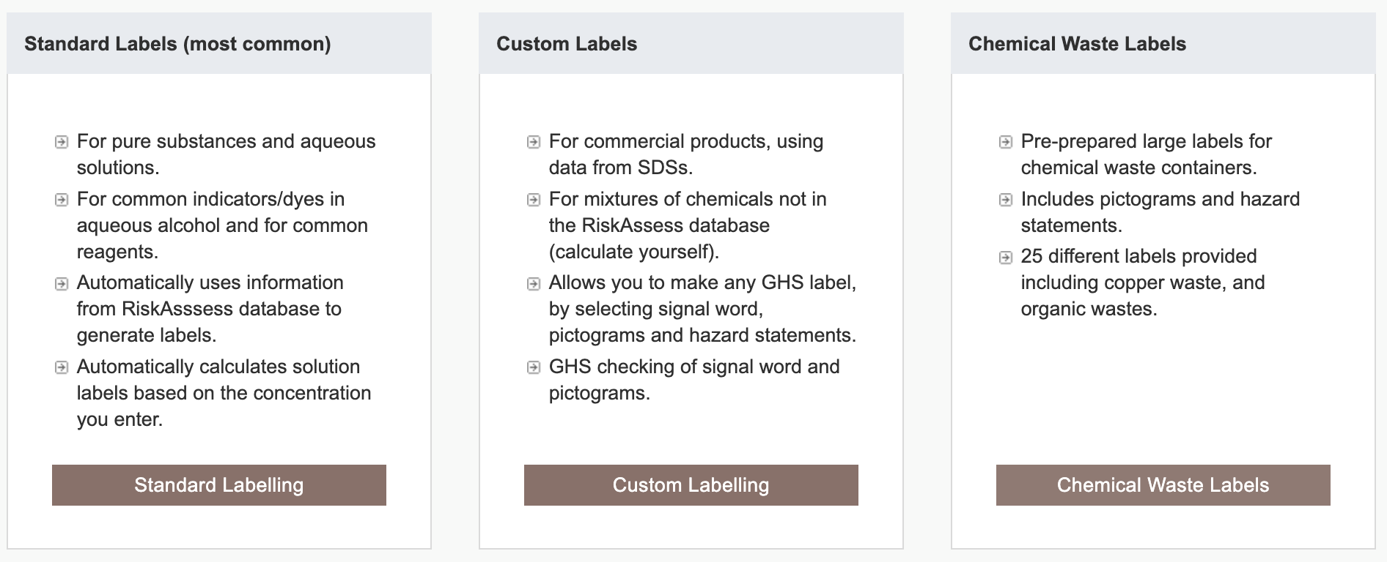
Chemical waste labels

Slide 14
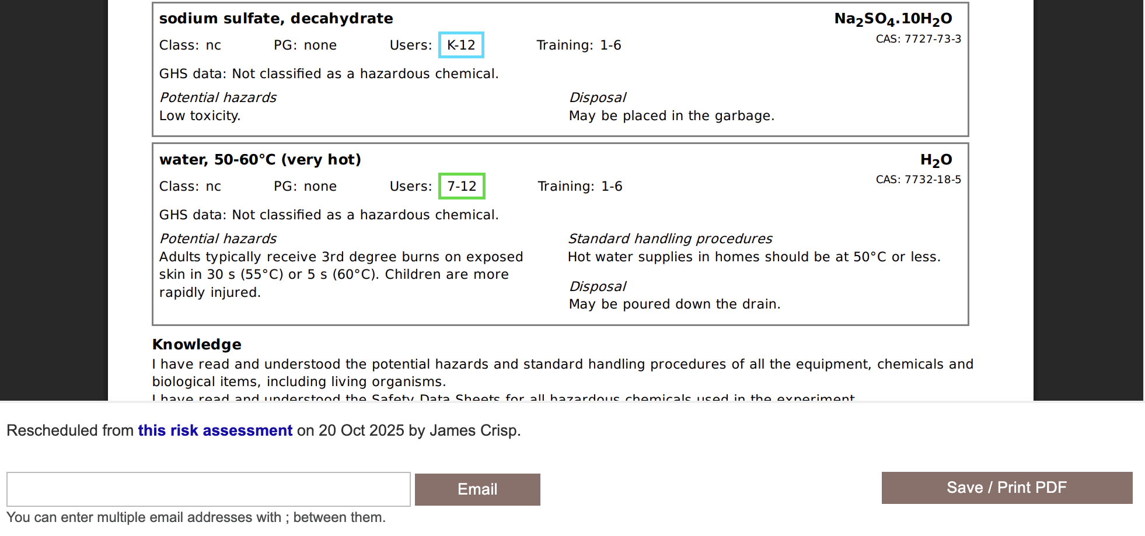

Slide 15
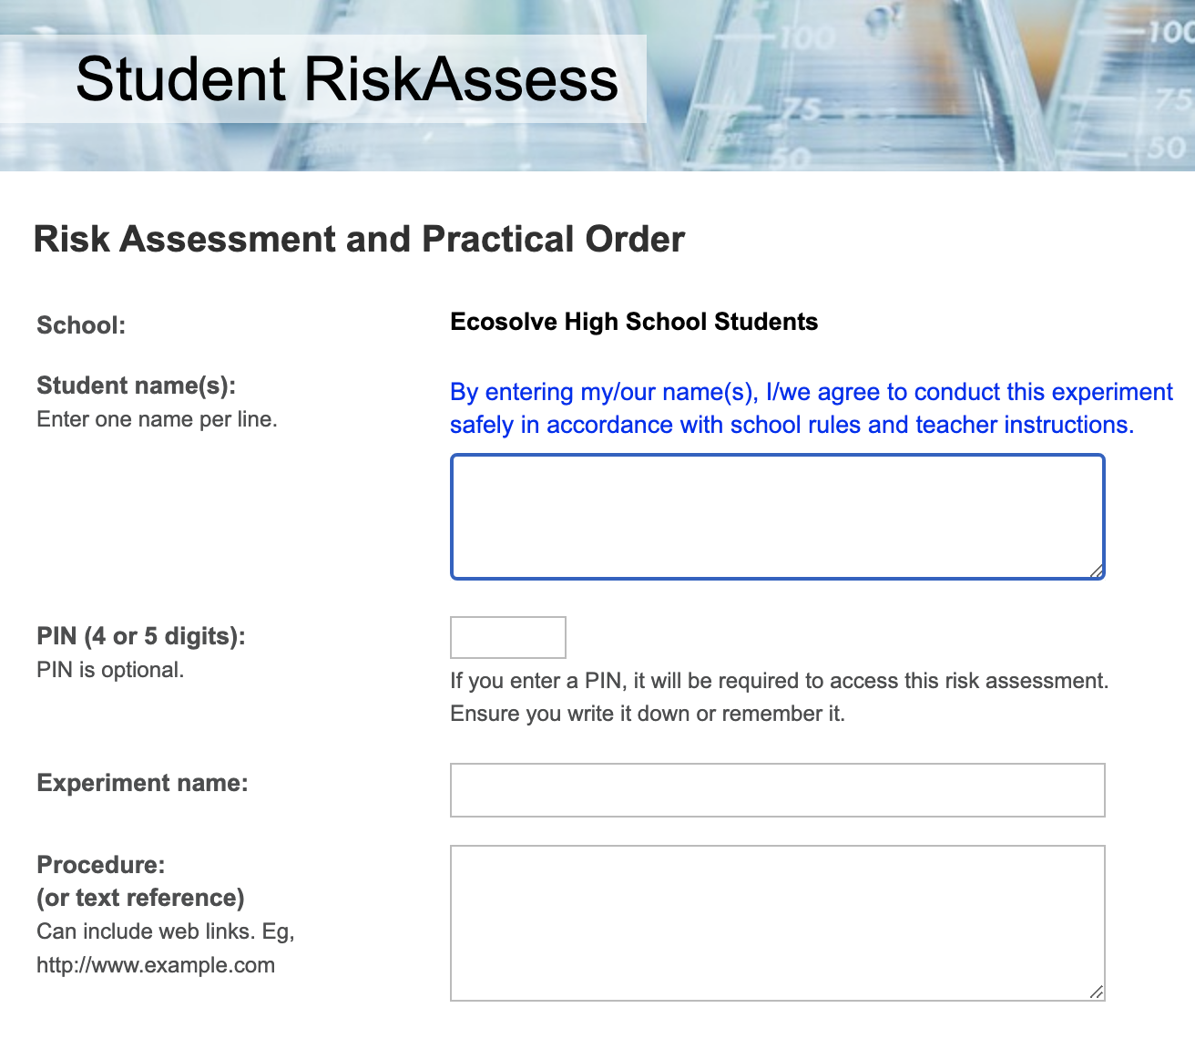

Slide 16
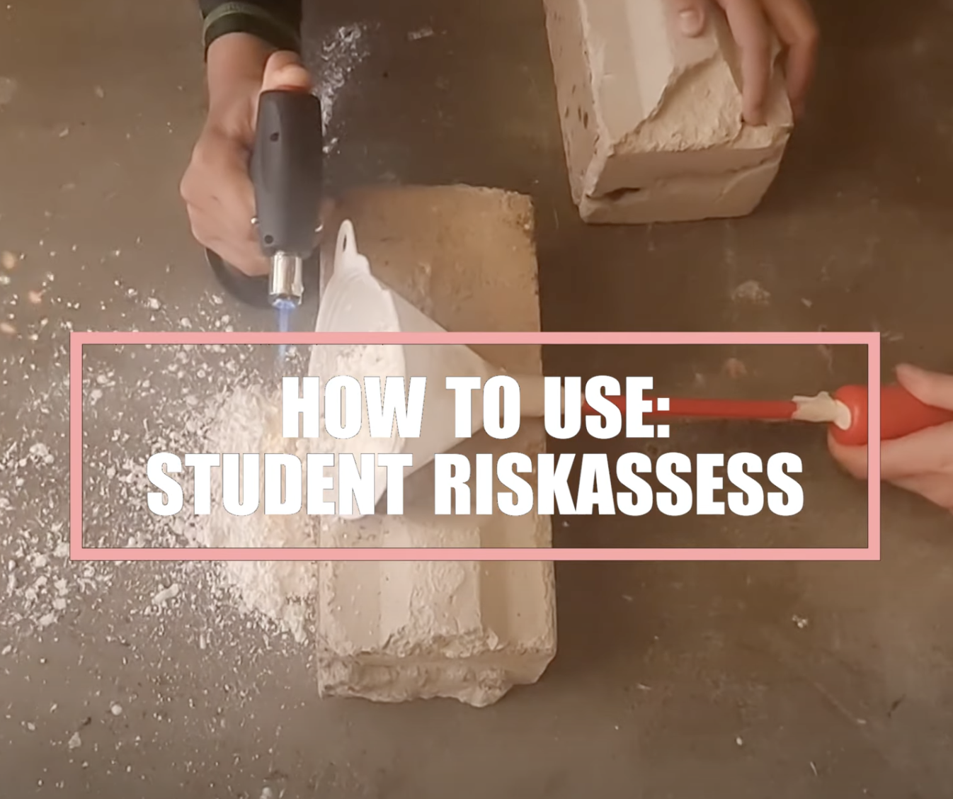

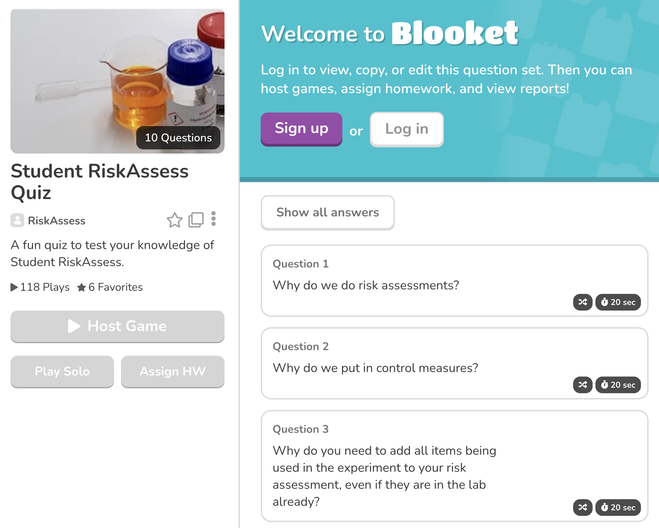
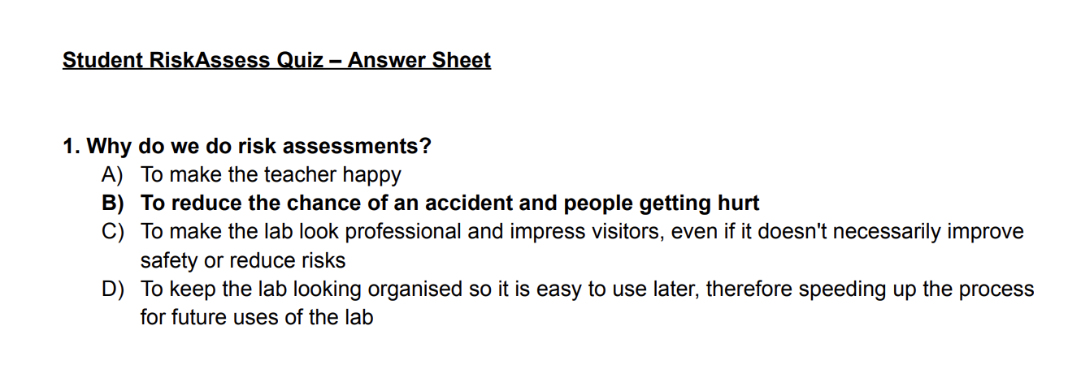

Slide 17
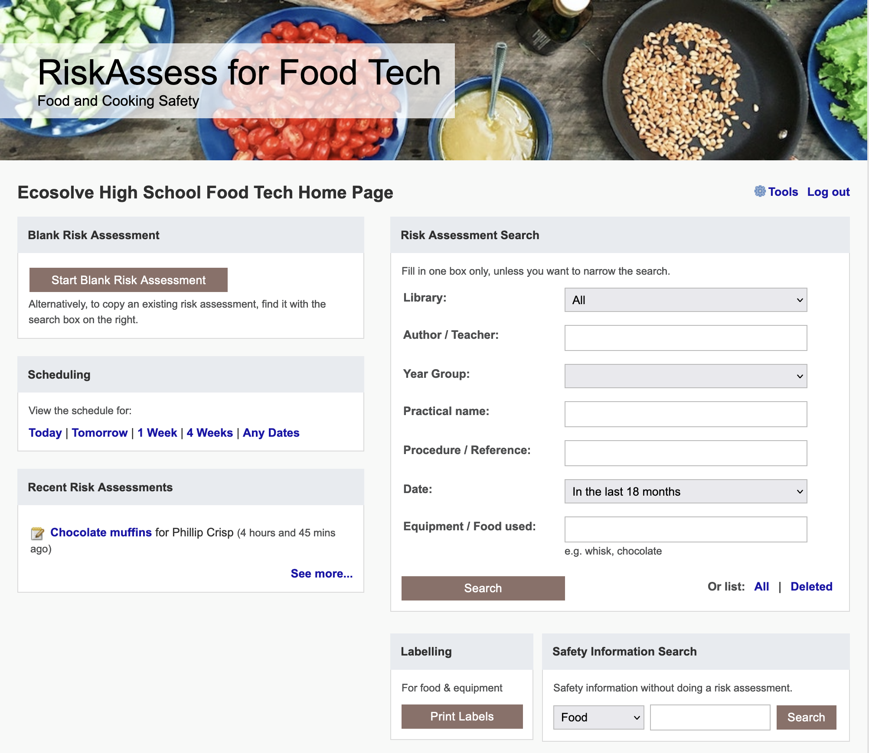

Slide 18
Best practices

Slide 19
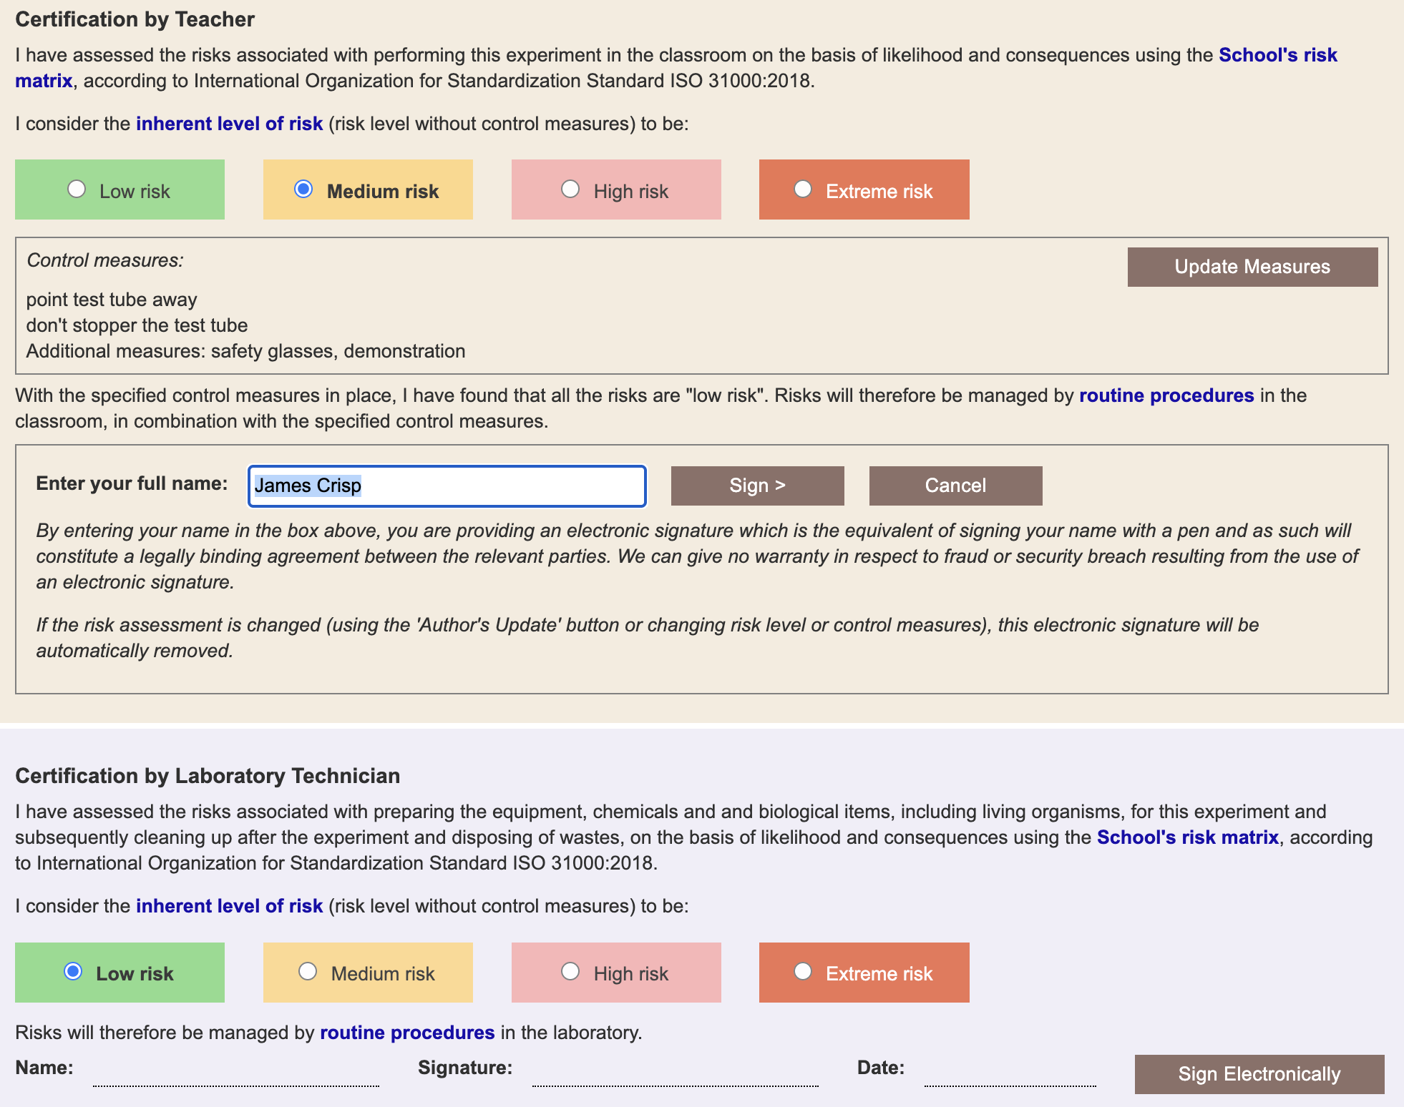

Slide 20
Multiple classes on
ONE SINGLE .
Risk Assessment

Slide 21
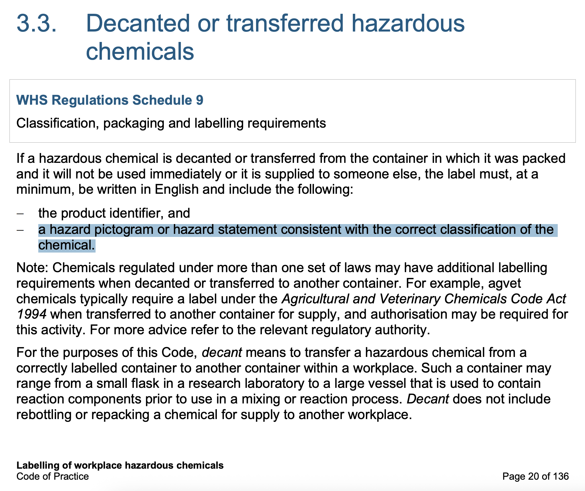

Slide 22
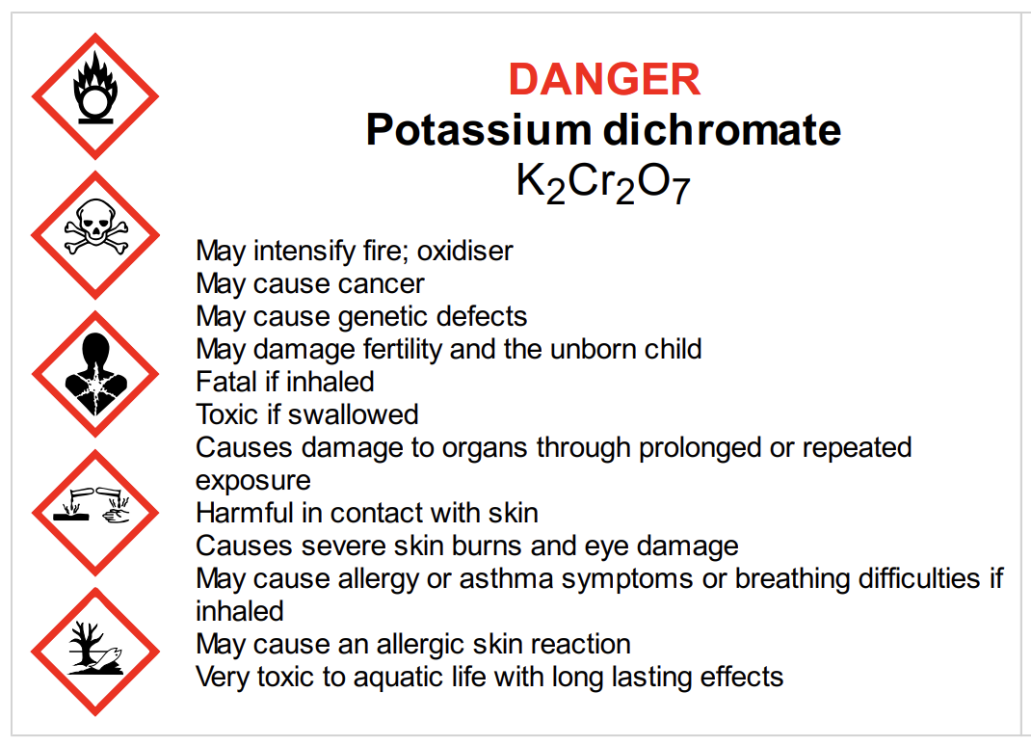
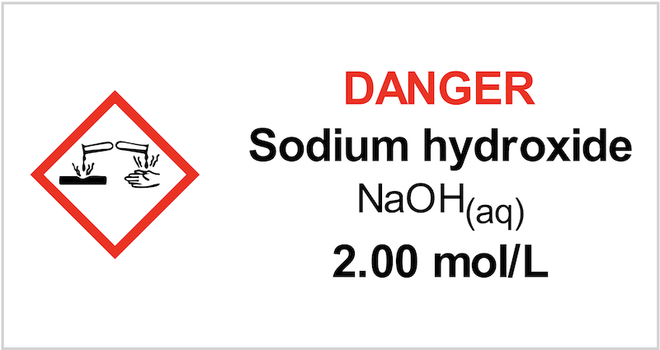
In RiskAssess, we have chosen to:
include the Signal word, since it provides a rapid summary of the hazard level
use pictograms, rather than hazard statements, since they are more readily understood
add hazard statements when there is sufficient room
focus on communicating the most essential information.

Slide 23
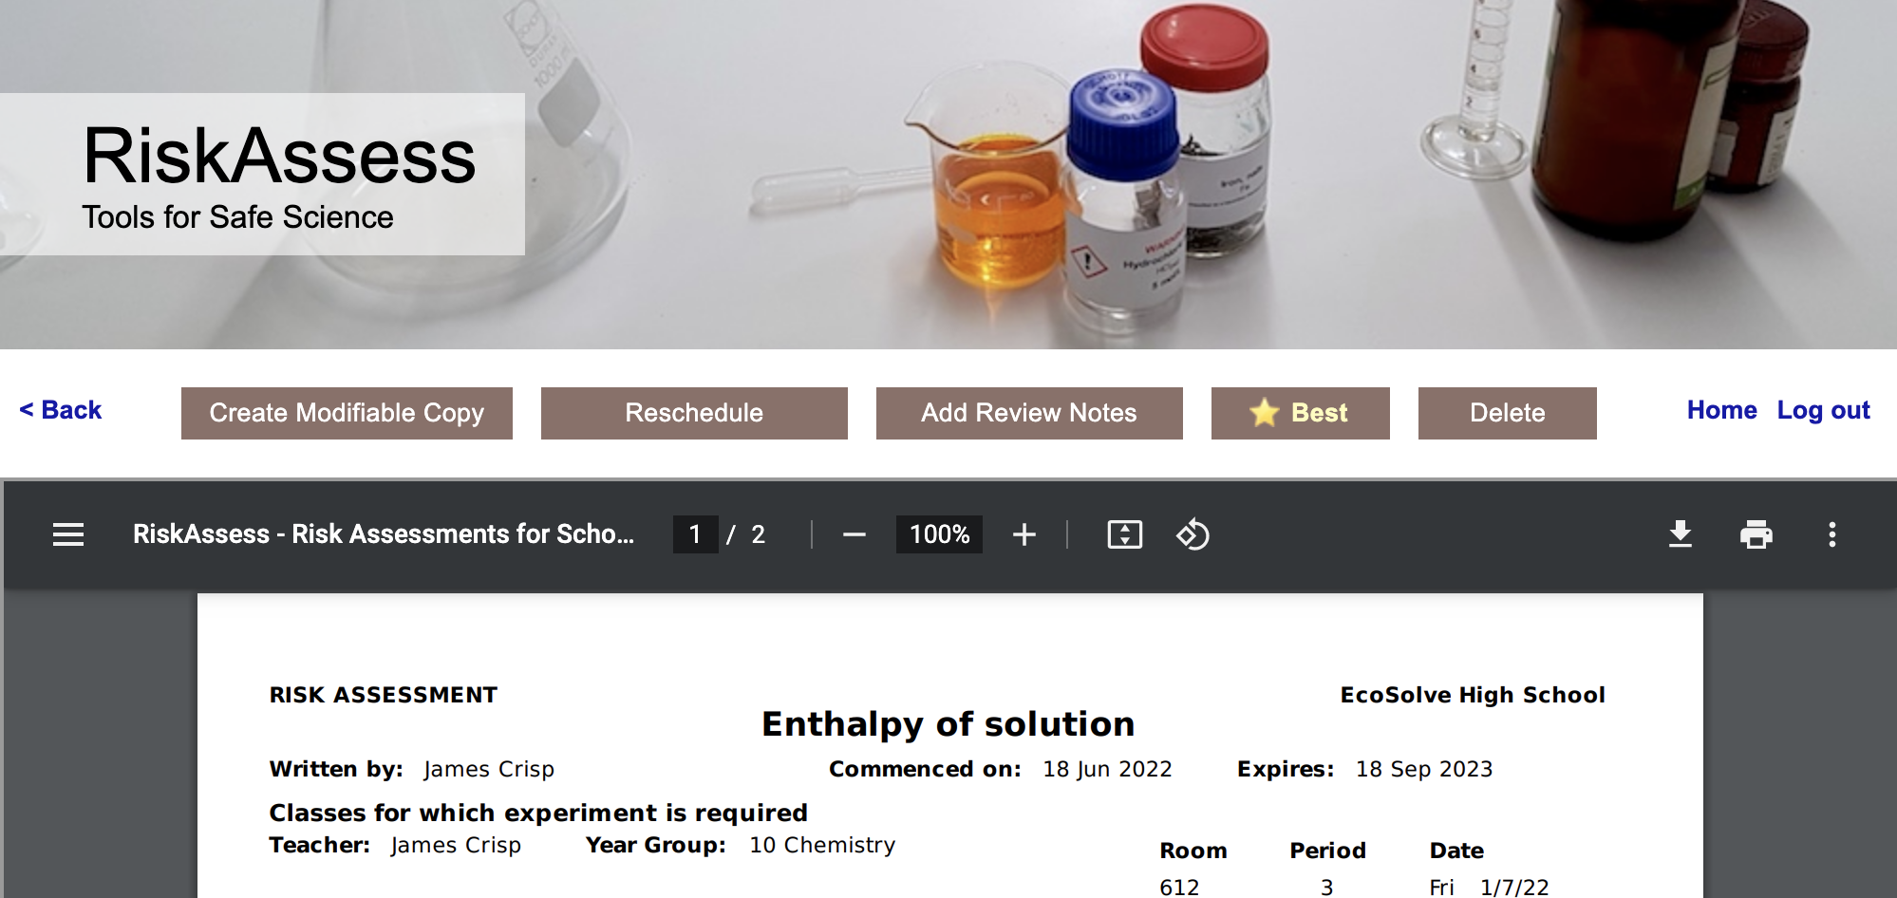
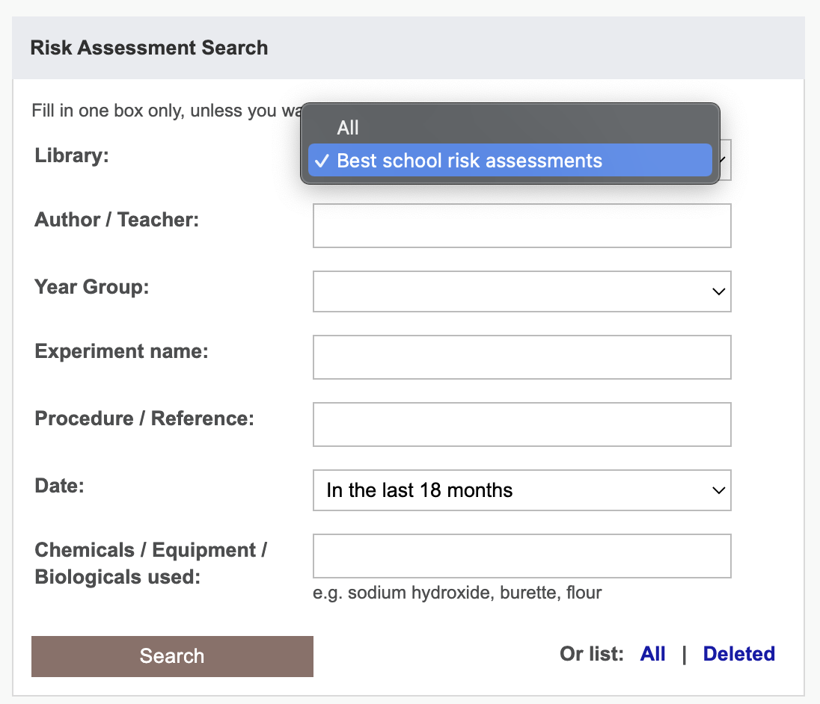
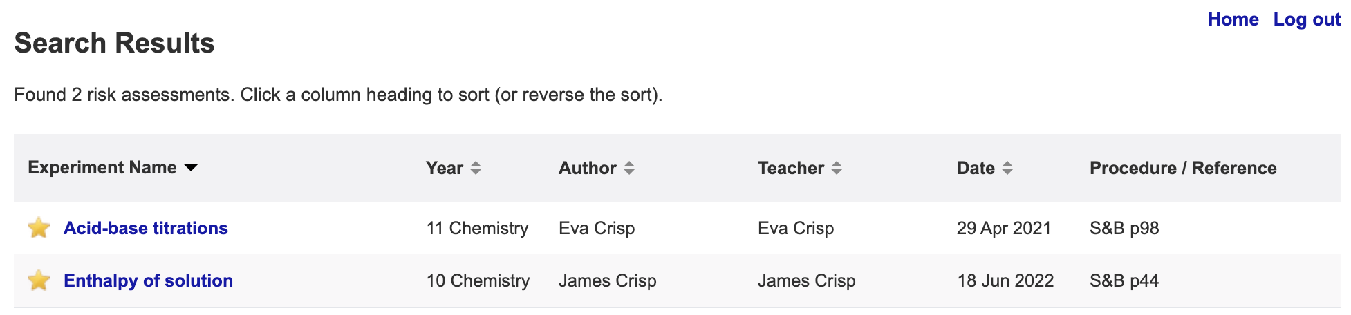

Slide 24
Future Plans

Slide 25
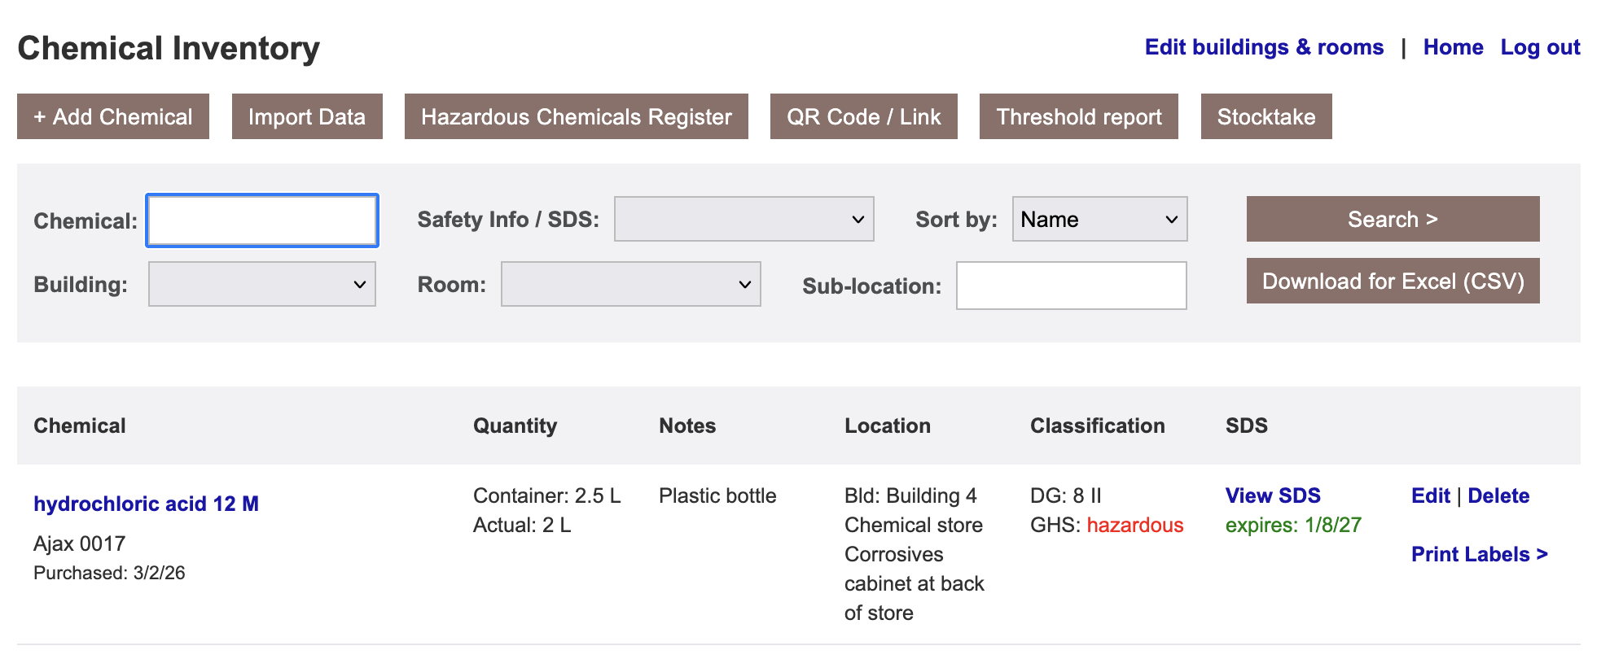
Chemical Inventory/Register
Links to RA safety info & SDS
Import from CSV Excel file
Easy print out register
Reports/colours for SDS that need updating
Building (list), room (list), location (text)

Slide 26
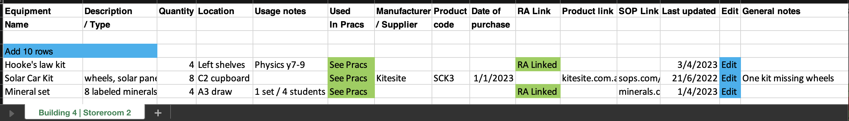
Equipment Inventory DRAFT
Building (list), room (list), location (text)
Import from CSV Excel file
Easy print out

Slide 27
Tips & Tricks

Slide 28
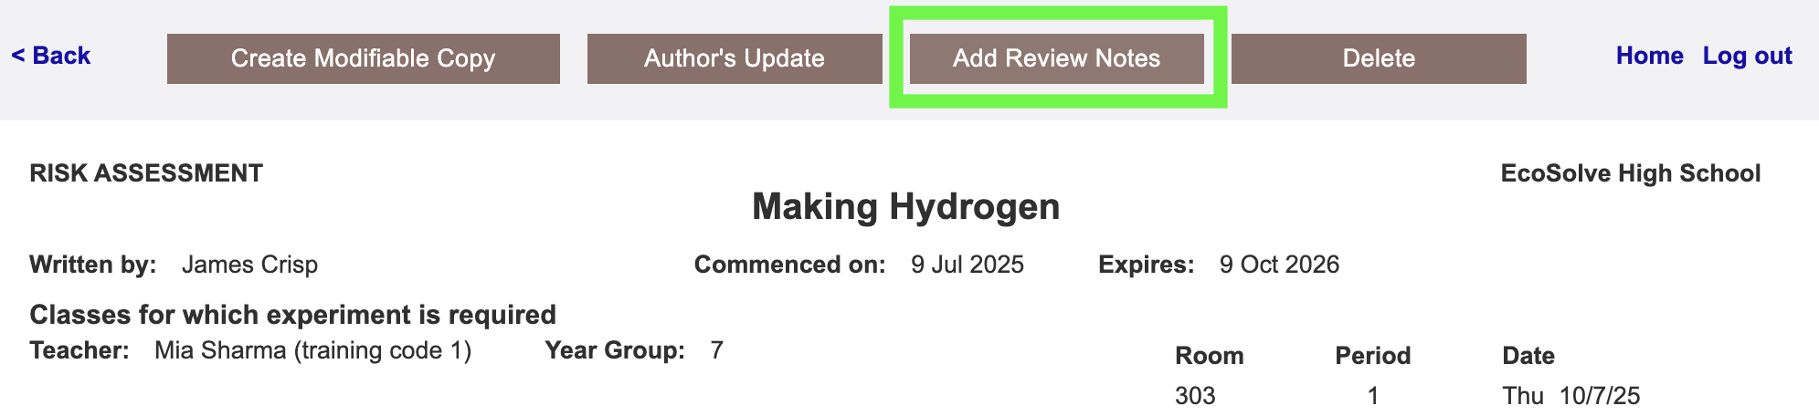
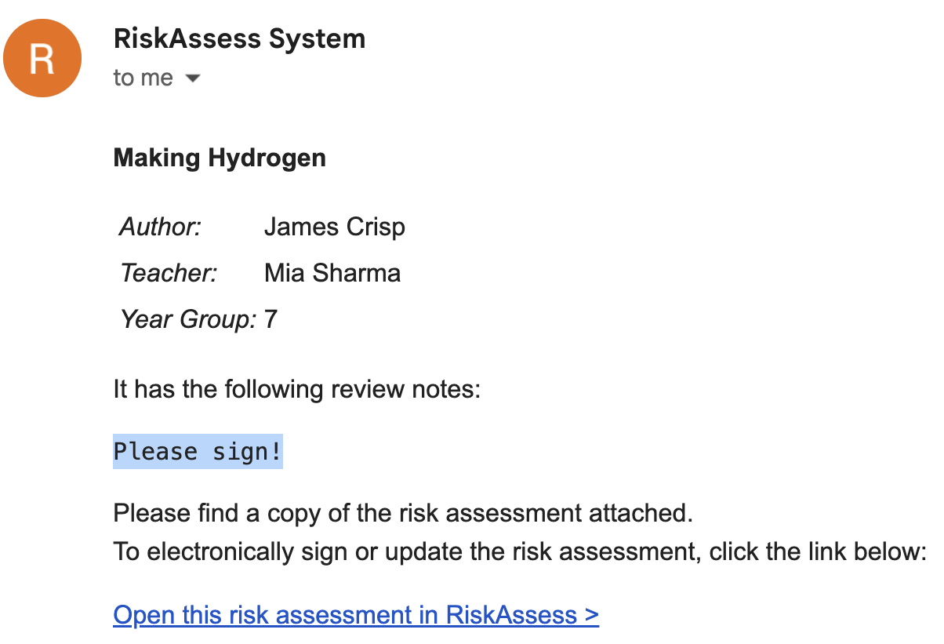

Slide 29
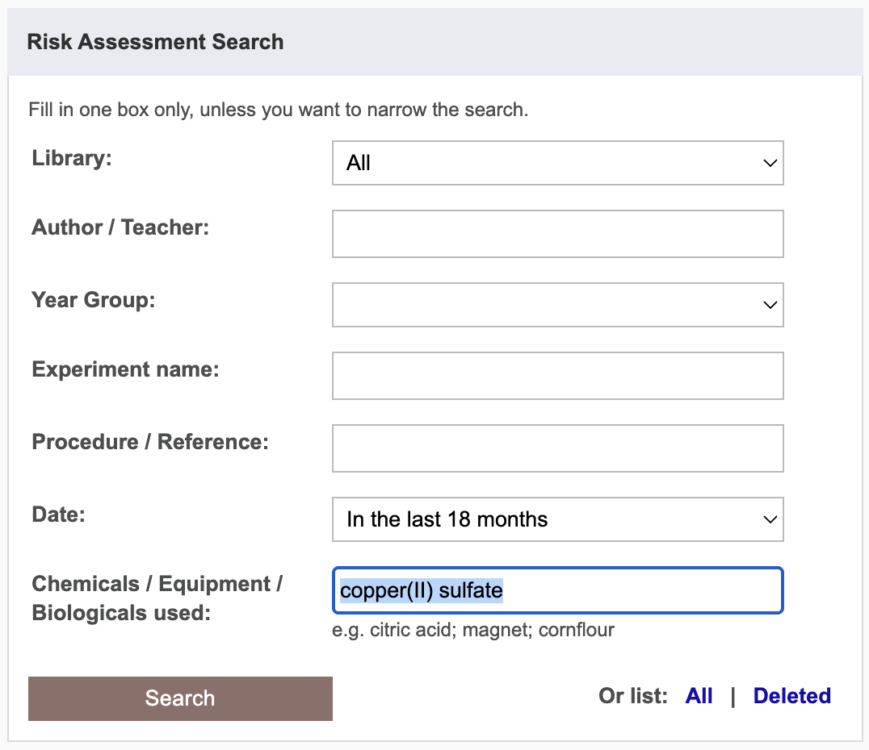
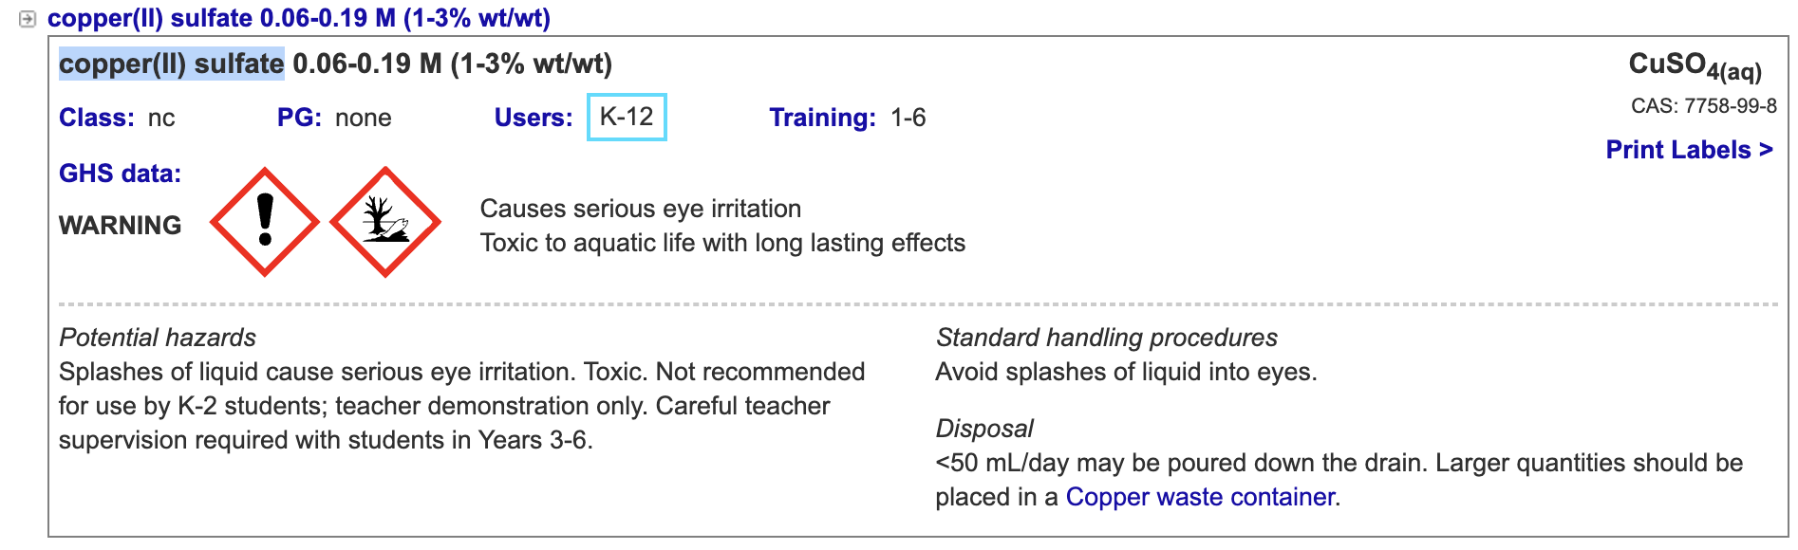

Slide 30
Menu
Shortcuts
icons, hcl, part name, CAS,
click banner, links, hot links, delete,
Best RAs
Scheduling & Searching
Excel/csv, date ranges,
search, # & sort, prep notes,
double booking, lodged date
Tools
contact, customise year groups,
stocktaking & usage, invoice,
backup system, blocked out days
Student RiskAssess
view student PINs, last year search
multiple prac management
Labels
standard, custom & waste labels,
multiple chemicals on sheet,
mixtures, non-chemicals,
free text, biohazard symbol
Operations
author’s update vs modifiable copy,
reschedule, archive risk
assessments, annual review,
tech-only RAs, review notes,
high/extreme: 3 signatures, list,
disposal info
Resources
learning resources, faq, eBook,
videos, libraries: Stile+EP+Edrolo
+Jacaranda

Slide 31
Questions?

