Slide 1
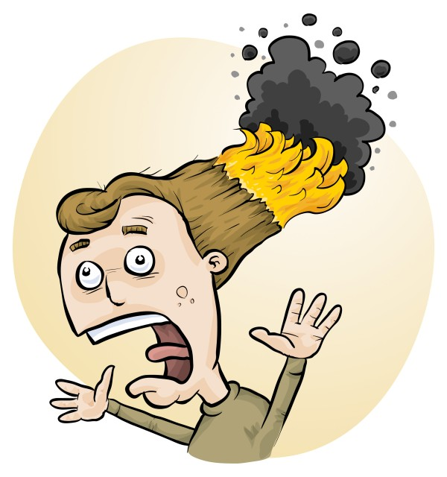
Risks in Primary Science investigations and how to minimize them
Phillip Crisp and Eva Crisp

Slide 2
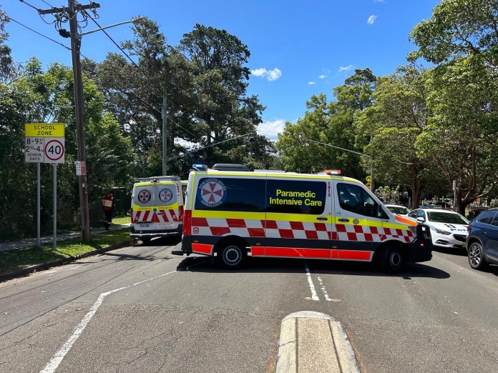
21 November 2022 Manly West Public School
2 students with serious burns
9 students with superficial burns
1 teacher with minor burns
• S Keoghan, M. Muroi and M. Gorrey “’Something had to be up’: Children in hospital as experiment goes wrong” Sydney Morning Herald, 21/11/22.
• “Hazmat incident at Manly West Public School”, Manly Observer, 21/11/22.
• E. Visontay and T. Rose “Children suffer serious burns after outdoor science experiment goes wrong at Sydney school” The Guardian, 21/11/22.

Slide 3
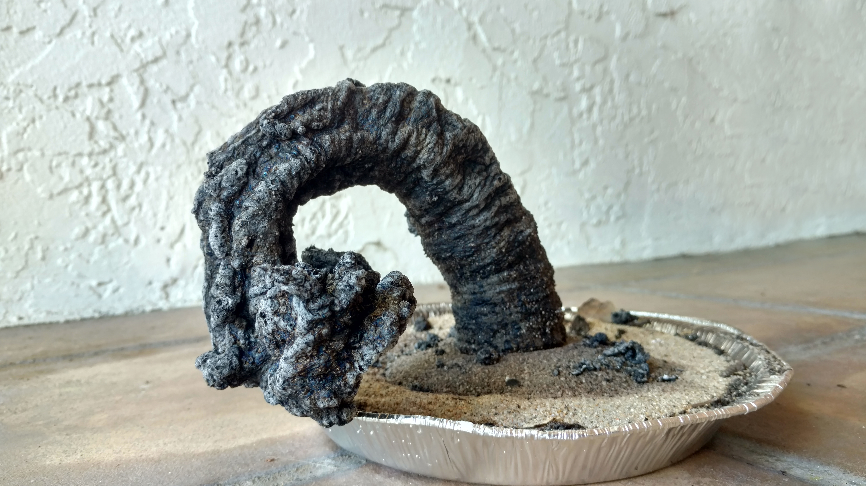
What happened?
Carbon sugar snake
(black snake, sugar snake)
sugar
sodium bicarbonate
methylated spirits / lighter fluid
From the limited information in the news reports, apparently:
• Demonstration performed outdoors on a very windy day
• Gust of wind blew burning material onto students
• Suspect a large-scale demonstration (since so many injured)
Further information?

Slide 4
Work Health & Safety Act 2011
. . . a duty . . . to eliminate/minimise risks to health and safety as far as is reasonably practicable.
. . . taking into account and weighing up all relevant matters including: (a) the likelihood of the hazard or the risk concerned occurring; and (b) the degree of harm that might result from the hazard or the risk . . . .
Part 2, Sections 17 and 18

Slide 5
all relevant matters includes
facilities available
behaviour of the class
students with special needs
students with allergies, etc
(NOT book “risk assessment”, tick sheet, etc)
likelihood
degree of harm consideration requires
proper risk assessment using a risk matrix
e.g. Aust/ISO Standard on Risk Management

Slide 6
How will we ever do that?

Slide 7
Be aware of the
• chemicals
• equipment
• biological materials
most likely to cause injury
Use reliable sources of safety information
Don’t follow YouTube without further research!
Try out the experiment beforehand
Carry out risk assessments as required by law
e.g. use Primary RiskAssess
and introduce control measures, if needed

Slide 8
Teacher challenges
Lack of familiarity with chemicals
Fear of injuries
Limited understanding of science

Slide 9
Safety requirements in the Australian Curriculum for Science
Years 3-4 Safely use appropriate materials, tools or equipment . . . (C) Discussing safety rules for equipment and procedures (E) (Students) discuss ways to safely use equipment . . (A) Years 5-6 Use equipment and materials safely, identifying potential risks (C) Discussing possible hazards involved in conducting investigations and how these risks can be reduced (E) (Students) describe potential safety risks when planning methods (A) C = Content description E = Elaboration A = Achievement standard
Notes:
And the curriculum

Slide 10
Safety requirements in the NSW Syllabus for Science and Technology
Early Stage 1 • develop safe skills when using materials and equipment
Stage 1 • make safe choices when using materials and equipment
Stage 2 • use appropriate materials and equipment safely (ACSIS054, ACSIS065)
Stage 3 • identify potential risks in planning investigations
• manage resources safely (ACSIS086, ACSIS103)
Notes:
And the curriculum

Slide 11
Chemicals most likely to cause injury
Demonstrations with . . .
• methylated spirits
lighter fluid, petrol, mineral turps
• hot water
• dry ice
Student use of • art materials (texta pens, paint sprays, white out,
tie dyes, glues)
Students eating chemicals (esp. K-2)
e.g. medicines in first-aid box
burns
allergies
poisoning
Food-grade chemicals are usually safe, except for allergies

Slide 12
Equipment most likely to cause injury
Demonstrations with . . .
• hot objects, e.g. hotplate, stove
• sharp objects
Student use of • button batteries (swallowing may be fatal)
• short-circuited batteries
• hot glue guns
• sharp objects
• latex gloves
Students throwing things!

Slide 13
Biological materials most likely to cause injury
Extreme allergic reactions to foods:
• peanuts, peanut oil, peanut products
• tree nuts
• shellfish and crustaceans (including sea monkeys)
and, less commonly, to
eggs, milk, wheat, soy, fish, sesame, . . . .
Allergic reactions to plant materials, including:
• rhus (leaves, stems)
• London plane tree (trichomes)
• pollens and moulds
Animal bites and stings
e.g. ticks, leeches, bees, pet animals

Slide 14
Cleaning chemicals (should be kept away from students!)
• bleach
dishwashing powder, caustic soda (for drains)
ammonia-based cleaners
oven sprays, often strongly alkaline
solvents, many highly flammable and/or toxic
graffiti remover
methylated spirits
Major risks are
highly alkaline materials, e.g. dishwashing powder in eye
allergic reactions
Primary schools may have cleaning materials in classrooms

Slide 15
Helps with
advice on potential hazards: chemicals, equipment, biological including allergies
risk assessments, as required by law

Slide 16
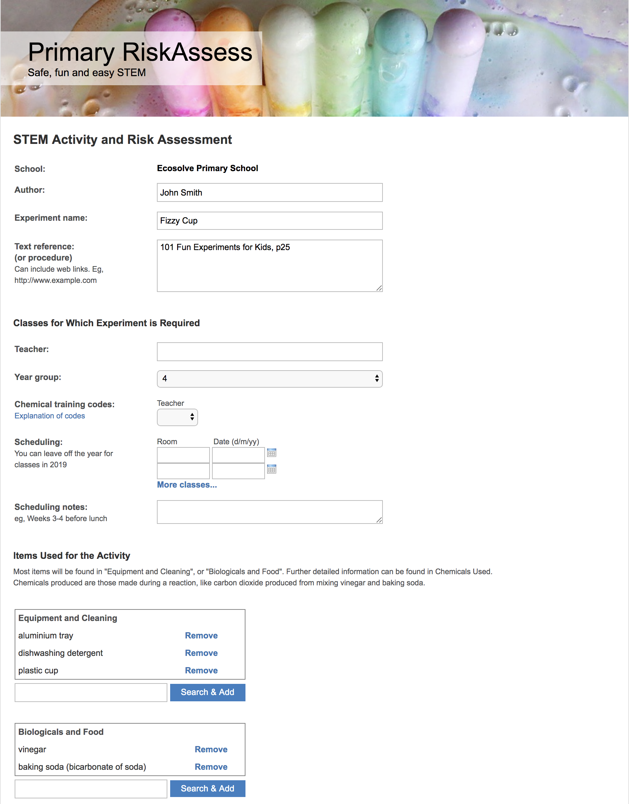
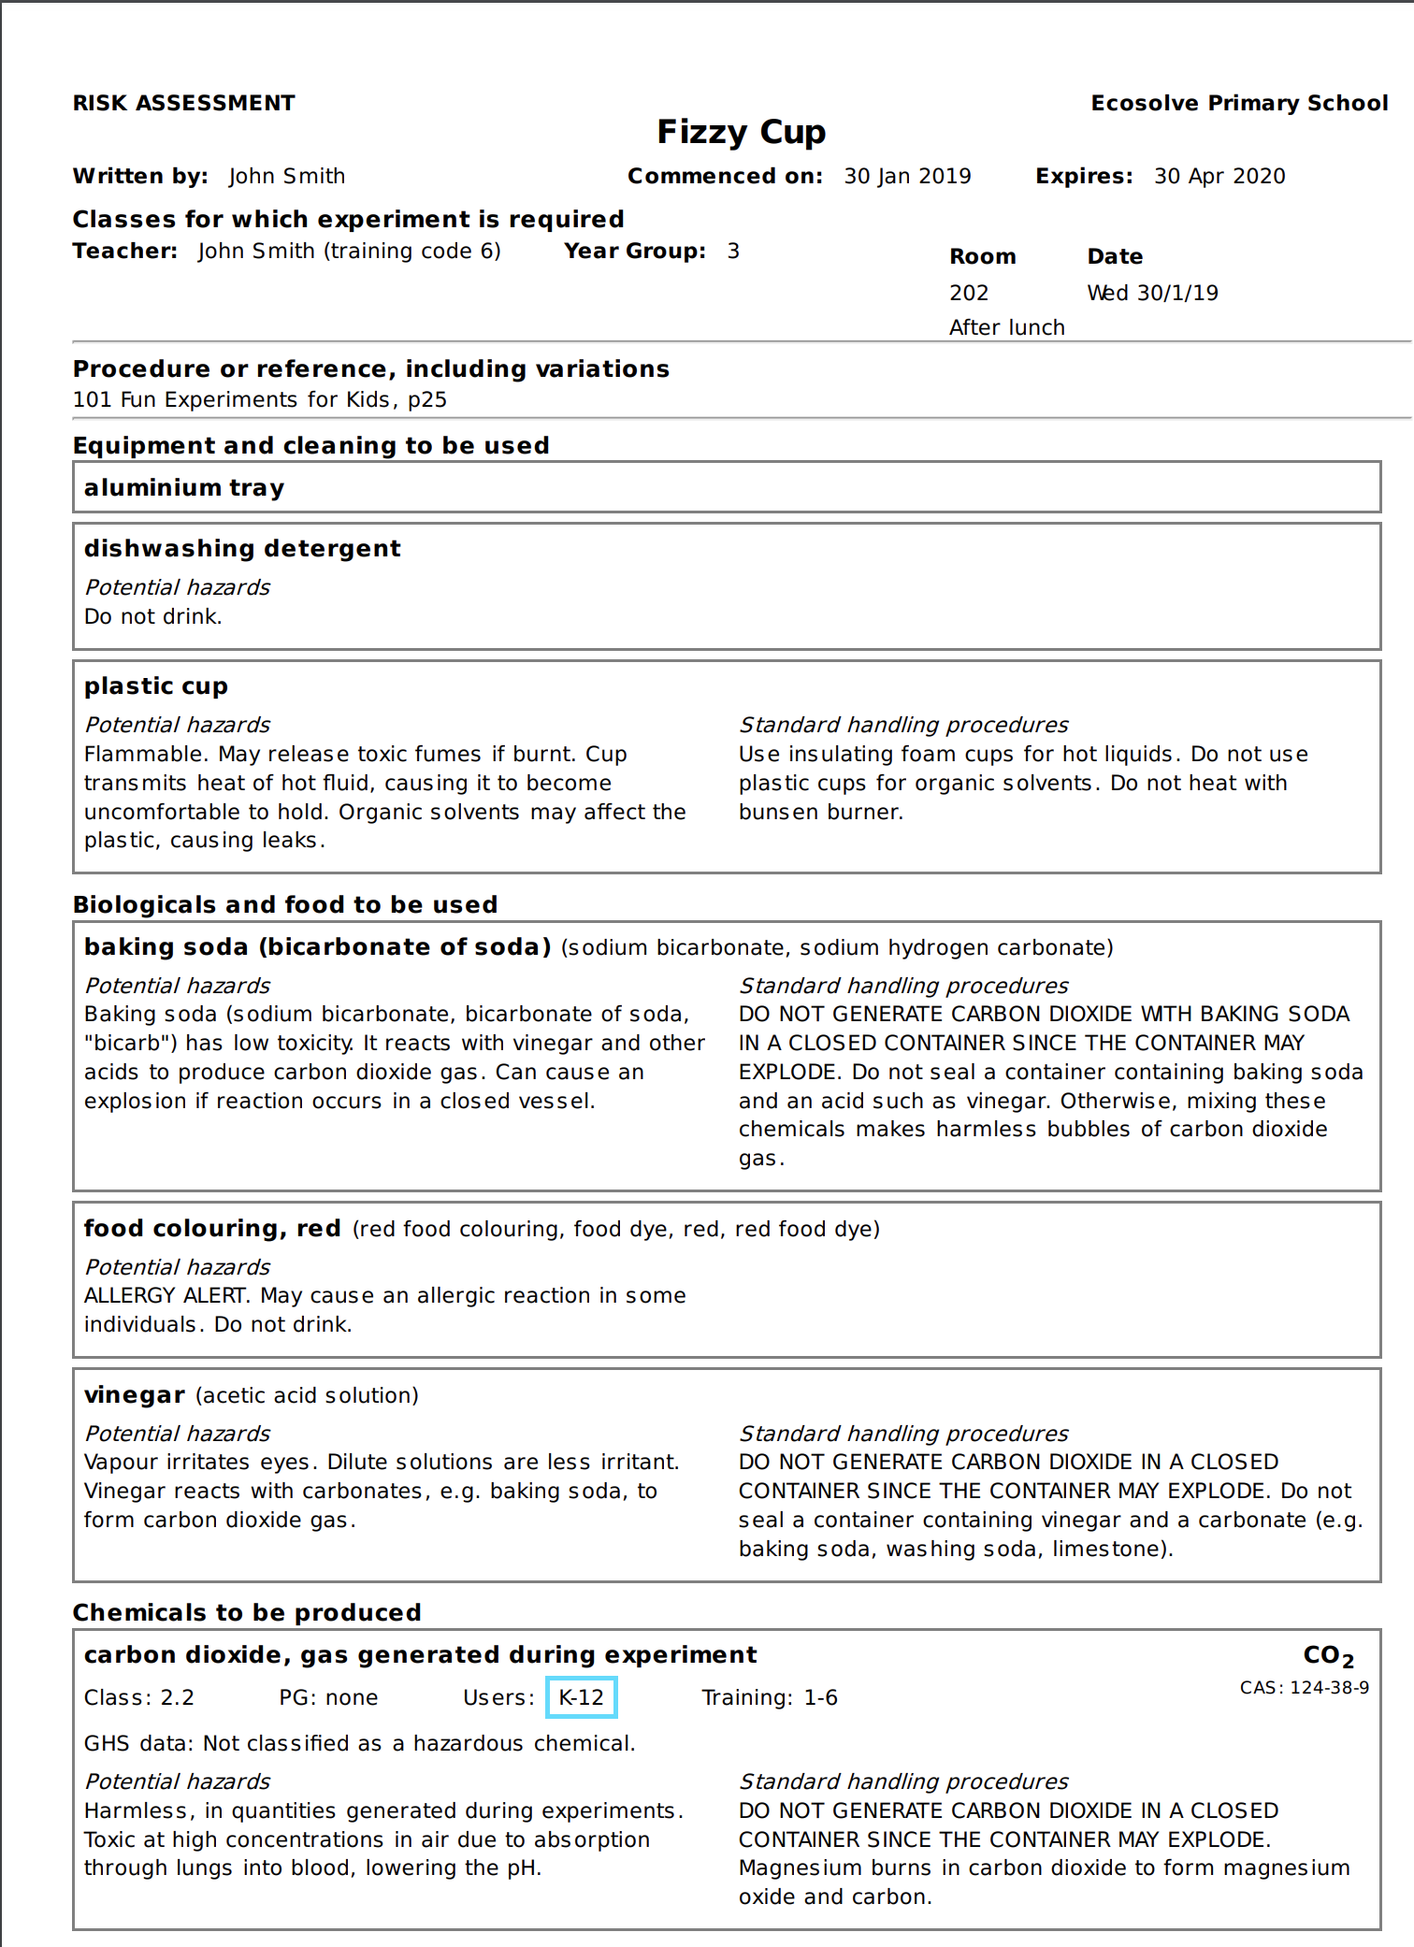

Slide 17
Primary RiskAssess
Safety information and risk assessment system
Web based, easy and fast to use
Designed for Primary use
Quickly find, share and re-use risk assessments
Minimal paperwork

Slide 18
More information about Primary RiskAssess
Website:
https://www.riskassess.com.au/info/primary_about
Brochure
www.riskassess.com.au/docs/PRABrochure.pdf
Video: Getting started with Primary RiskAssess
https://www.youtube.com/watch?v=O0WJp30fTDw
This presentation is available in (free) Learning Resources at:
https://www.riskassess.com.au/info/learning_resources

Slide 19
Volcano
https://www.thoughtco.com/baking-soda-volcano-science-fair-project-602202

