Slide 1
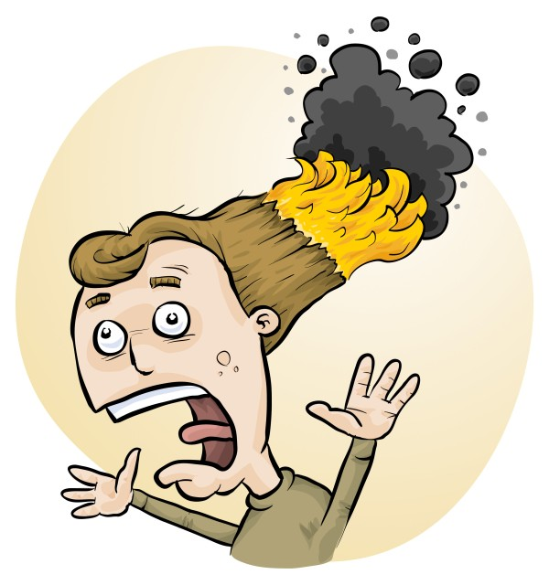
RiskAssess
New Features
Chemical Disposal,
Tips & Tricks
Phillip and Eva Crisp

Slide 2
New features

Slide 3
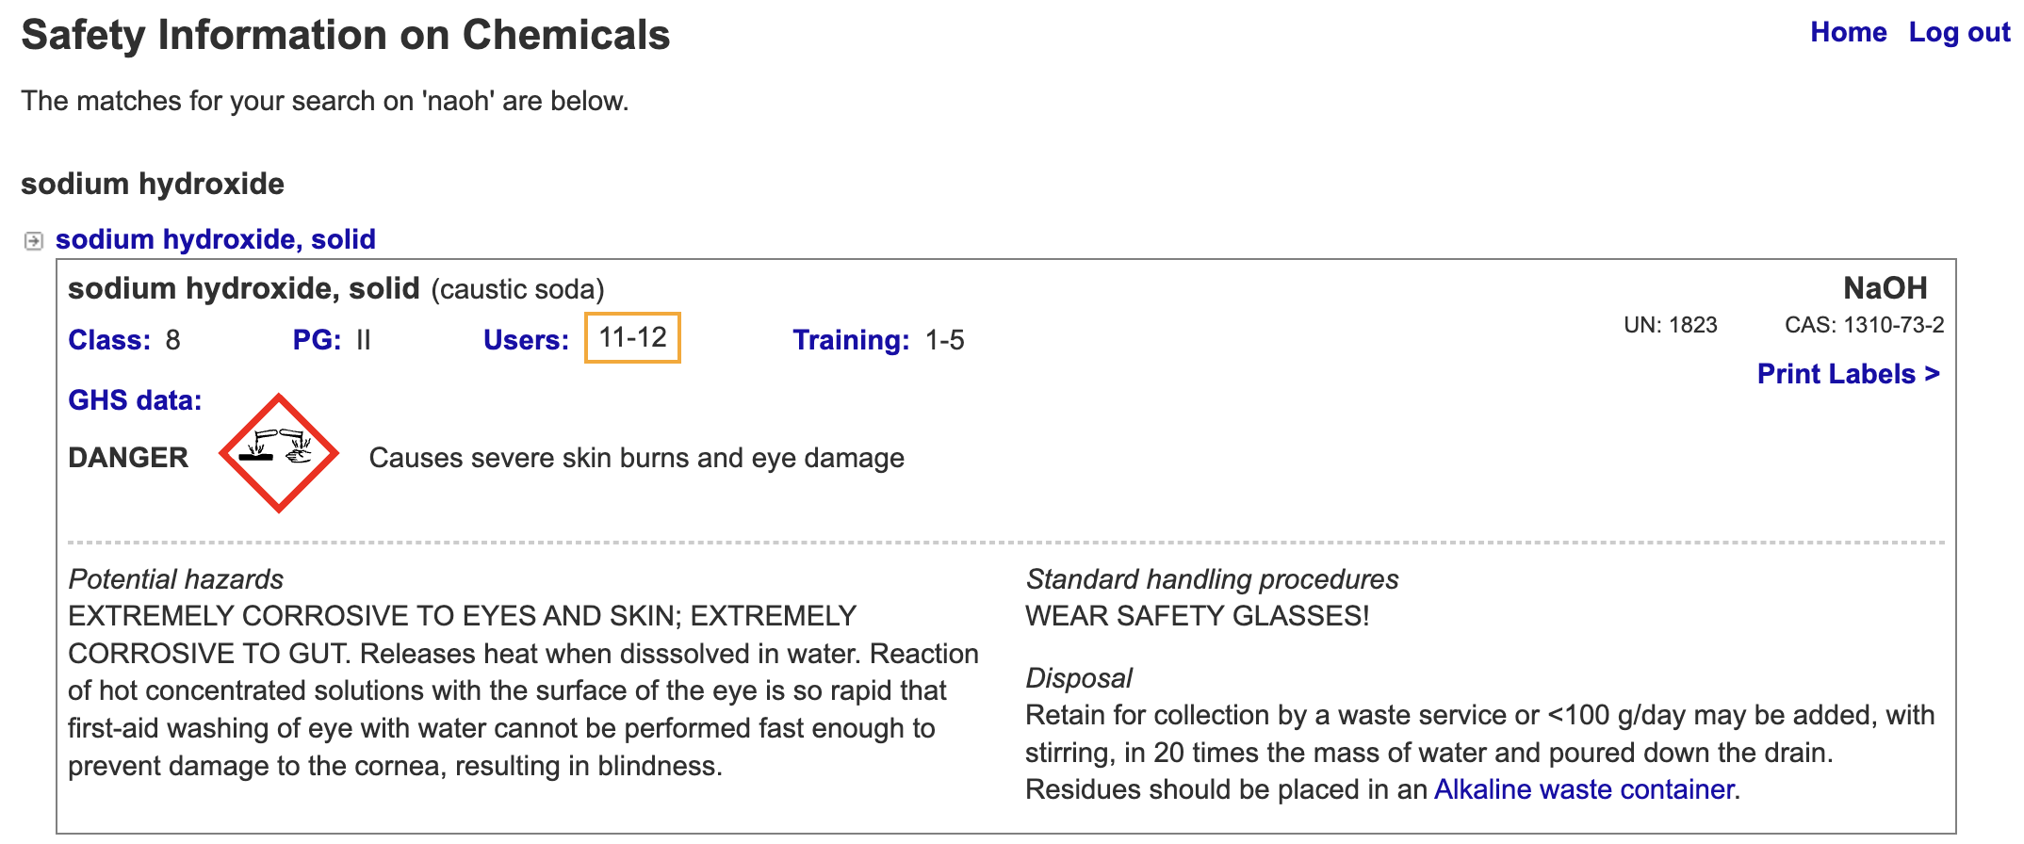
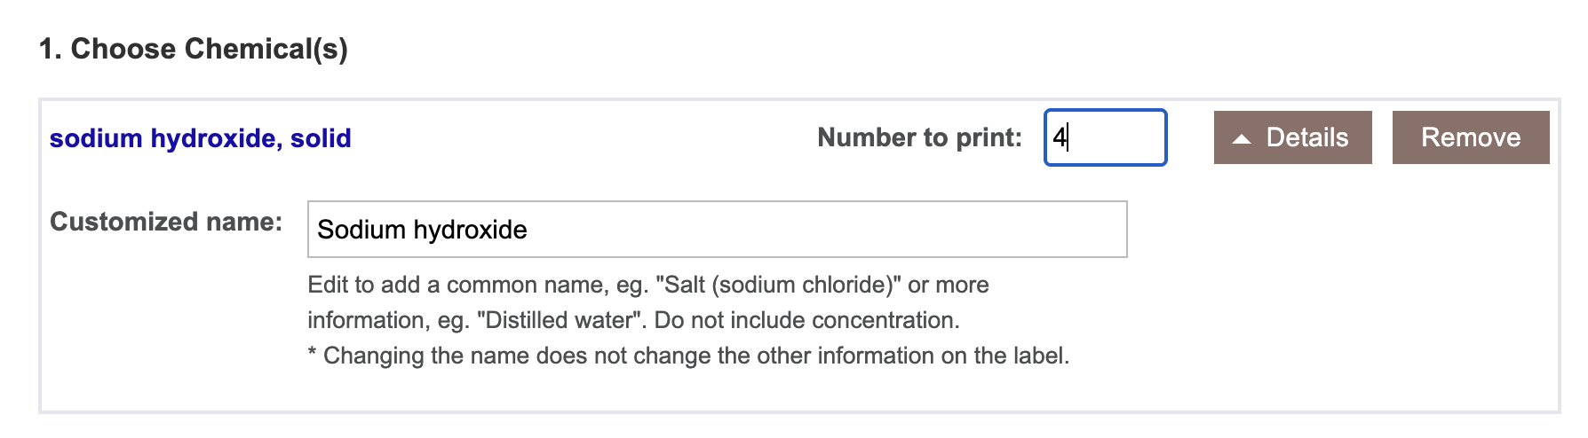
Databases
Added 171 chemicals and solutions
163 equipment items
74 biological/food items
Improved advice:
300+ items

Slide 4
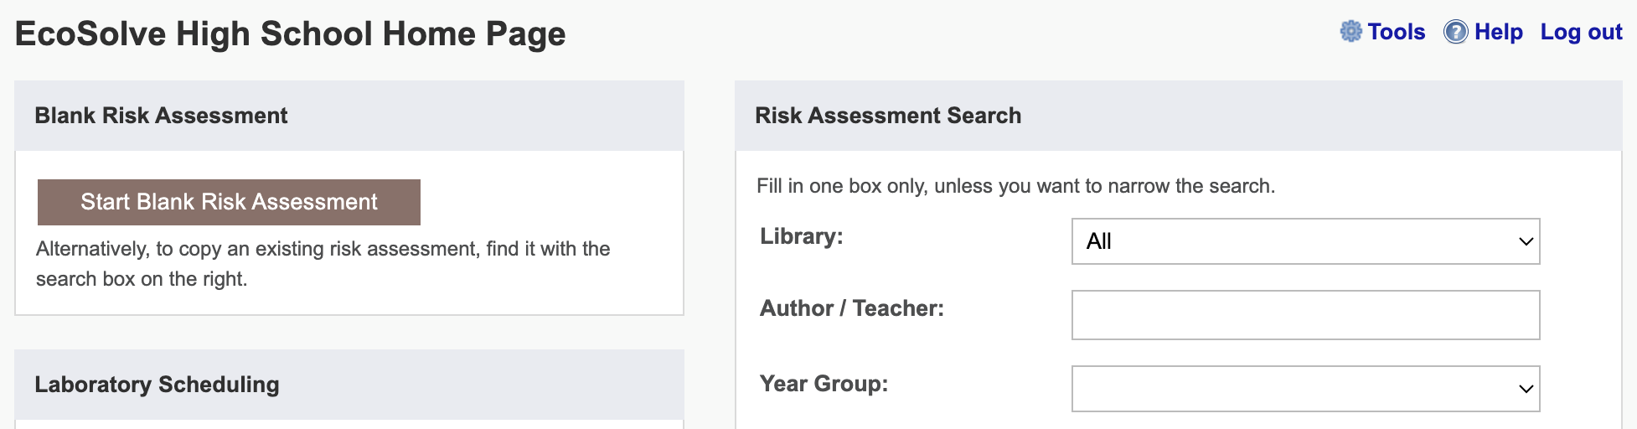
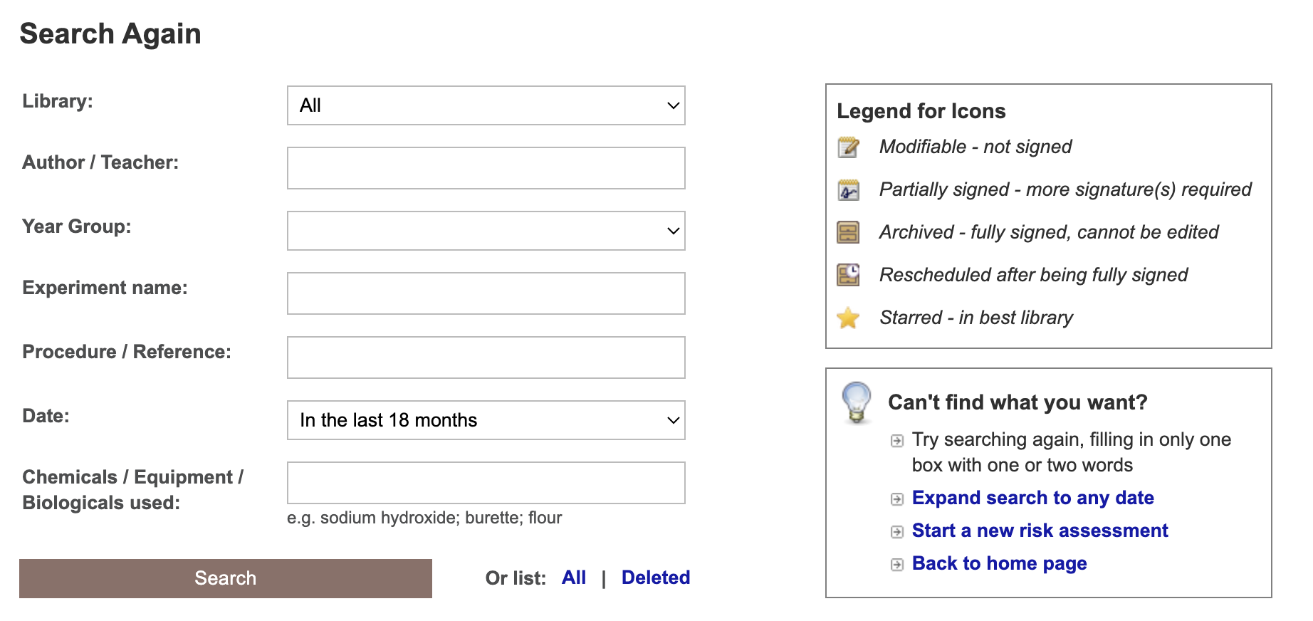
Notes:
Learning resources, videos & faq. And Phillip’s book!

Slide 5
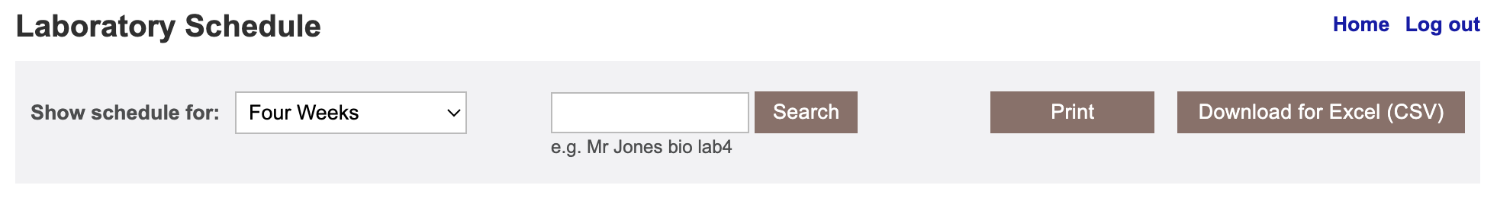
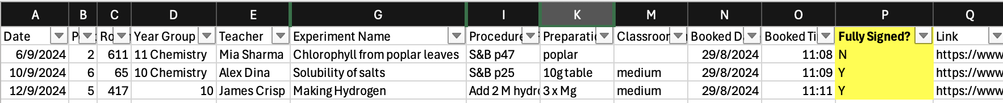
Notes:
Fully signed, but lots of other things like stats, high risk etc

Slide 6
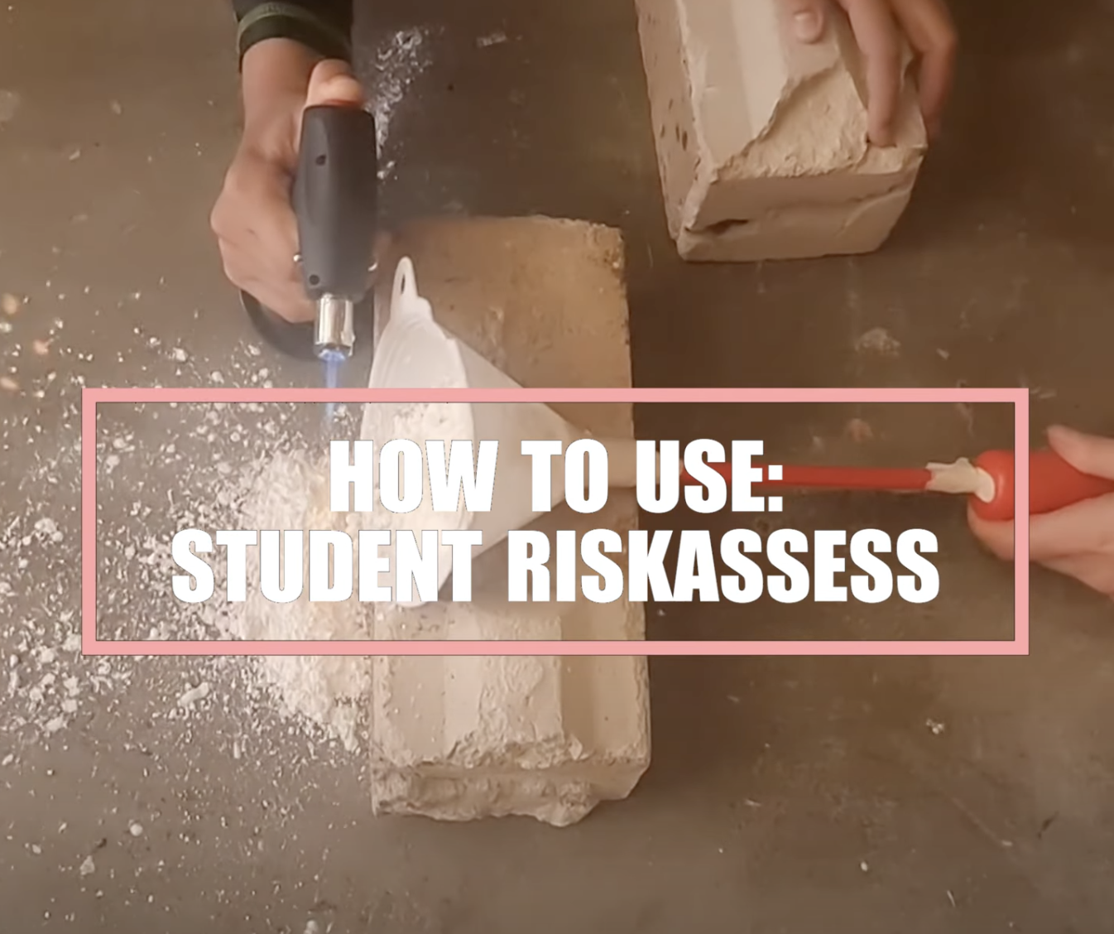

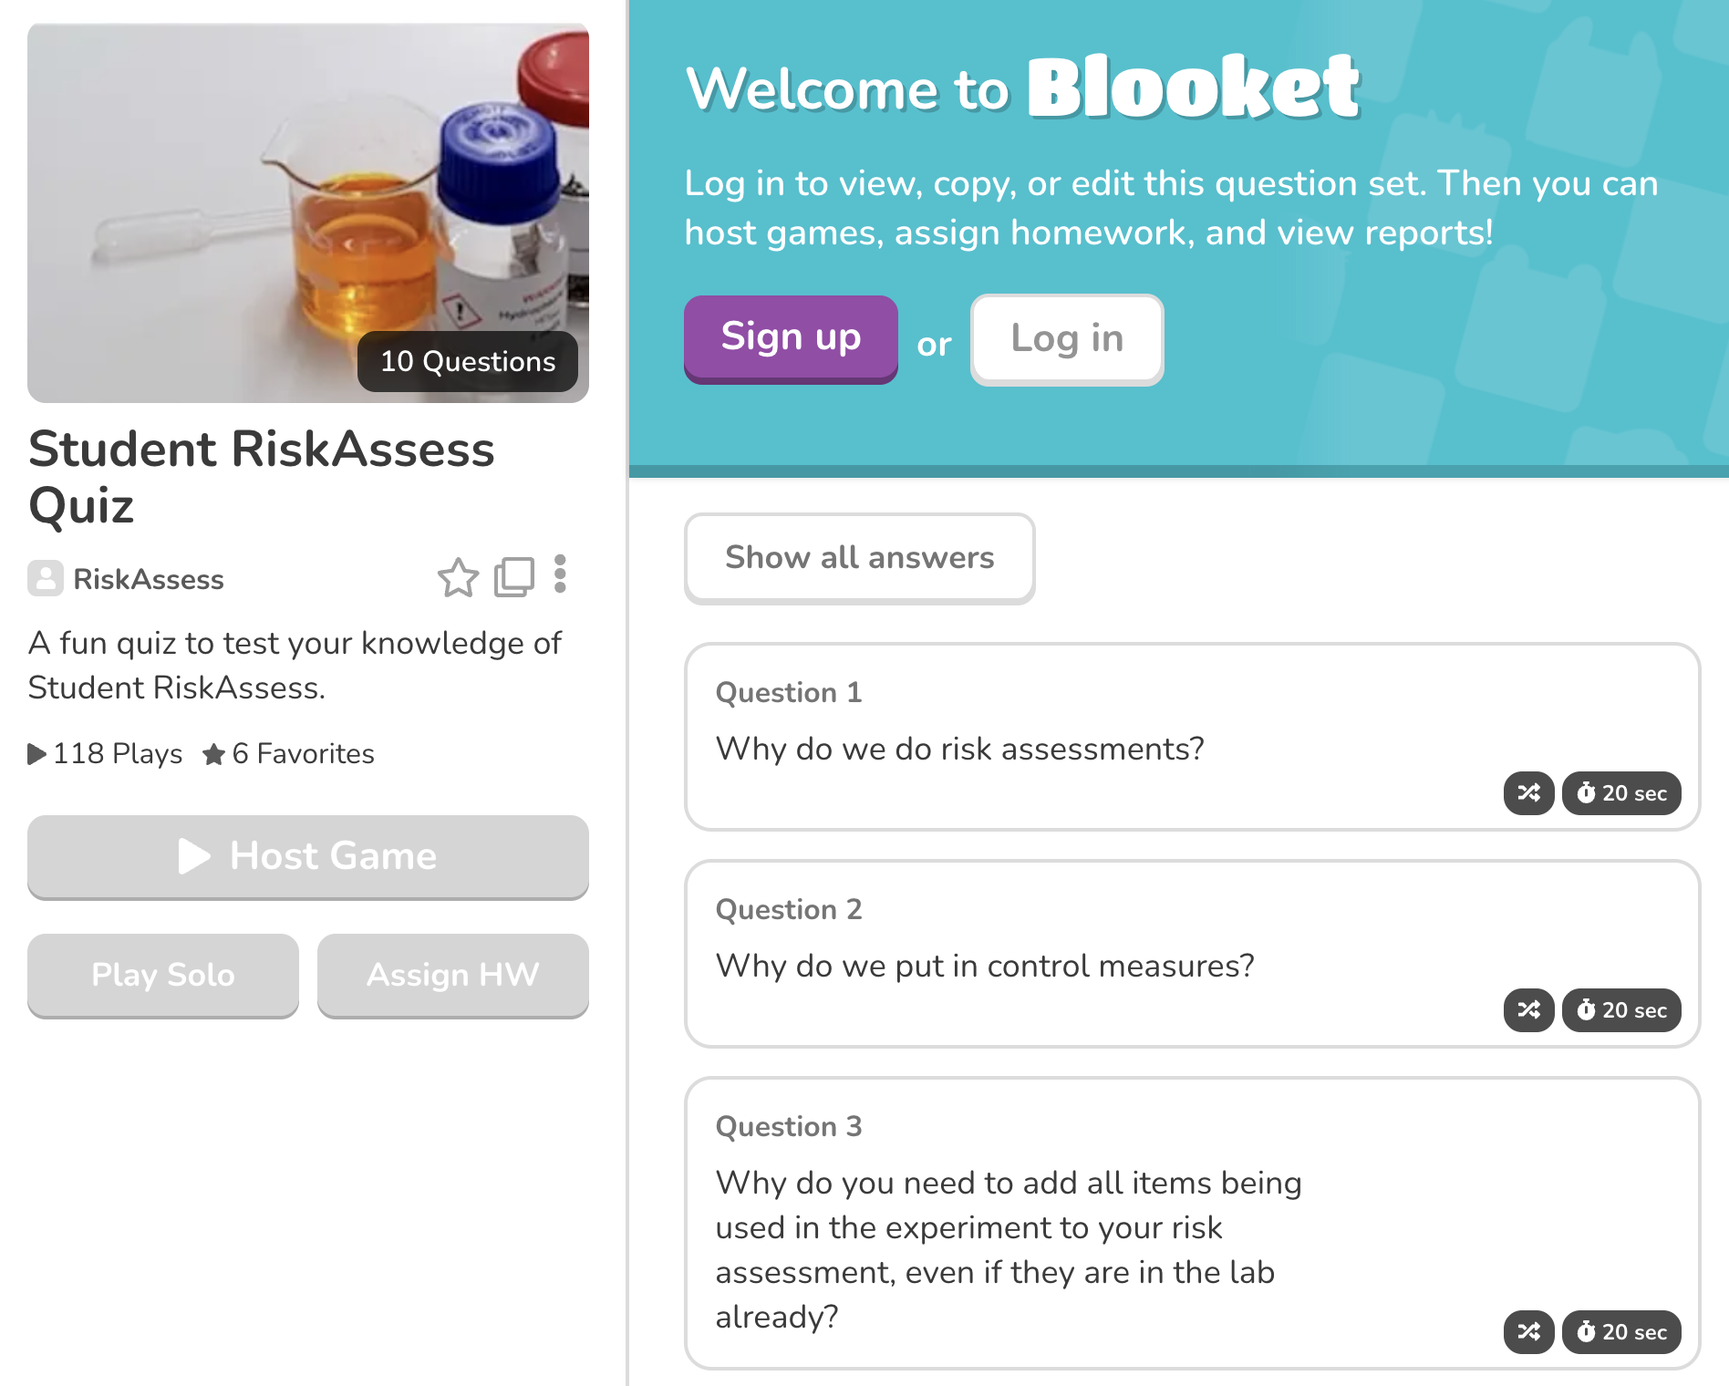
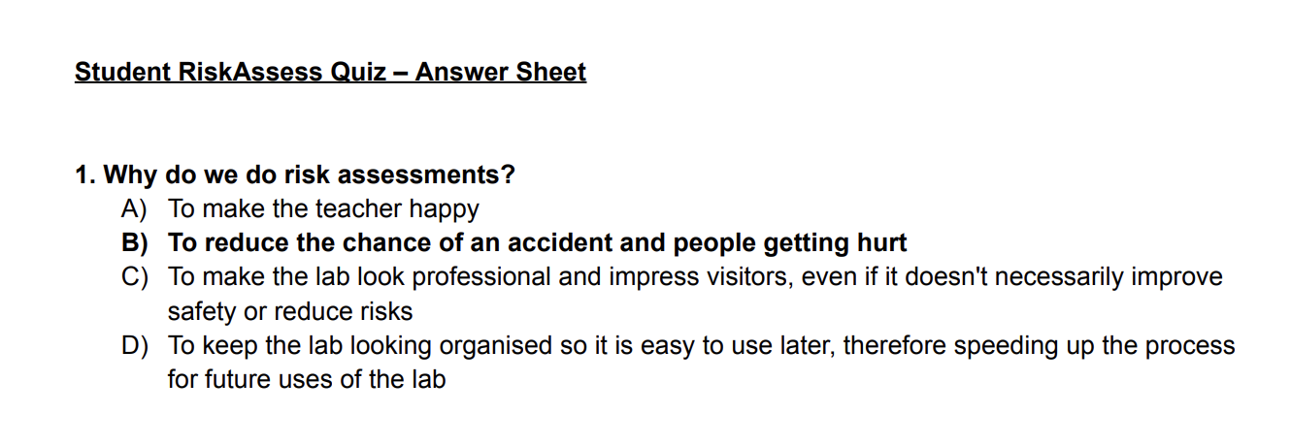
https://www.riskassess.com.au/info/student_resources
Notes:
New resources, classroom video, blooket & quiz for students

Slide 7
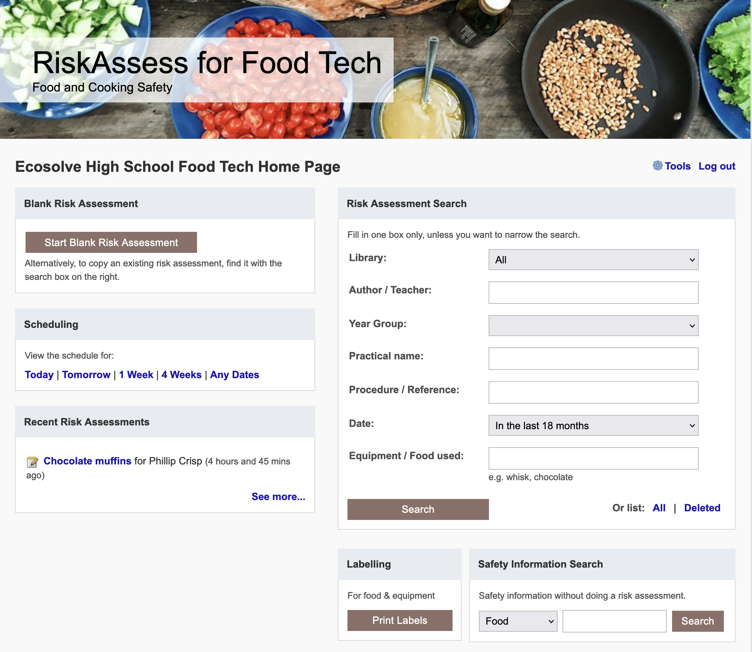

Slide 8
Chemical storage in science
Advice for:
• chemical store
• prep room
• student laboratories
Design, storage arrangements, segregation, ventilation, specific chemical advice, labelling, housekeeping, etc https://www.riskassess.com.au/docs/ChemicalStorageInScience.pdf
15 page document

Slide 9
Chemical inventory and chemical register with
SDS management
QR codes stocktaking on phone

Slide 10
Chemical disposal

Slide 11
The law
Follow local regulations for disposal of wastes to sewer and garbage, rather than the advice in RiskAssess.
Retain wastes for collection by a waste collection service, if not allowed to put down drain or in garbage
Inland waters usually have special requirements.

Slide 12
Disposal advice
Disposal advice in RiskAssess:
• provides a ‘default’, when no other advice is available
• prioritizes safety
• minimizes harm to the environment
• offers a responsible approach to student learning.

Slide 13
RiskAssess Advice
Individual chemical advice in ‘Disposal’
for each of 3000+ chemicals and solutions
‘Disposal of chemical wastes’
https://www.riskassess.com.au/docs/DisposalOfChemicalWastes.pdf
‘Chemical waste containers’
https://www.riskassess.com.au/info/waste_containers
‘Labels for Chemical waste containers’
https://www.riskassess.com.au/info/waste_container_labels
‘How to dispose of chemical wastes’
In: ‘Safety in Schools’ book, chapter C7

Slide 14
Chemical Disposal
The quantity of chemical wastes generated in a school is very small compared with industry, agriculture, mining, etc.
HOWEVER
• A school is an educational institution
• Attitudes adopted during youth continue into
adulthood
• Proper training should be given to those who
will later be decision makers

Slide 15
The improvement process
eliminate unwanted chemicals
redesign procedures to minimize waste production, e.g. spot reactions, recycling, destruction, less toxic chemicals
dispose of wastes LEGALLY
SAFELY by
- sewer
- garbage
- waste collection service

Slide 16
Chemical wastes in schools
*
Aqueous liquid wastes
• dissolved salts
• acidic or basic
• suspended particles
Water-miscible organic wastes
alcohols, e.g. methylated spirits
ketones, e.g. acetone
Water-immiscible organic wastes
• hydrocarbons, e.g. hexane, kerosene
• special chemicals, mostly for organic chemistry
Solid wastes
• precipitates, e.g. BaSO₄, Fe oxides

Slide 17
Problems in the sewer!
• toxic metals
e.g. Hg, Cd, Pb, As, . . . VERY BAD
Cu, Ni, Co, . . . BAD
since contaminate sludge $$$
• toxic persistent organic chemicals
e.g. pesticides
since contaminate sludge $$$
• highly acidic/alkaline liquids
since may damage pipes
• flammable liquids (water-immiscible)
since may cause an explosion!

Slide 18
Aqueous liquid wastes
Pour down the sewer ONLY if the criteria of the water authority are met.
Otherwise, an environmentally responsible approach:
• neutralize to ~pH 6.5-8.5 (natural waters)
• only “safe” amount of each chemical down the drain
in order to minimise environmental harm from treated sewage when it is released into river or ocean.
All wastes exceeding a “safe” amount of a chemical should be retained for a waste collection service.
WHAT IS SAFE?

Slide 19
Estimation of “safe” quantities*
Consider the cation and anion in a salt separately.
Toxicity of a salt is dominated by the most toxic ion:
e.g. lead chloride, potassium dichromate
Some ions should not go down the drain at all
e.g. Hg²⁺, Pb²⁺, Cd²⁺, . . .
while others are OK almost without (school) limit
e.g. Na⁺, Ca²⁺, Cl⁻, SO₄²⁻, . . .
and other ions in between
* RiskAssess “Disposal of chemical wastes”, in Learning Resources

Slide 20
Tabulation and calculation
“Safe” disposal quantity for an ion for a class:
0 – 1000 g/day
Copper sulfate
copper: 1 g/day [Very toxic to aquatic life
with long lasting effects]
sulfate: 1000 g/day. [In solid laundry detergent]
Therefore, copper sulfate: 1 g/day (as solid or solution)
Enough for some spot tests down the drain.
Beyond that, wastes need to be collected!

Slide 21
Organic liquid wastes
Water-miscible
e.g. methylated spirits, acetone
Dilute 1 part to 20 parts water, then down the drain.
Prevents explosive air/vapour mixture.
Microorganisms in sewer will consume the chemicals.
Water-immiscible
e.g. hexane, kerosene
Retain for collection by waste service.
Separate hydrocarbon waste from halogenated waste.

Slide 22
Waste processing
Collection
Large bottles (e.g. 2.5 L ‘Winchesters’)
correctly labelled, funnel at top (fume cupboard)
Treatment
Only if time and skilled people available
Disposal
To maximum recommended daily quantity:
• down the drain or into garbage
Otherwise, retain for waste collection
SEPARATE CONTAINER FOR EACH WASTE!

Slide 23
Solid wastes
Only “material of a domestic nature”
is allowed to be disposed of in the garbage
Consider
transport of garbage
leaching from landfill
Geologically-stable minerals
(precipitated during reactions)
e.g. barium sulfate (baryte)
No leaching of toxic chemicals in a domestic landfill.

Slide 24
Purpose of disposal advice
• assists decision making
• promotes safe disposal techniques
• focuses on avoiding serious environmental harm
• reduces the cost of waste collection service
• decreases emphasis on less harmful substances
• provides a learning tool for staff and students
• promotes care for the environment

Slide 25
Tips & Tricks

Slide 26
Shortcuts
icons, hcl, part name, click banner,
links, hot links, delete,
Best RAs
Scheduling
Excel/csv, any dates, last week,
search, no# pracs, prep notes,
double booking, lodged date
Tools
customise year groups,
stocktaking & usage, invoice,
backup system, defaults
Resources
learning resources, faq, eBook,
videos, libraries: Stile+EP+Edrolo+
Jacaranda
Labels
standard, custom & waste labels,
multiple chemicals on sheet,
mixtures, non-chemicals,
free text, biohazard symbol
Operations
author’s update vs modifiable copy,
reschedule, archive risk
assessments, annual review,
tech-only RAs, review notes,
high/extreme: 3 signatures, list,
disposal info
Student RiskAssess
view student PINs, not last year
multiple prac management
Chemical inventory/register
QR codes, stocktaking on phone

